Slide 1

Building for extensibility
A look at drupal 8’s plugin api
Notes:
Press the big red button!
Thank Kevin for making recordings
Opening joke about time zone

Slide 2

Building for extensibility
    A look at Drupal 8’s Plugin API
      Presenter:
      Marc Isaacson
      Drupal Architect and SME
      July 24, 2019
Notes:
Marc Isaacson, Drupal Architect and SME, Accenture Federal Services
Programming since 1989 and doing web development since 2010
Working with Drupal since 2010
I instantly understood Drupal and have learned so much from the community
My Drupal nick is vegantriathlete, and yes I am both vegan and a triathlete. I’ve completed all the way through IronMan distance.
“Today I’m going to talk to you about the basic building blocks for writing a pluggable module”

Slide 3
I don’t always build for extensibility but when I do I use plugins.
      – marc isaacson

Slide 4
Here’s what’s about to go down
  Options to allow for extensibility besides plugins
  Defining a plugin manager
  Using annotations
  Defining your plugin namespace
  Using your plugin manager and instantiating plugins
  Using config entities (to create profiles)

Slide 5
Hooks,
Alters
And
Events.
Oh my!

Slide 6
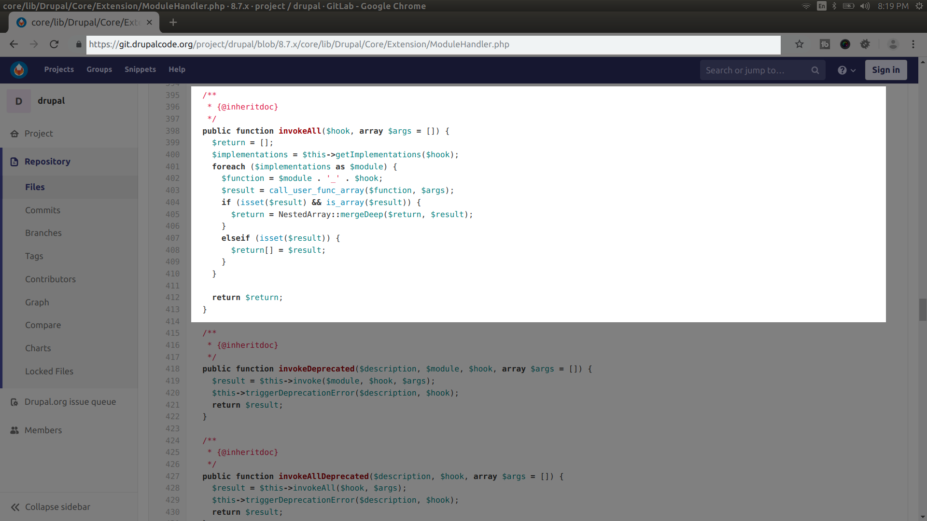

Slide 7
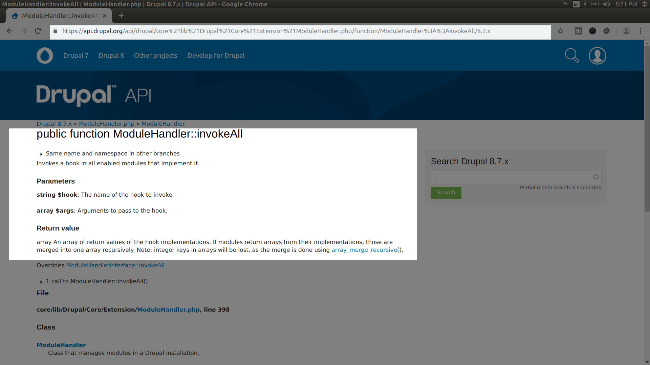

Slide 8
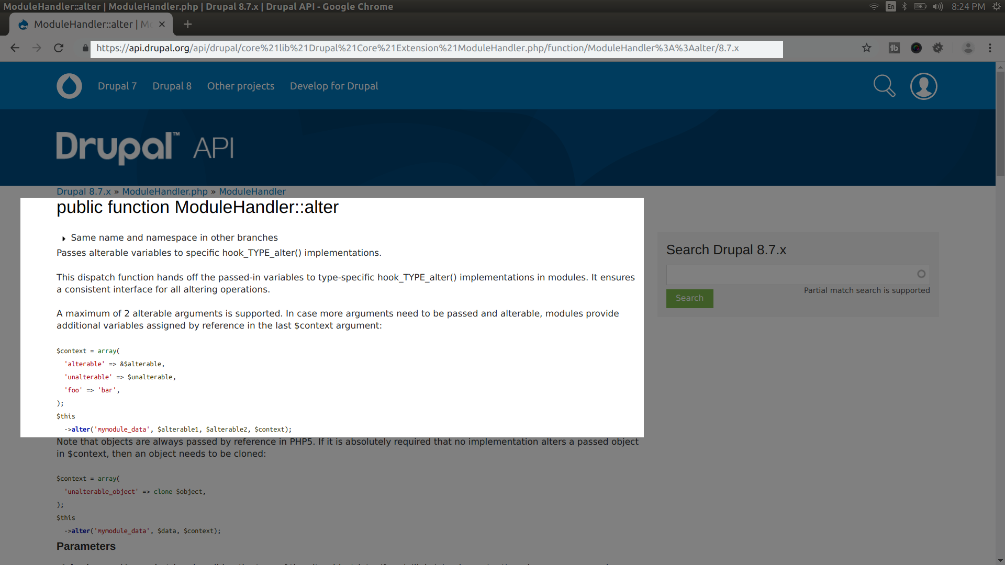

Slide 9
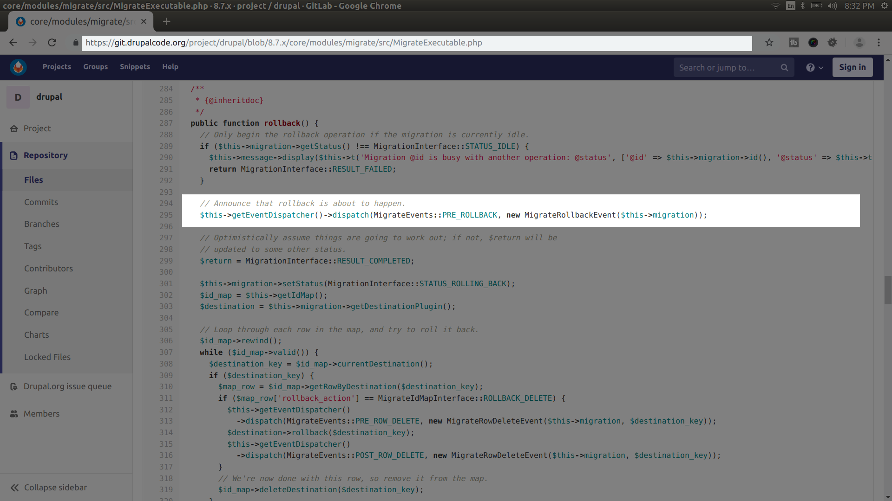

Slide 10
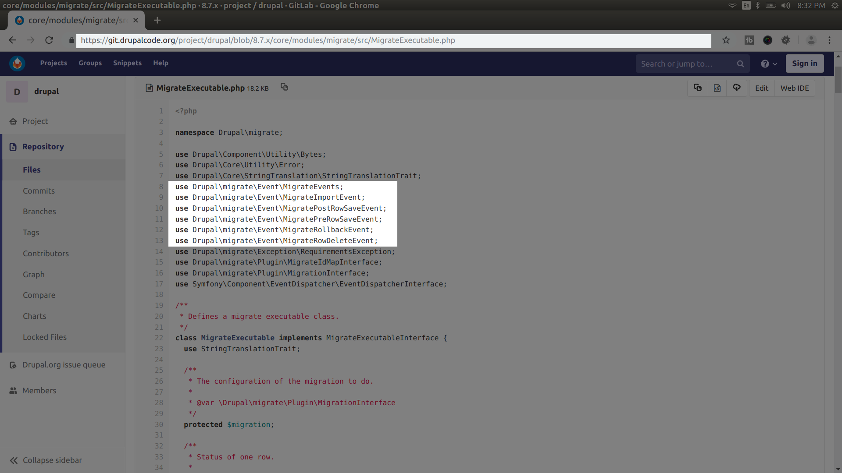

Slide 11
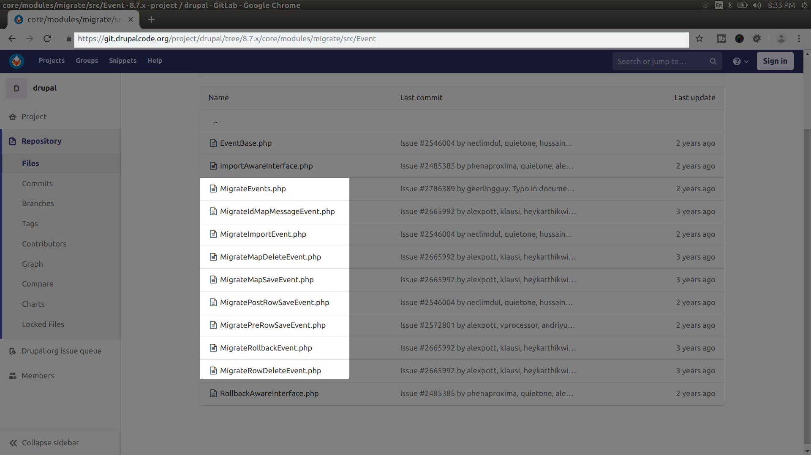

Slide 12
Let’s start talking about plugins already!

Slide 13
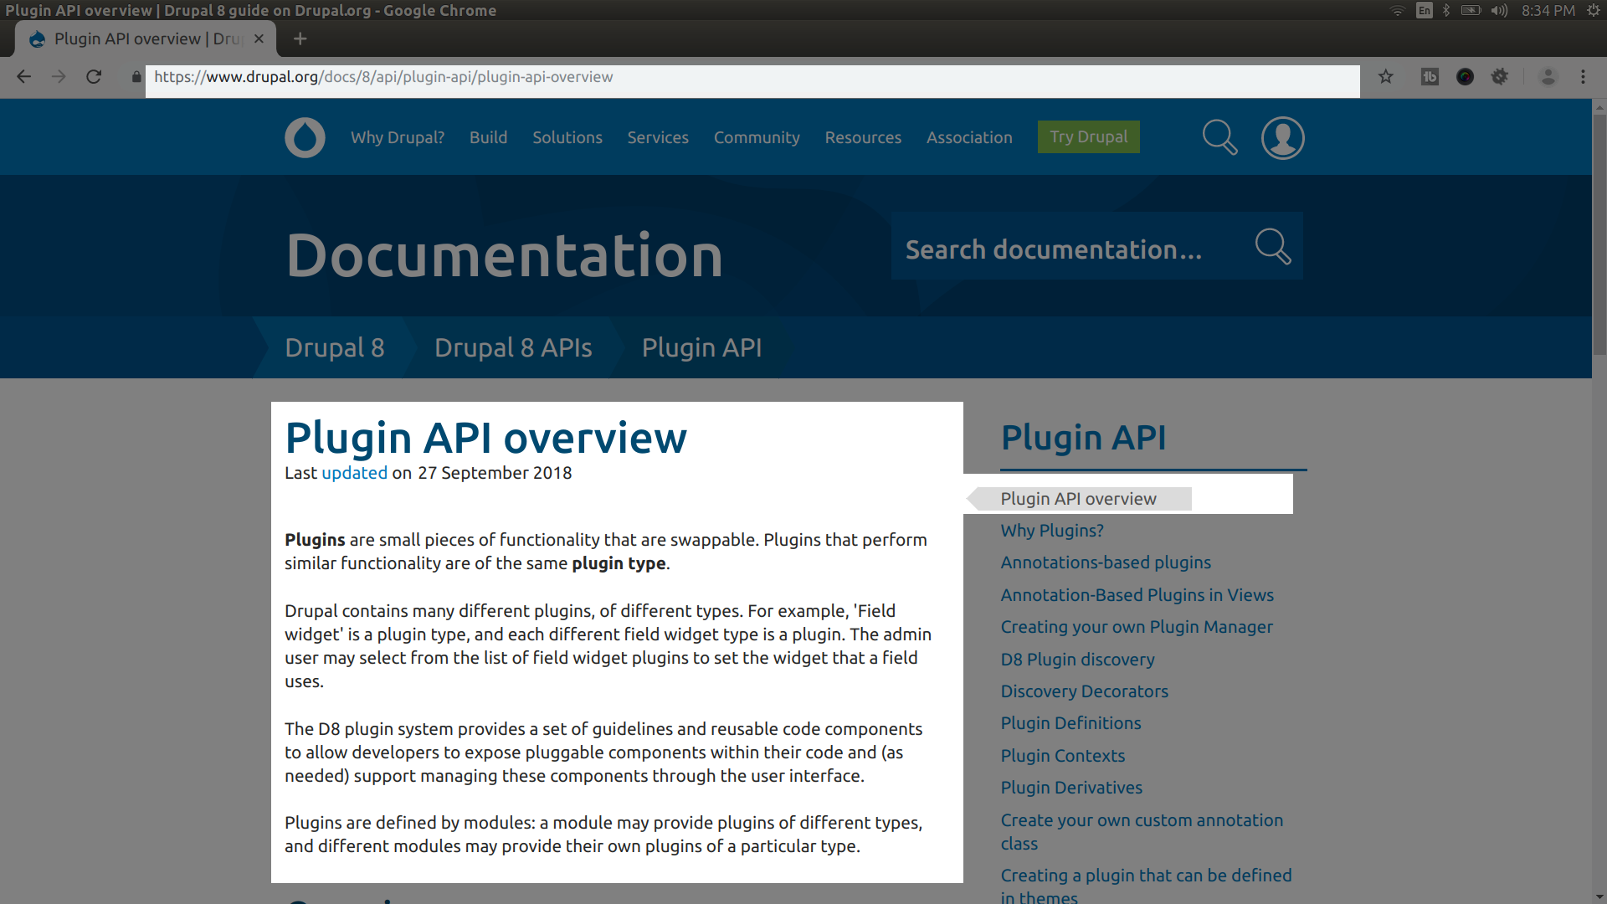

Slide 14
Defining the service for your plugin manager

Slide 15
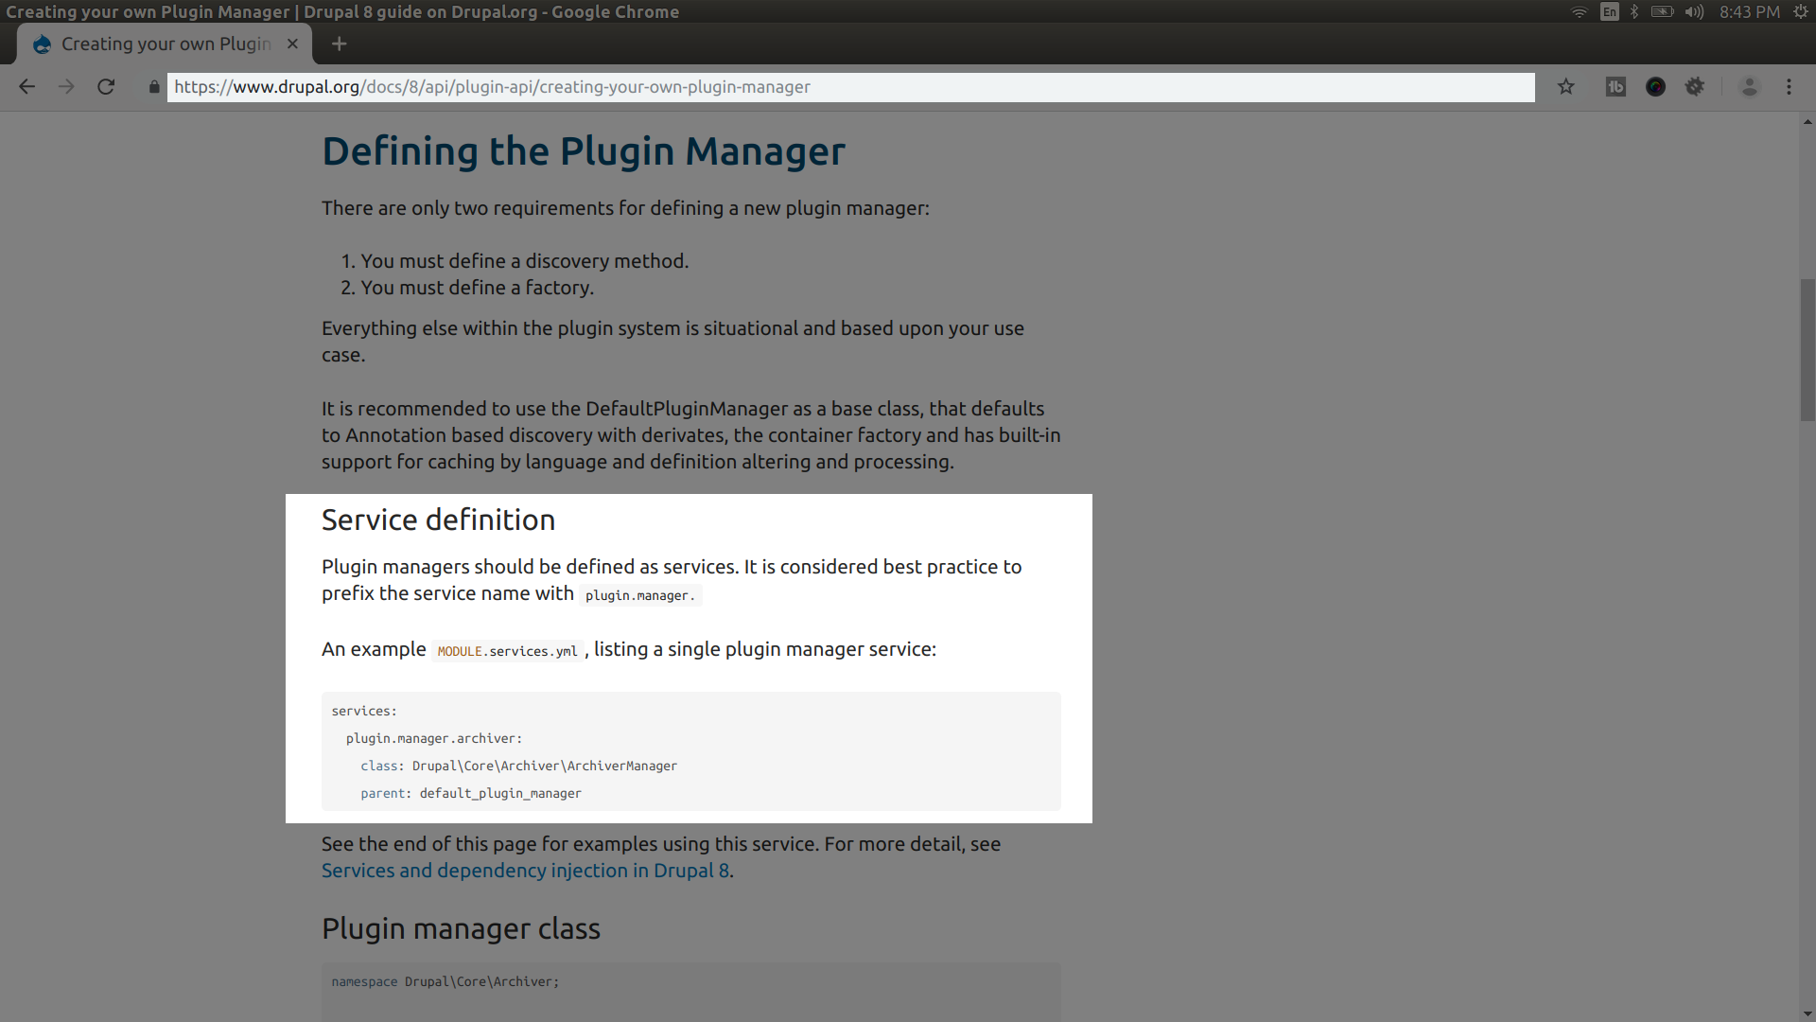

Slide 16
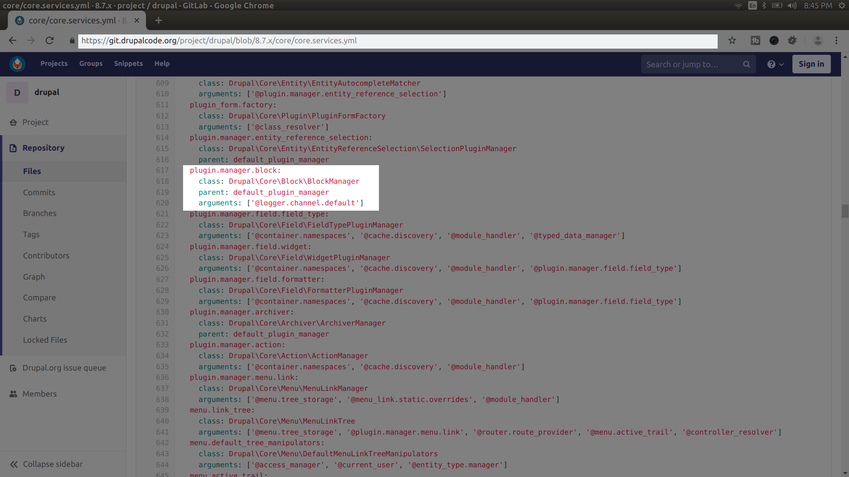

Slide 17
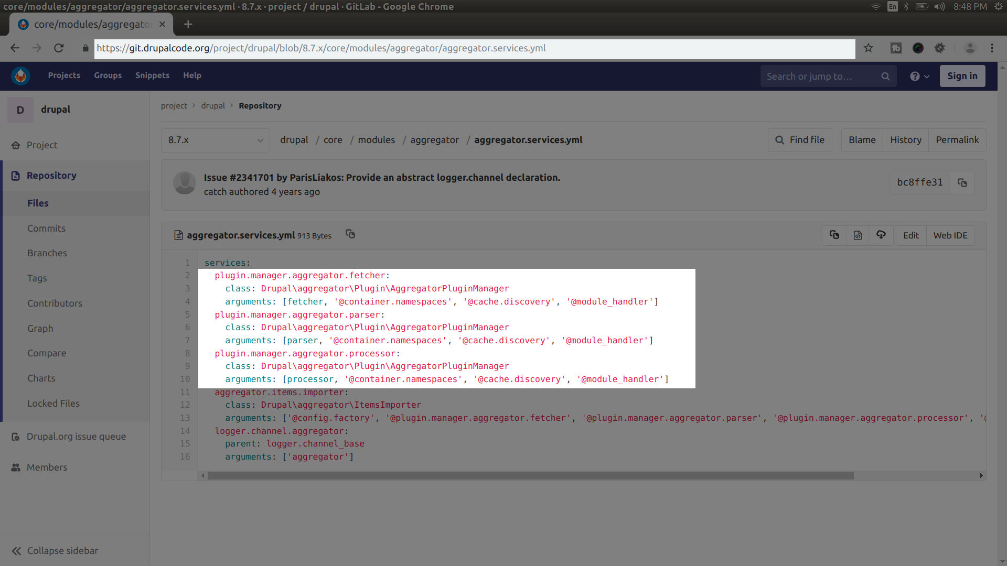

Slide 18
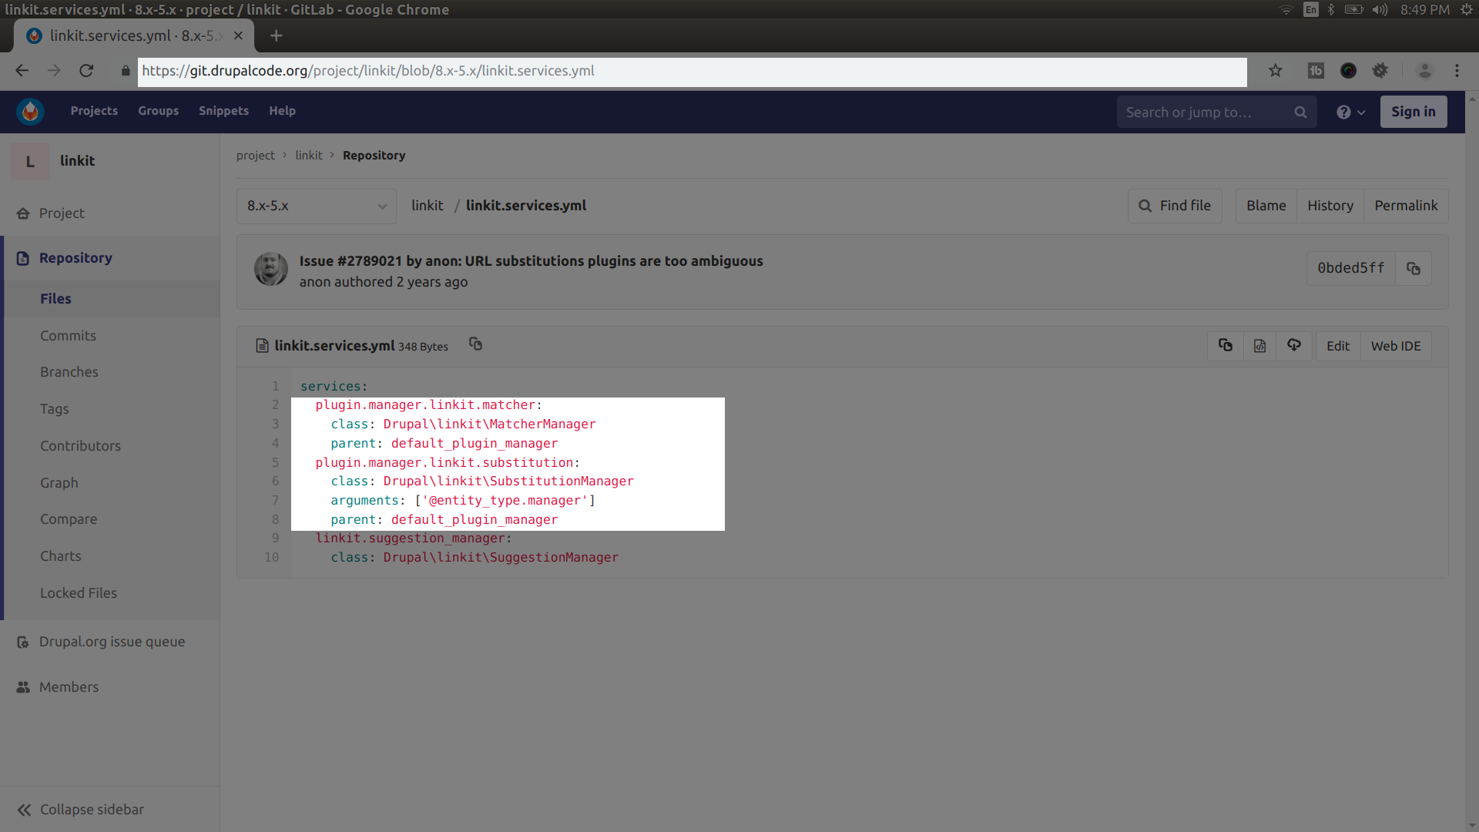

Slide 19
Defining your plugin manager class

Slide 20
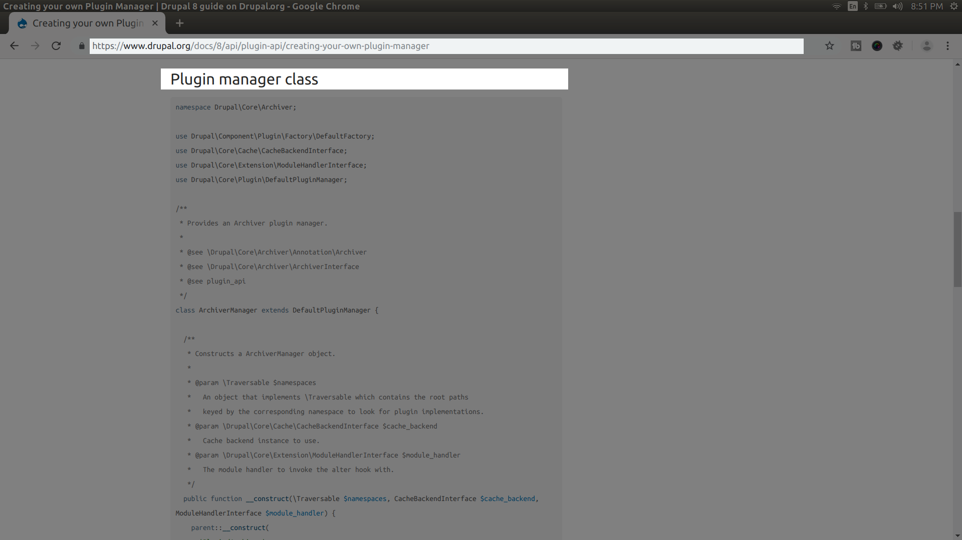

Slide 21
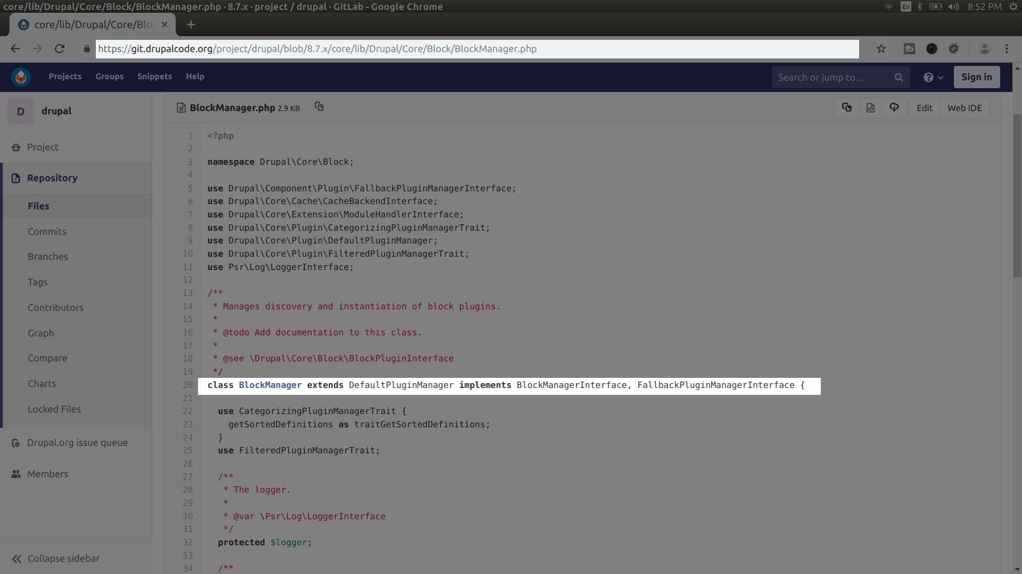

Slide 22
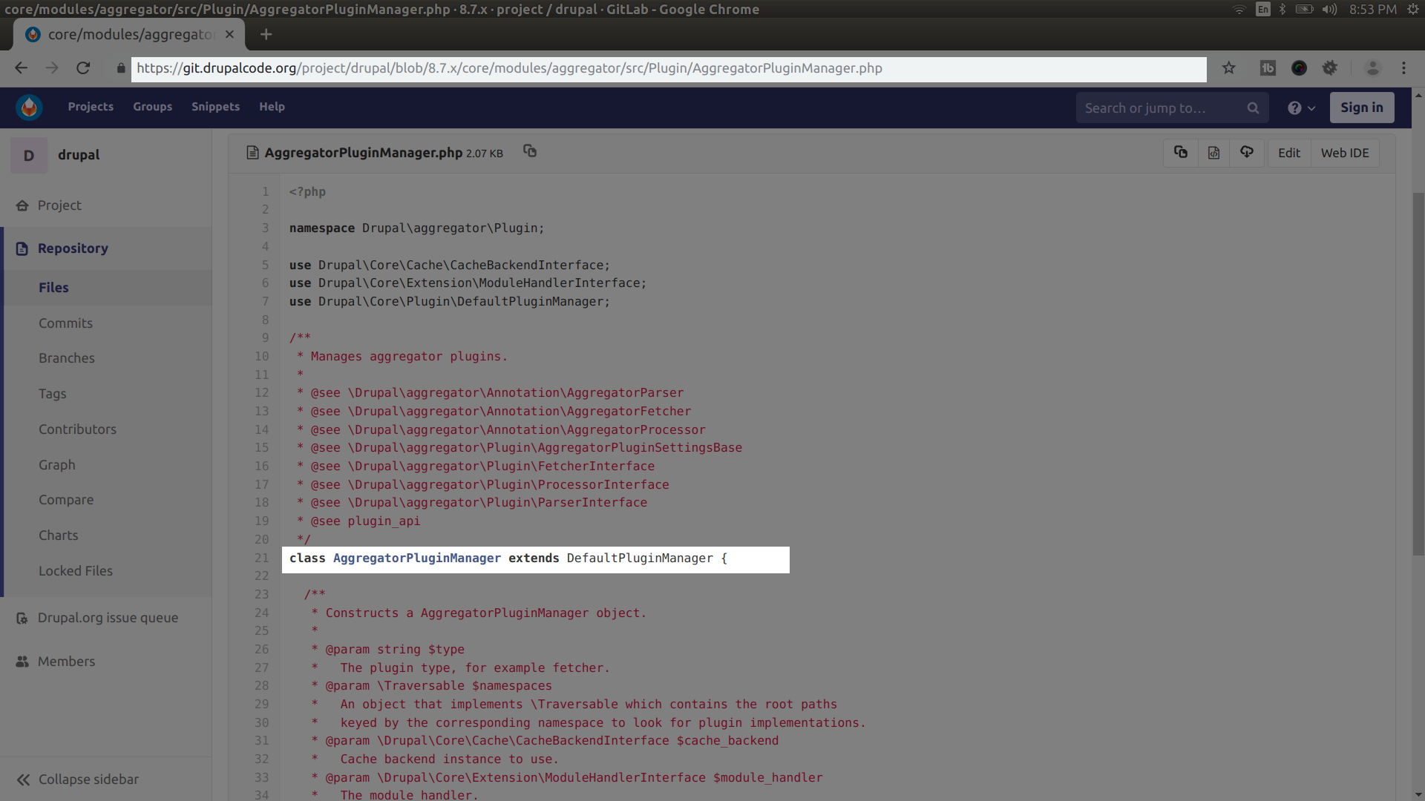

Slide 23
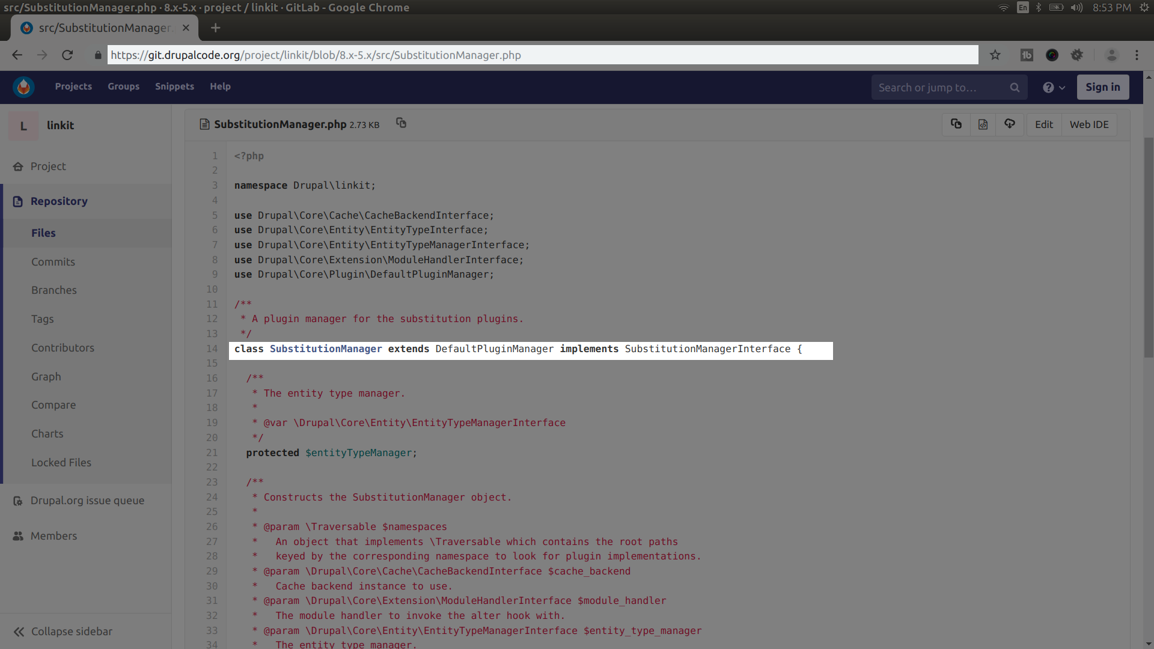

Slide 24
Defining annota-tions for plugin types

Slide 25
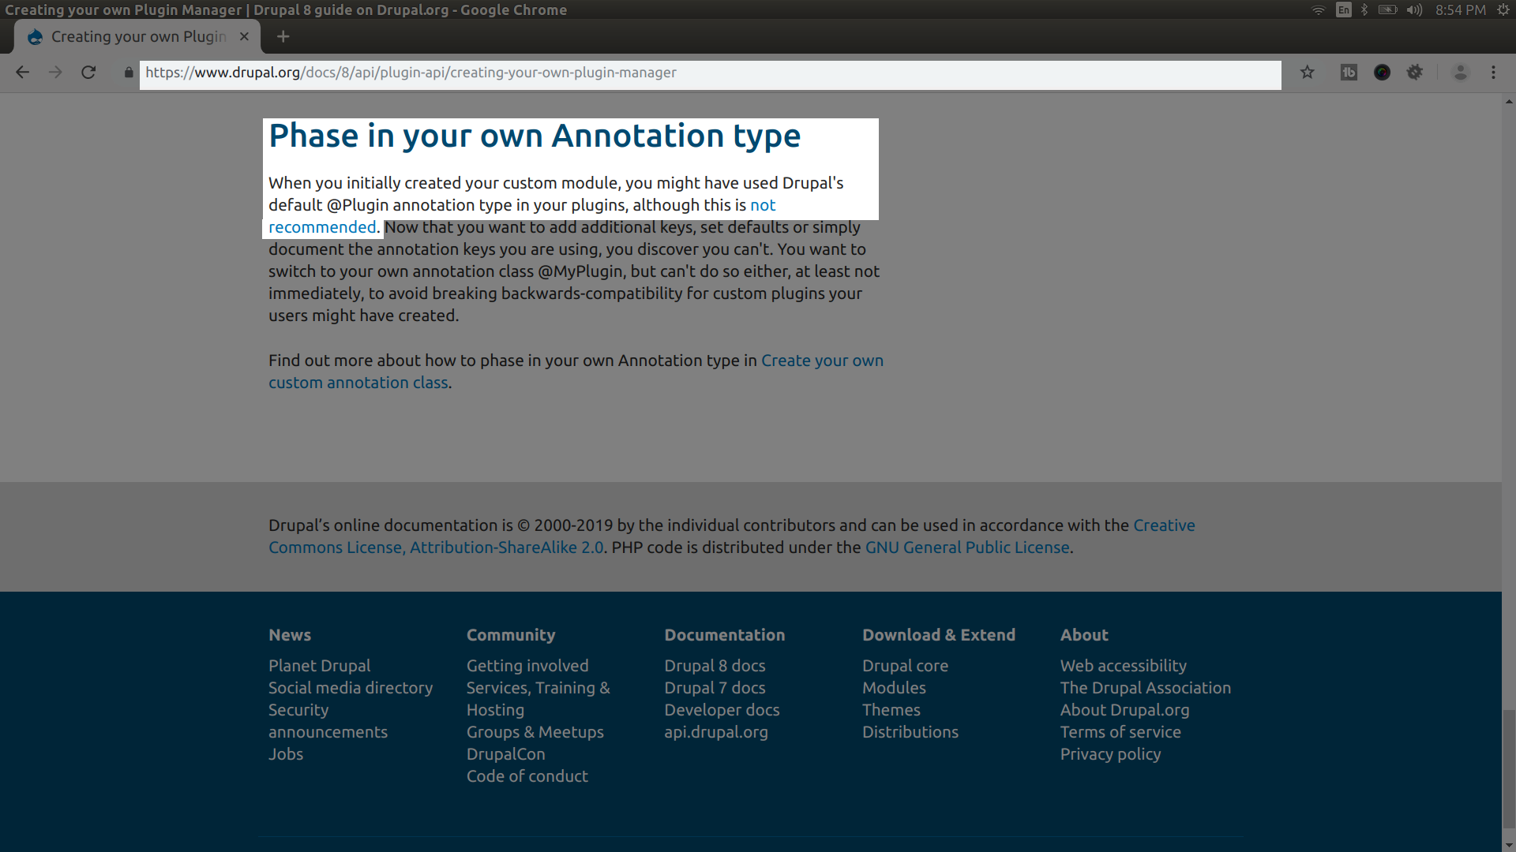

Slide 26
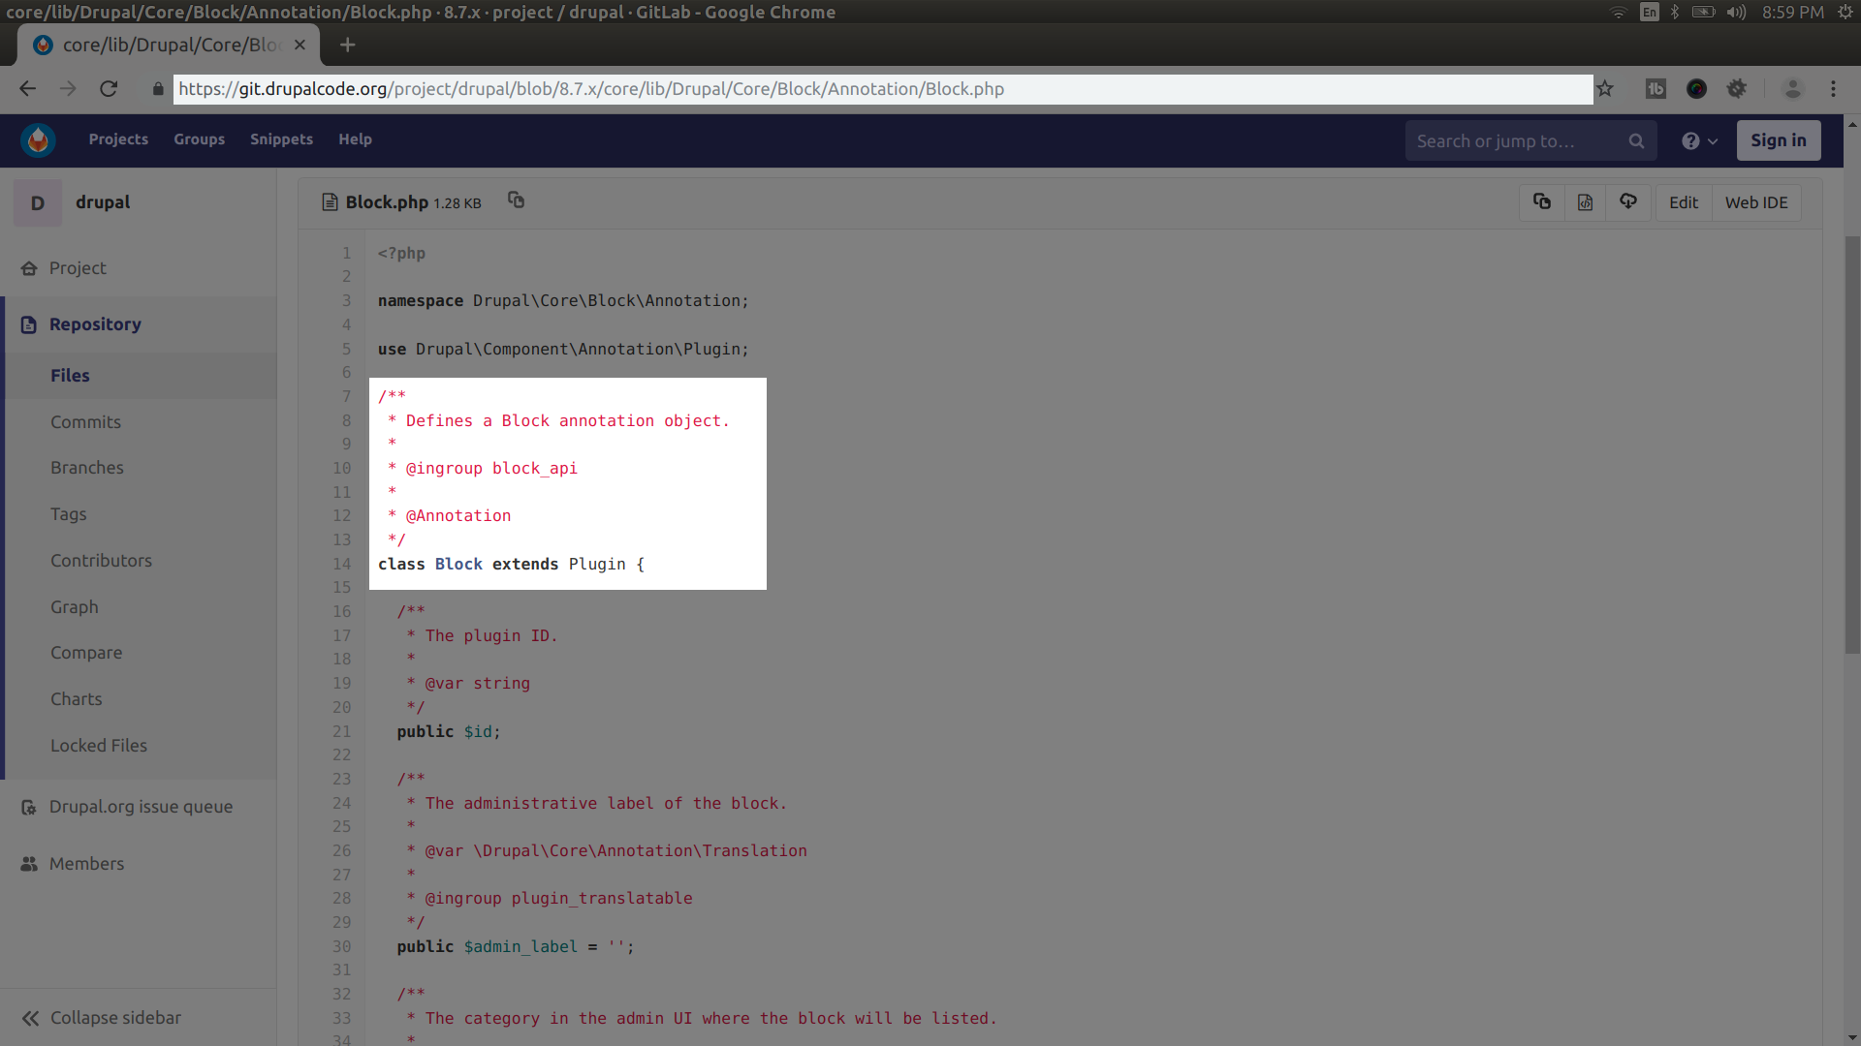

Slide 27
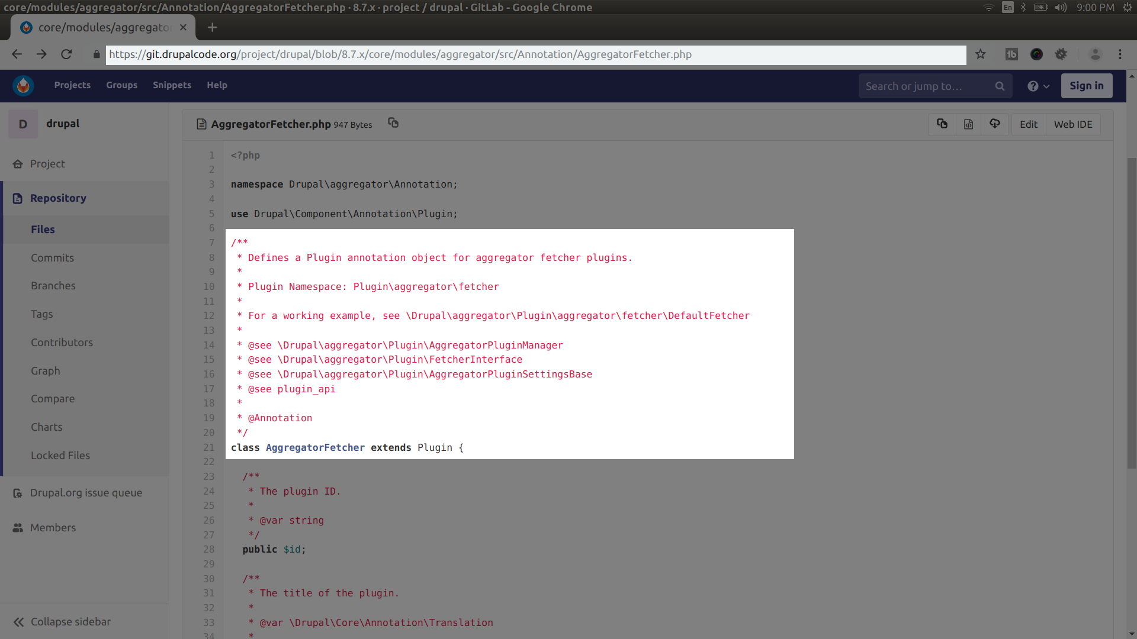

Slide 28
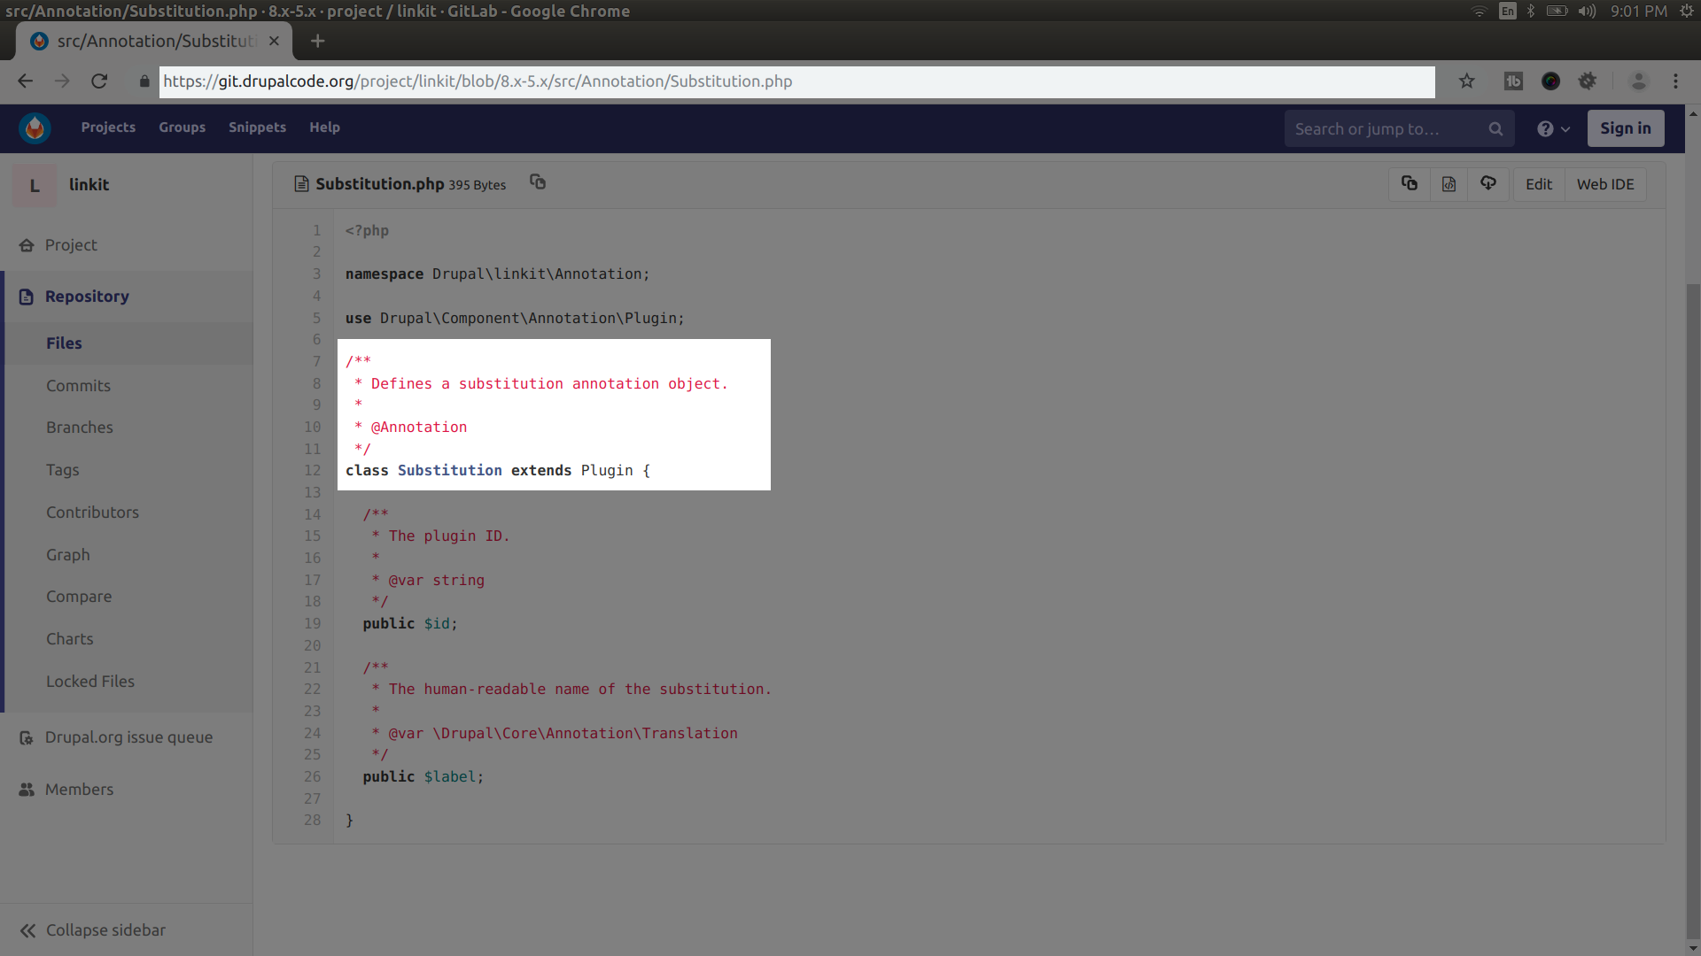

Slide 29
Defining your plugin name
space

Slide 30
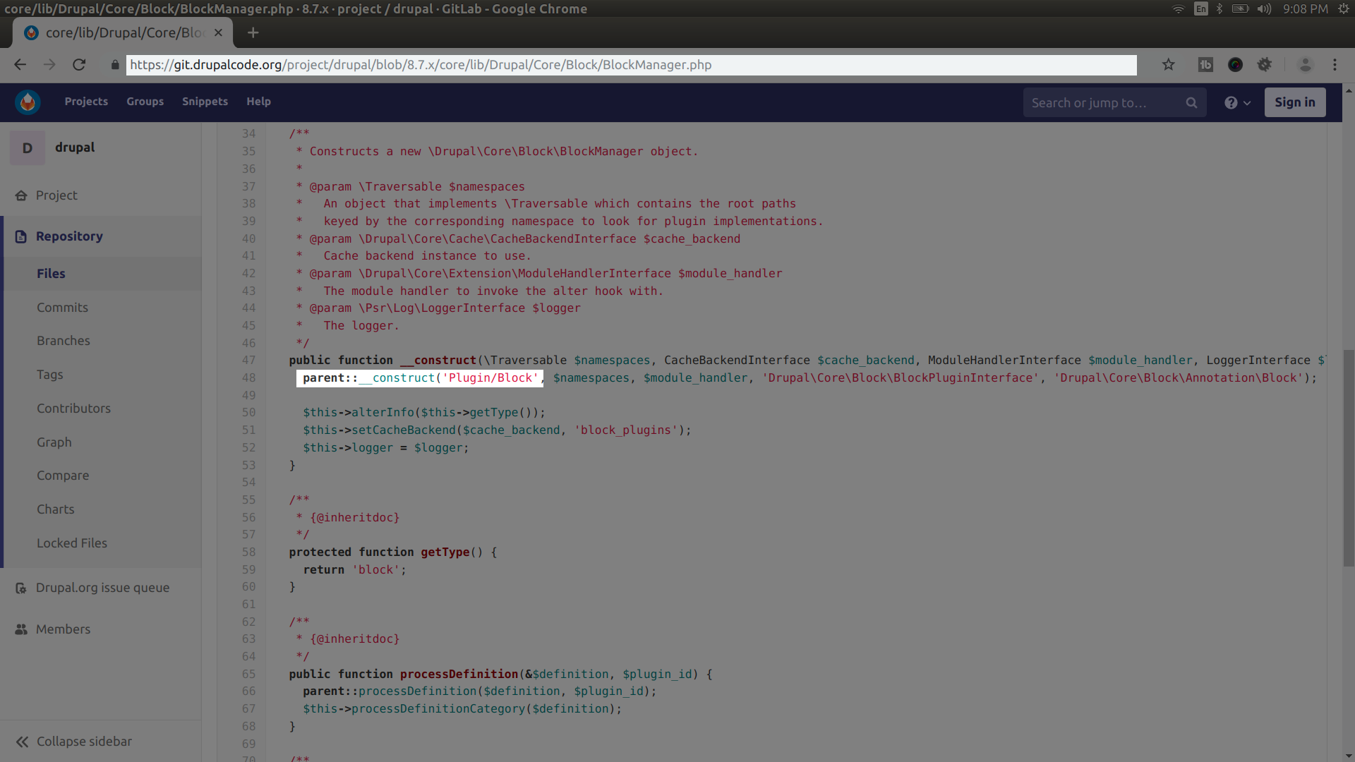

Slide 31
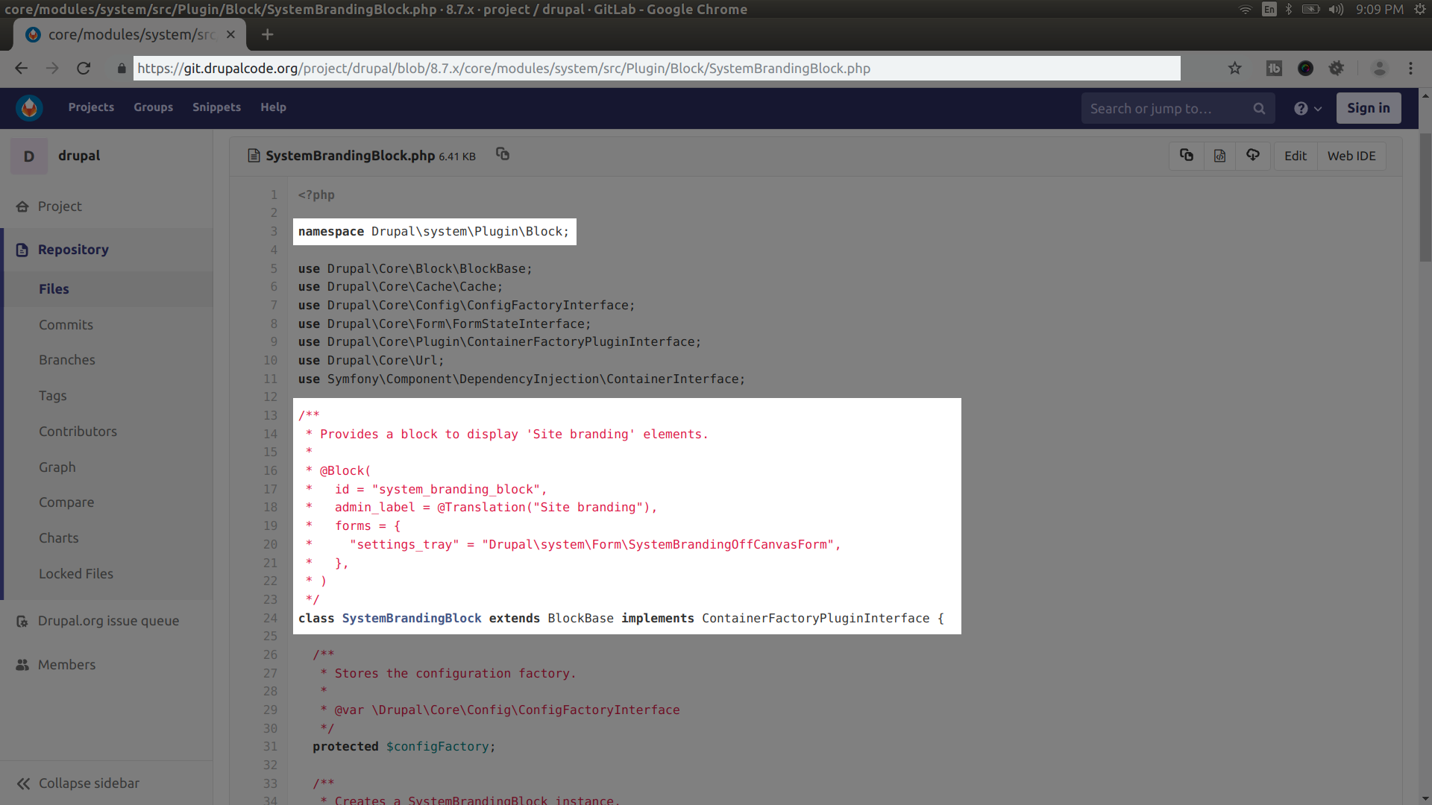

Slide 32
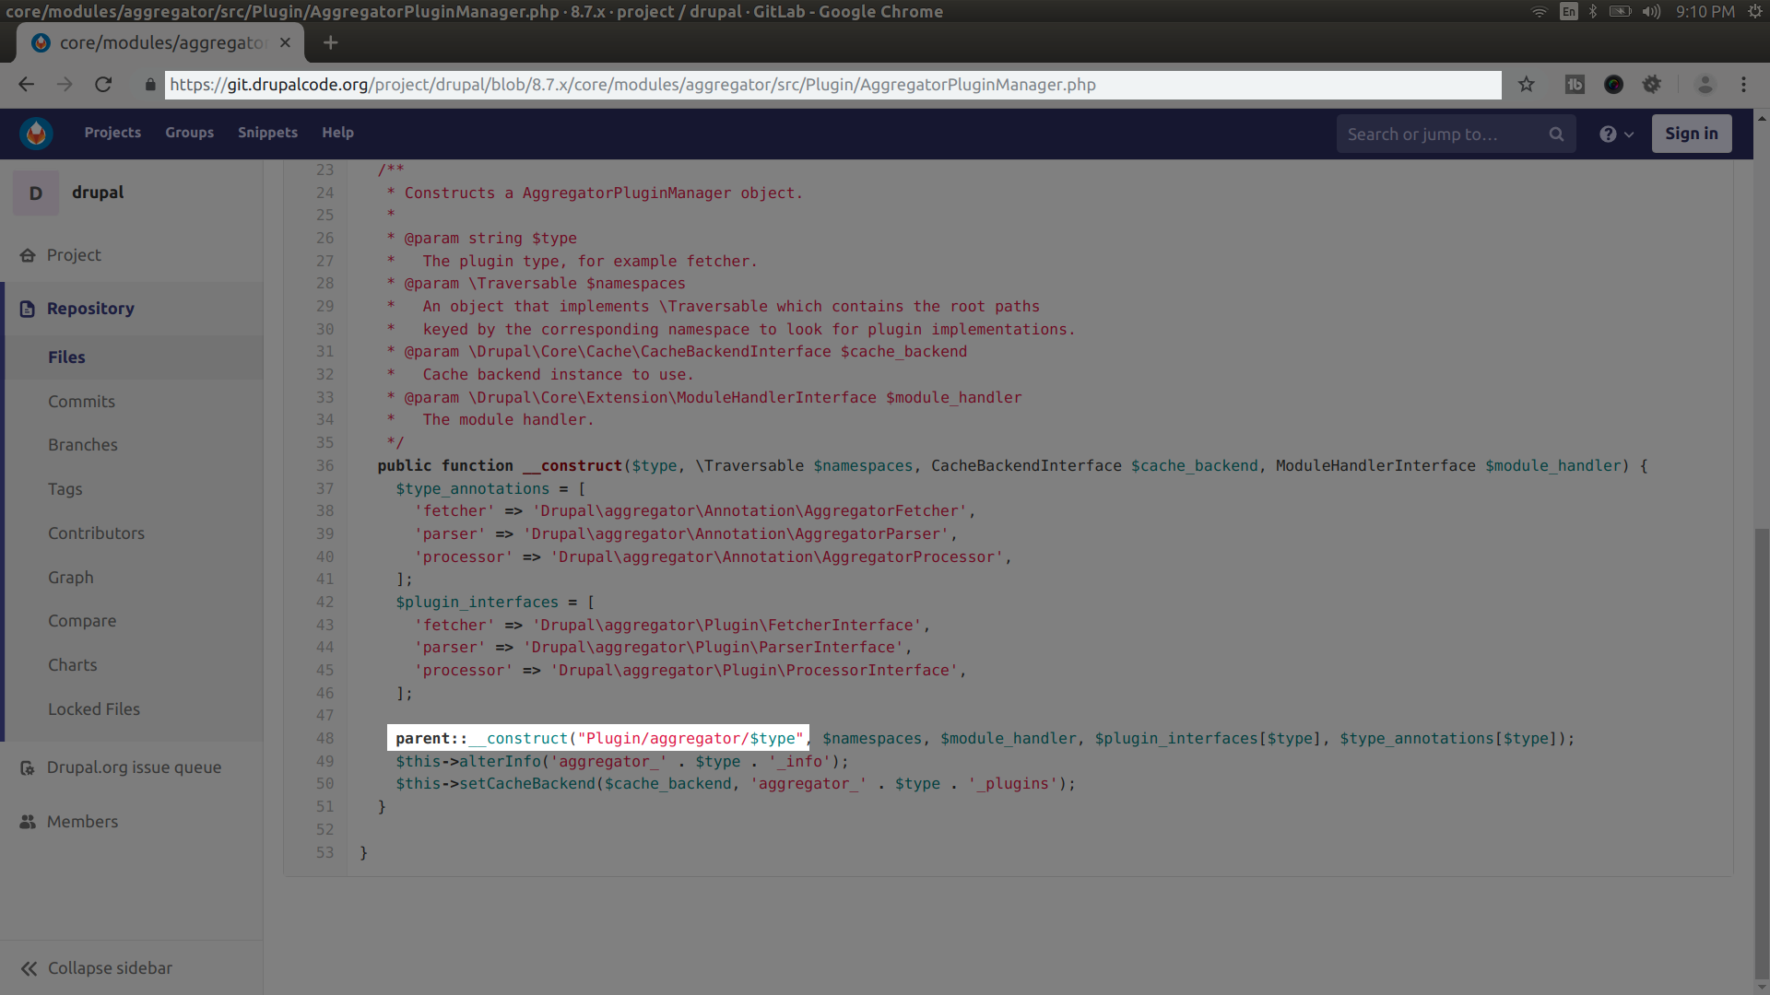

Slide 33
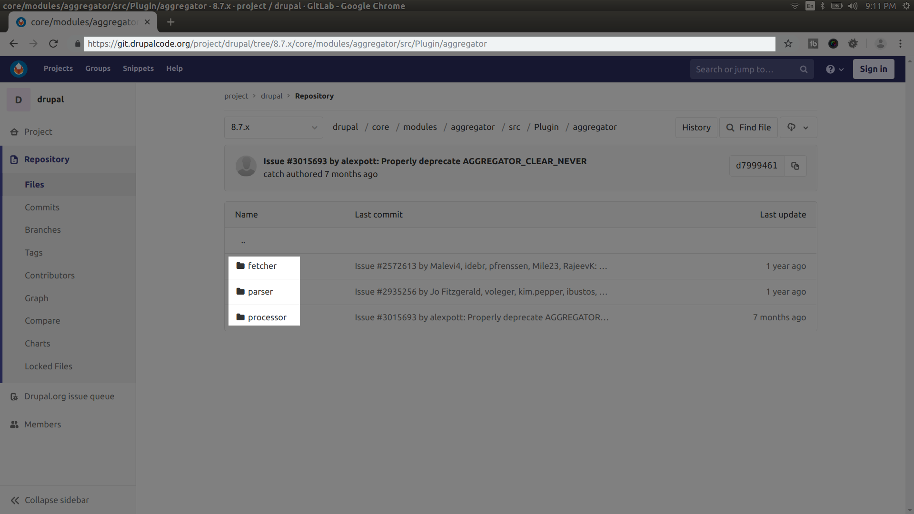

Slide 34
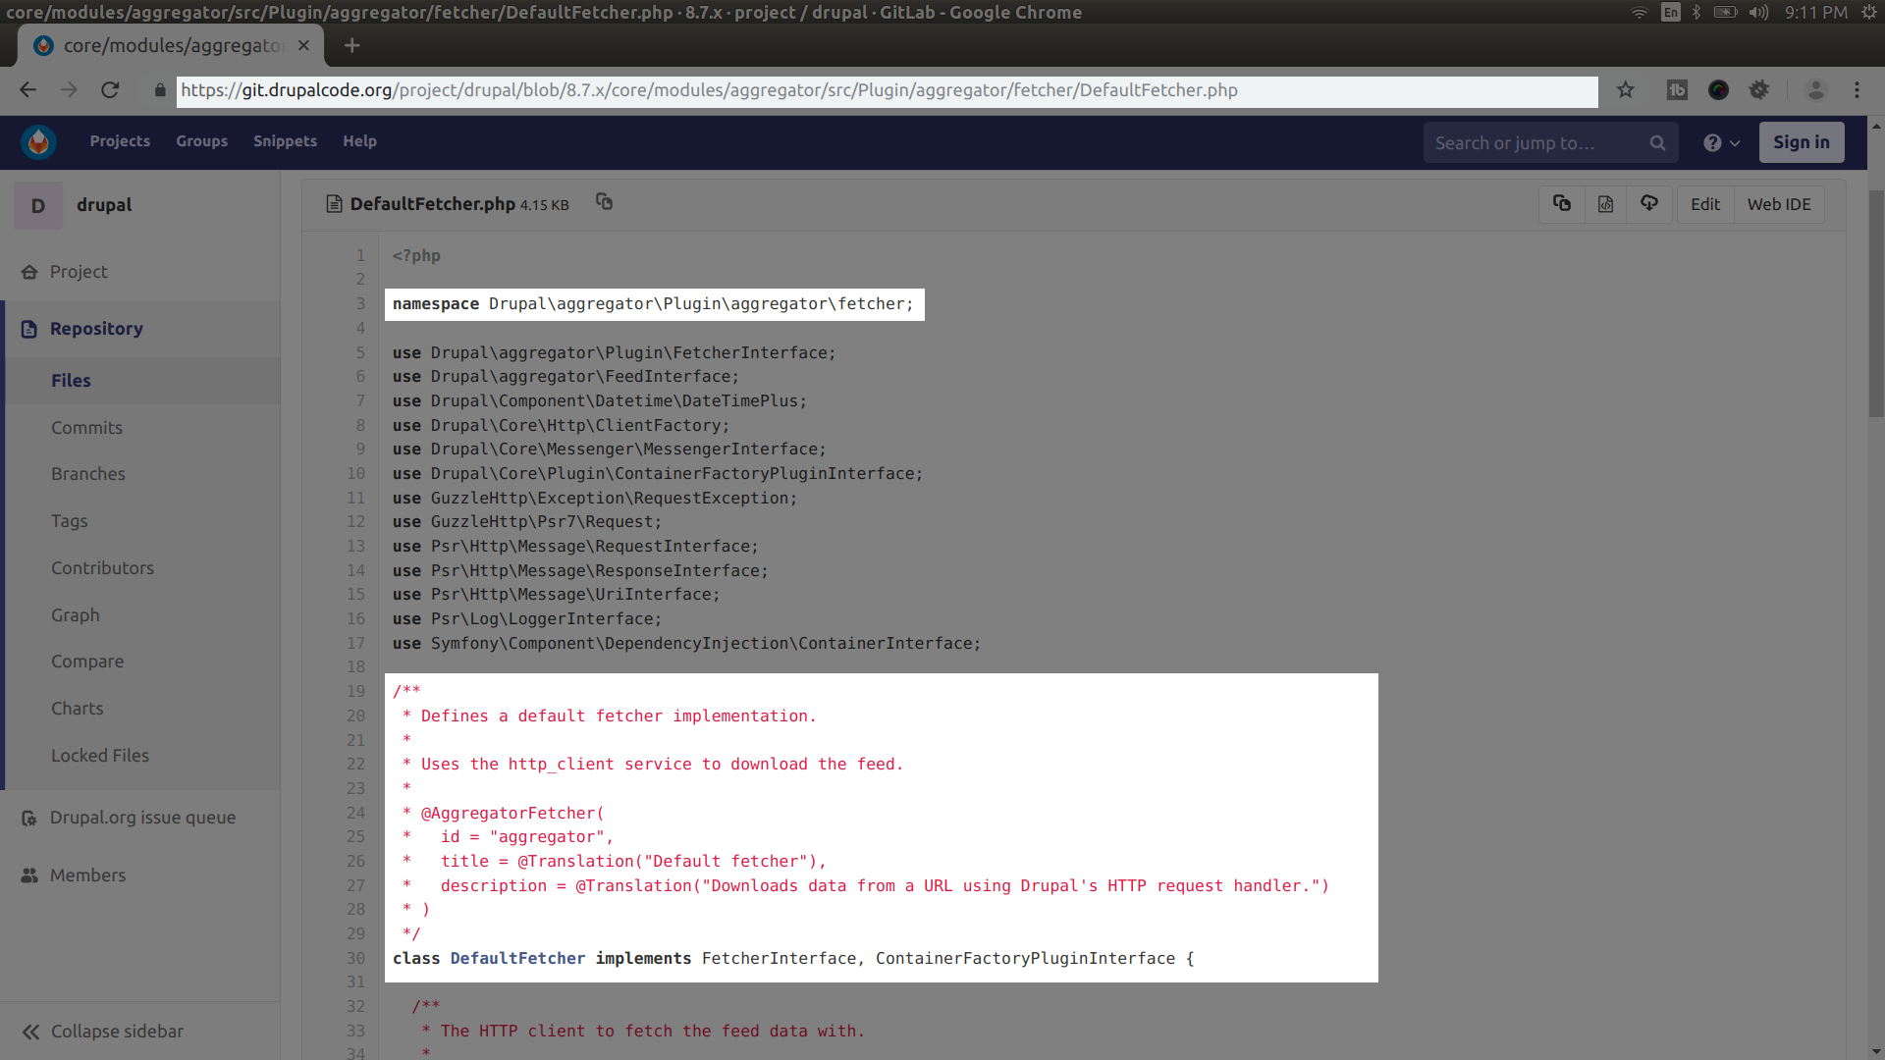

Slide 35
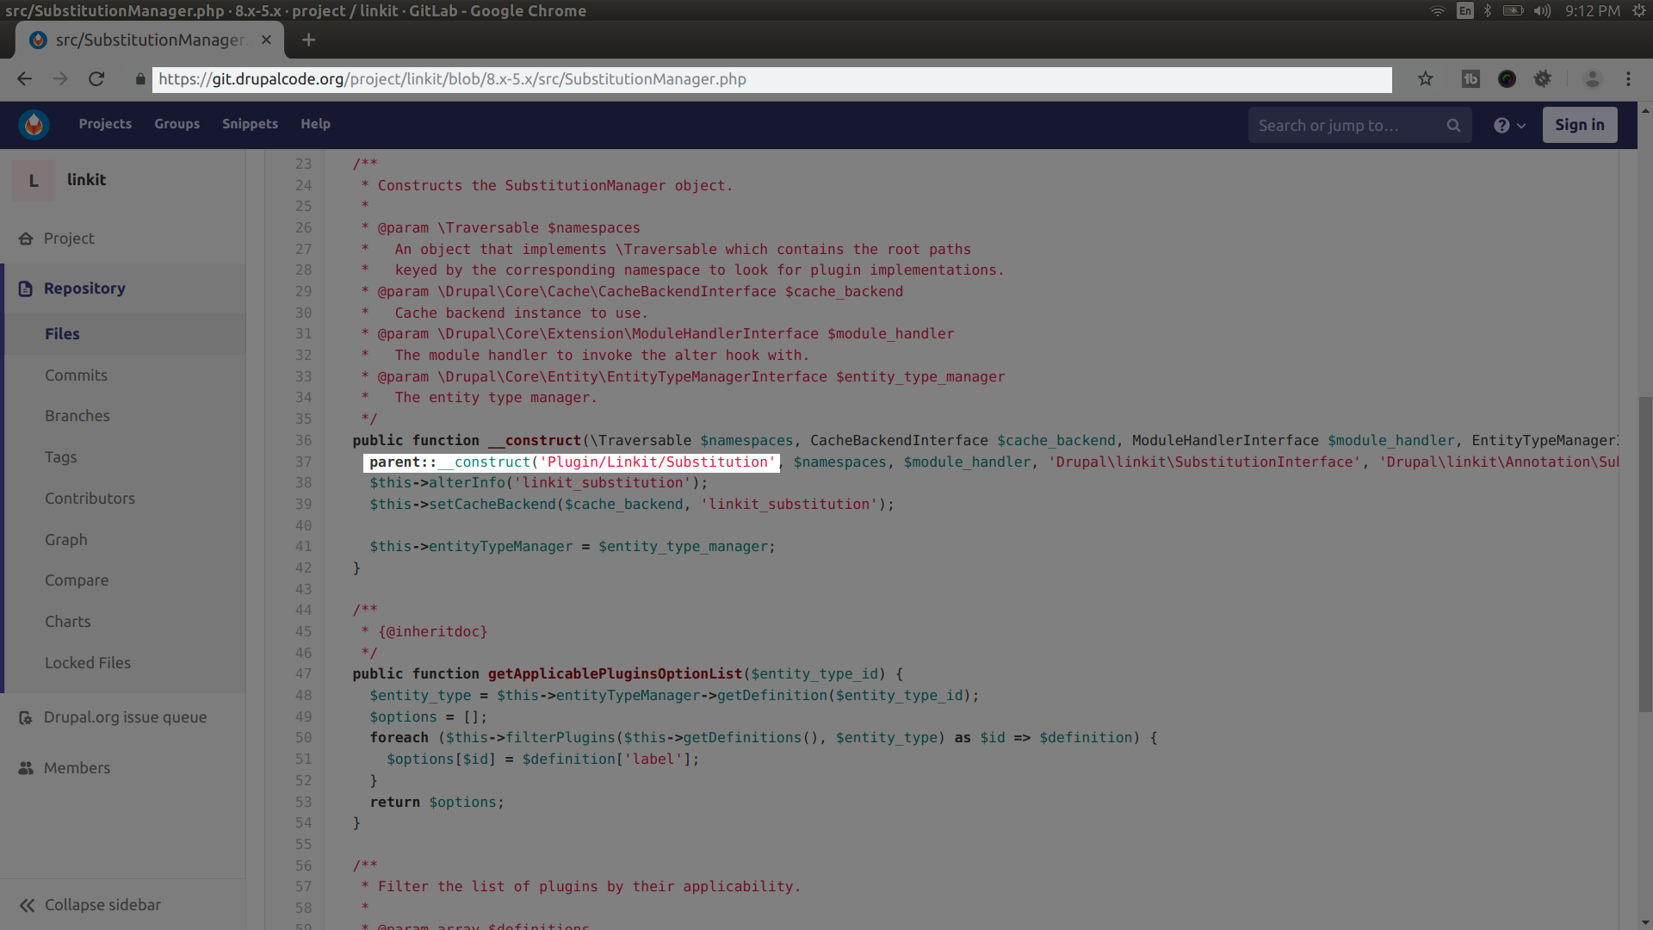

Slide 36
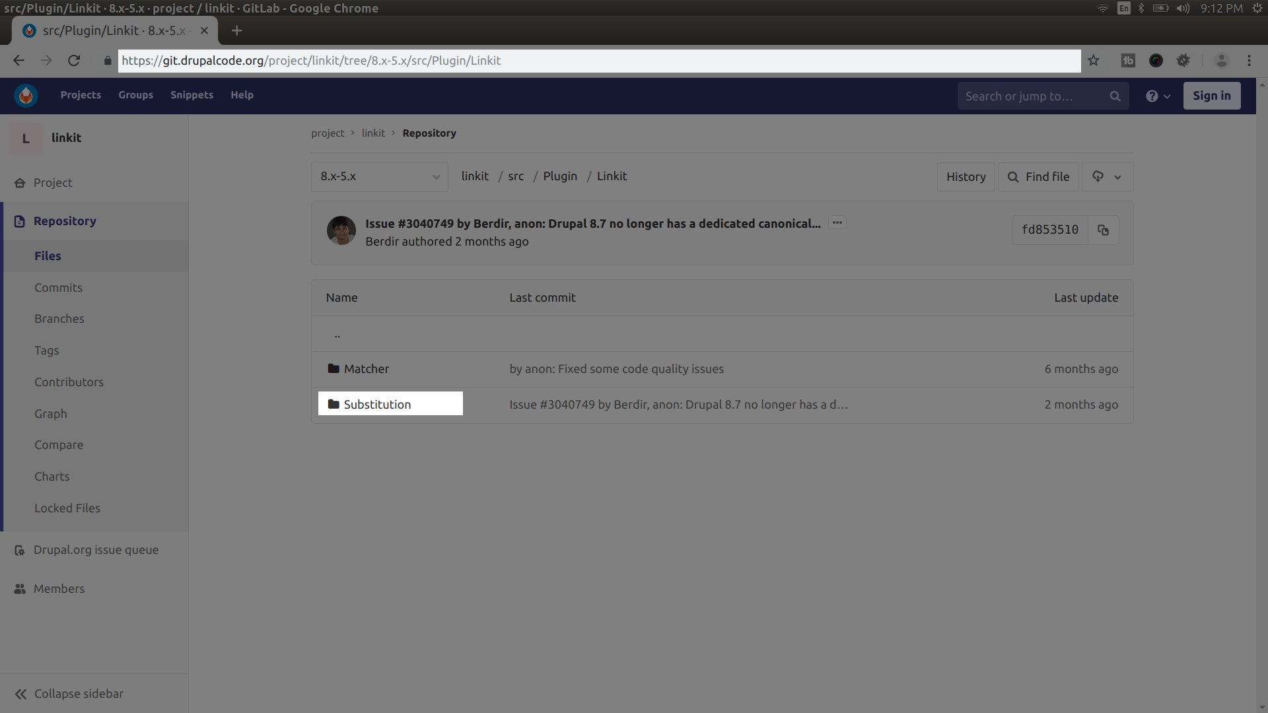

Slide 37
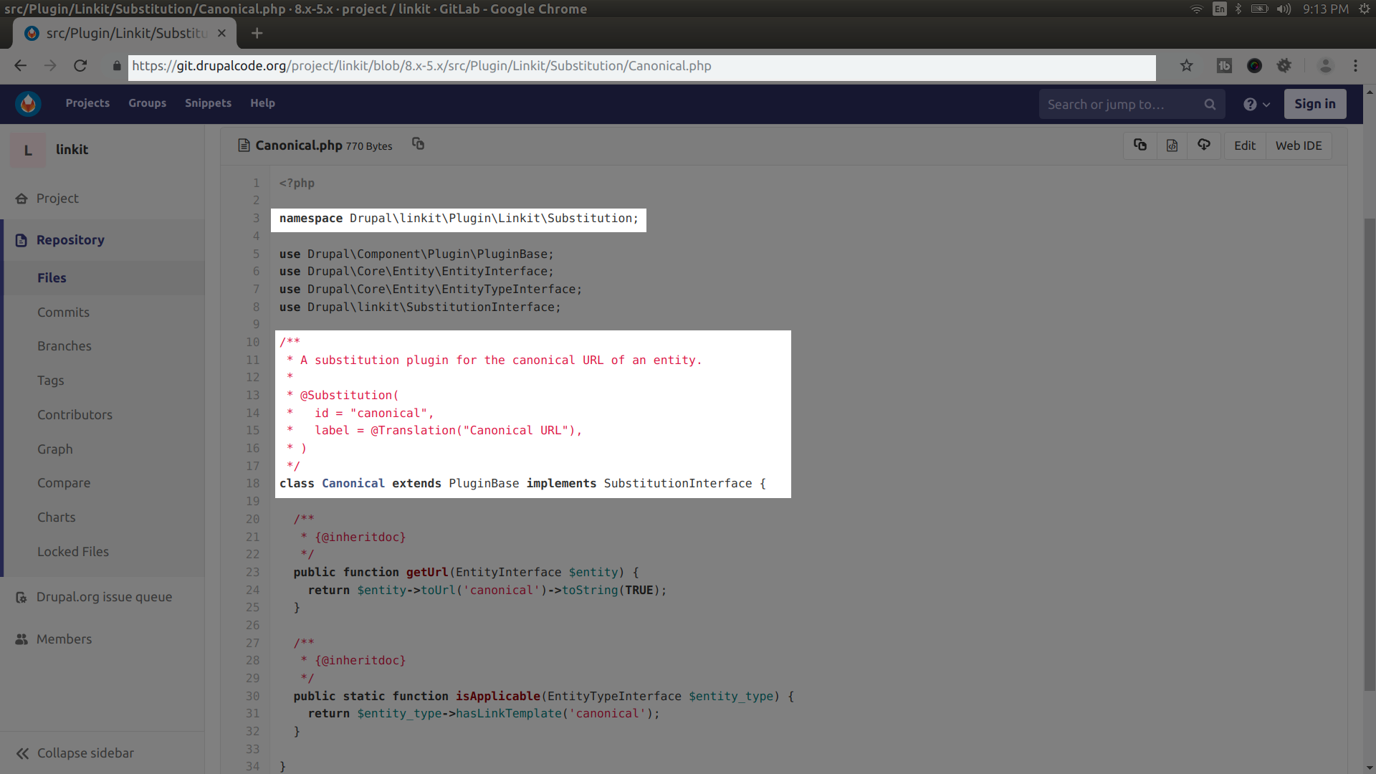

Slide 38
Discover-ing
Plugins with annota-tions

Slide 39
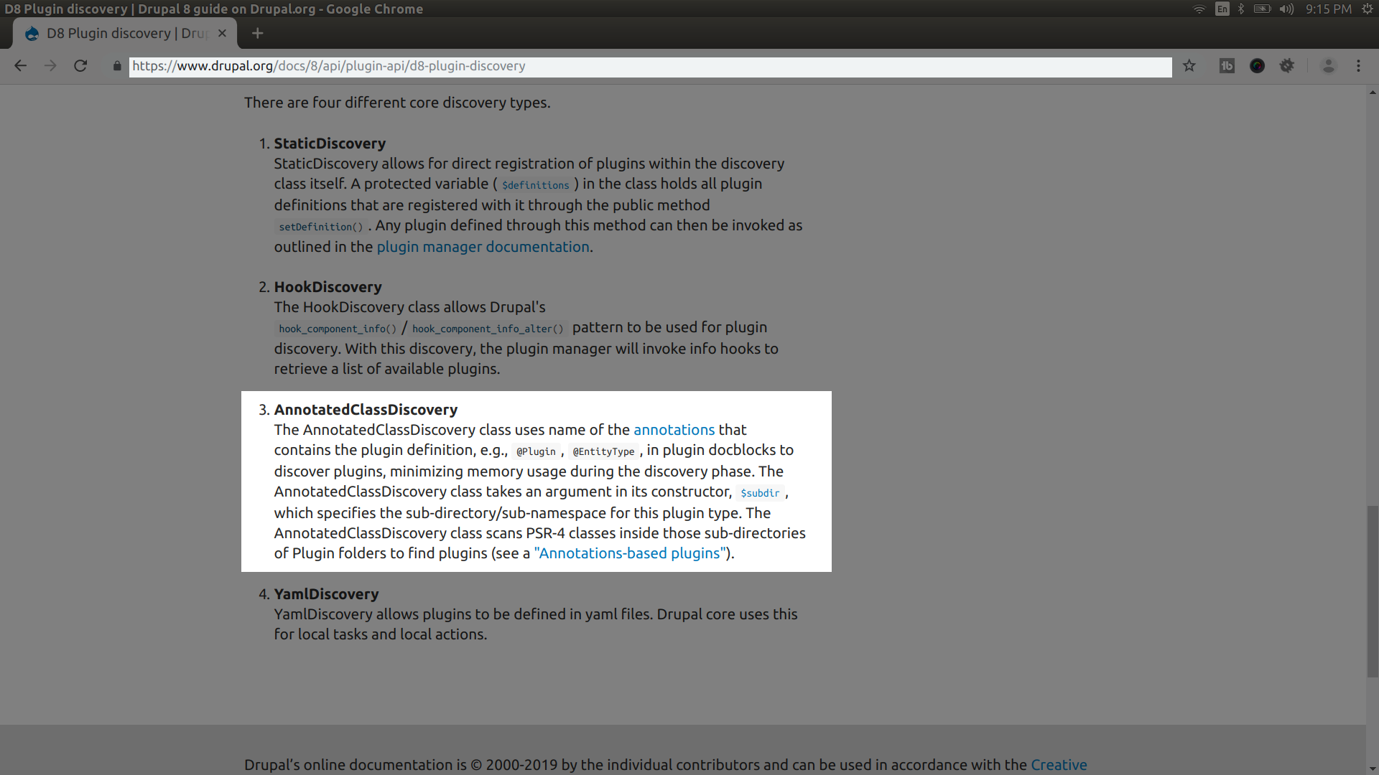

Slide 40
Using your plugin manager

Slide 41
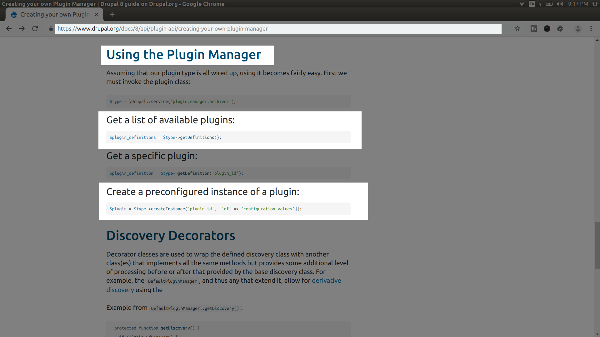

Slide 42
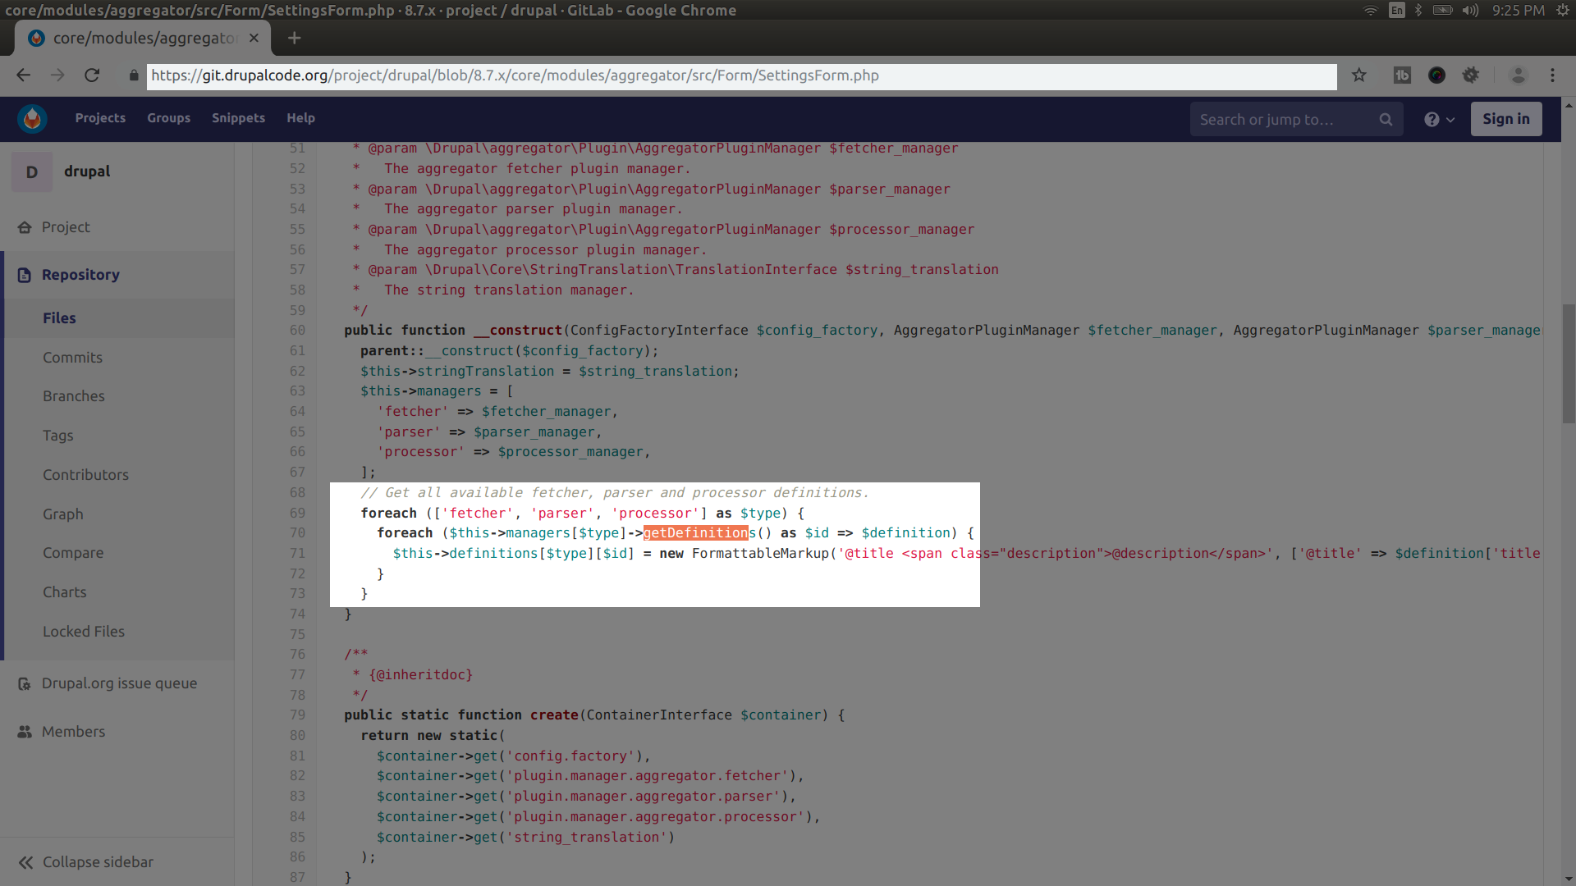

Slide 43
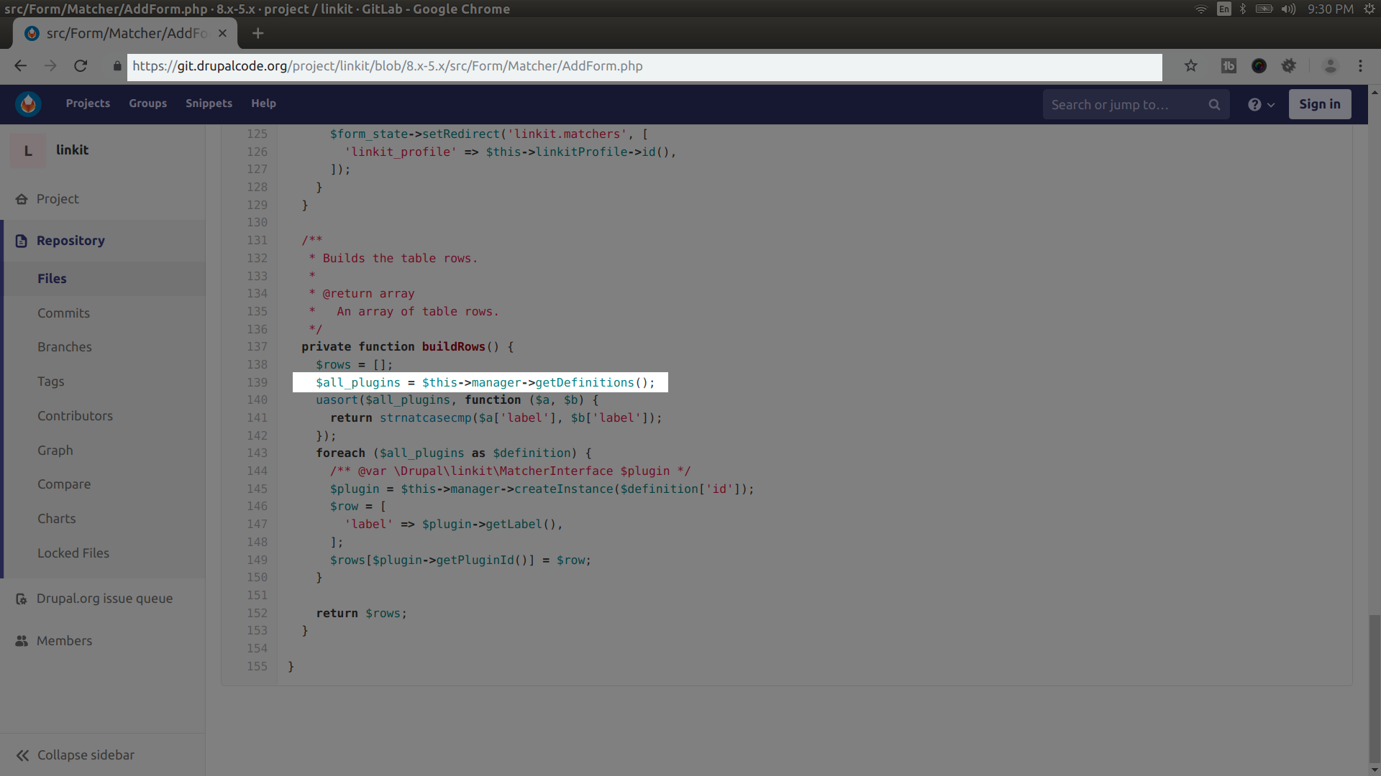

Slide 44
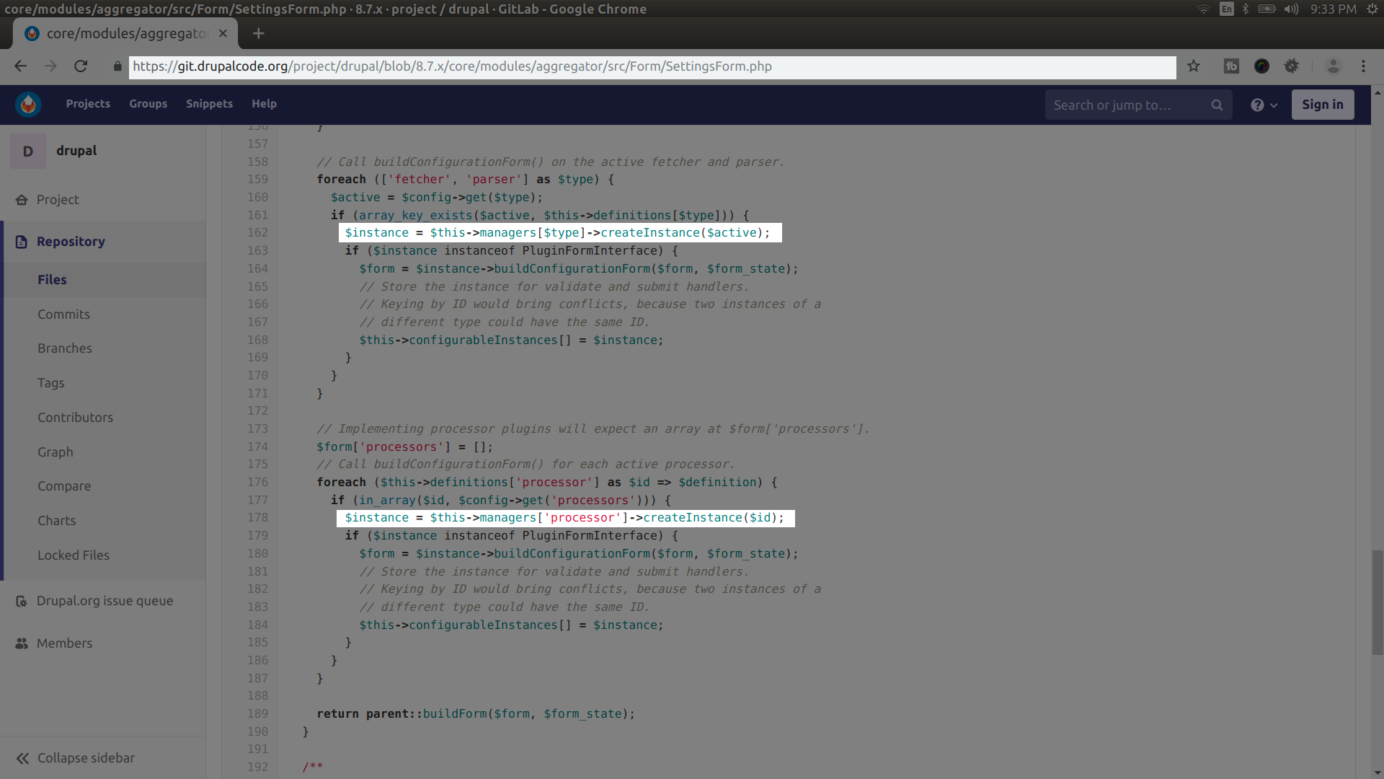

Slide 45
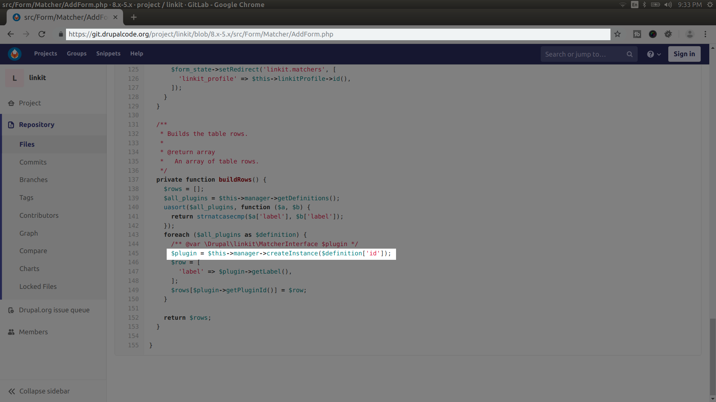

Slide 46
Using A
Config
Entity
To manage plugins

Slide 47
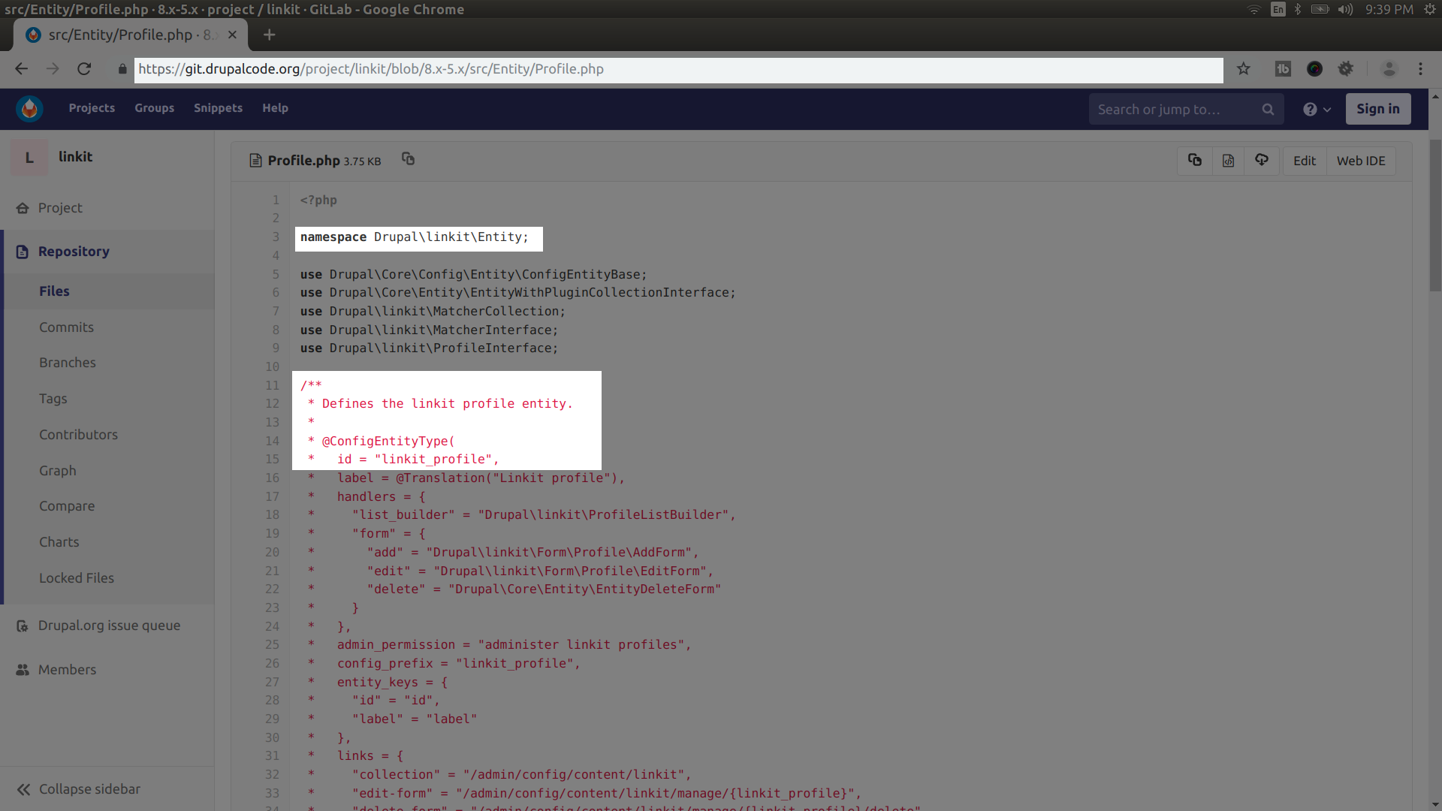

Slide 48
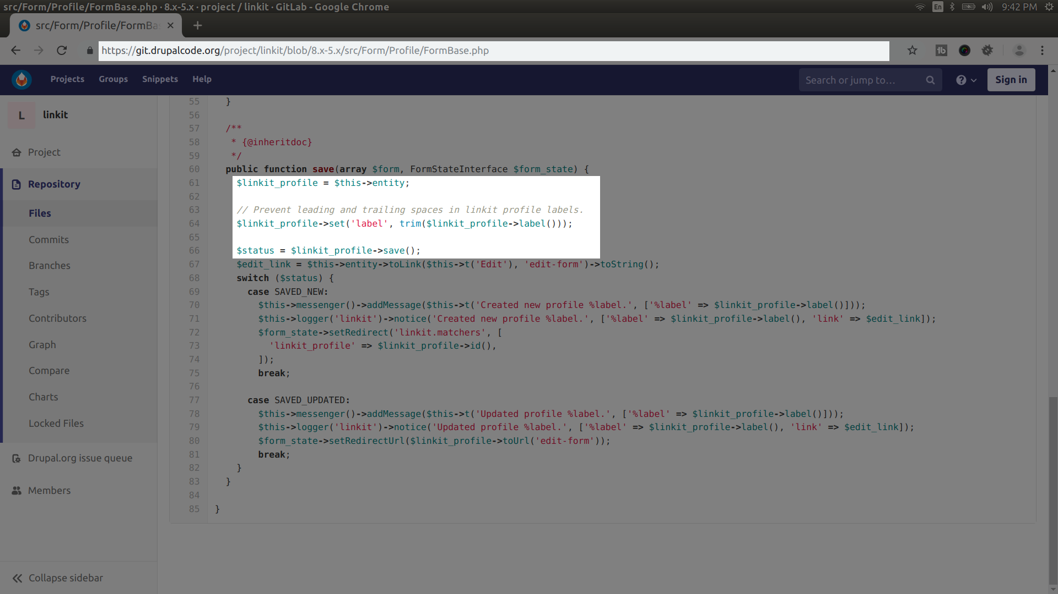

Slide 49
Questions?

Slide 50
Thank you!
Notes:
Press the big red button!

