Slide 1
Training our 5124 Registered WebCMS Users
08/22/18

Slide 2
Hopes and Dreams
EPA Web Team
  We’d be in charge of the Web site (OEI and OPA/OWC)
  Big pile of pages would become a smaller pile of pages.
    Why we transformed instead of migrated.
  Fewer PDFs
EPA WebCMS Users
  That nothing would really change

Slide 3
Everything changed
One EPA Web Ideal – Topics not Organizational content
New WebCMS
Updated our Web Standards
New server
  Didn’t migrate content
  We transformed content
Flat structure
New look and feel
  Two site design options
  Responsive design
    No local styles

Slide 4
Our New WebCMS is Ready.
Now What Do We Do?
Every one needed training regardless of experience in Web development
People located across the country (location and time zones)
  People get snippy if we have morning classes
Limited resources for training

Slide 5
Solutions
Help desk
  We had to train the help desk support too
Training Site for the WebCMS
  Ready on release
  Added to it as questions came in
  Update it when we have new releases
  Created “how to” videos
  70ish HTML pages of content

Slide 6
Training Classes
Basic classes
  We have 100s of basic pages and 1 homepage per web area
  Guess which one people cared about
Specialty classes
  Forms
  Dynamic lists
  Events

Slide 7
Document Pages
Making Good Document pages.
  The document page content type is used to add PDFs to the WebCMS.
  We don’t allow PDFs to be added to the system in any other way.
  EPA Editors hate document pages.
  EPA Search loves document pages.
  For the same reason.
  We force the collection of metadata per document.
    If you’re going to add it, you have to describe it.

Slide 8
Fixing Broken Links
Correcting Broken Links
  We have tools in our WebCMS that identify 404, 403, 301 and 302 errors
  We’ve spent time telling people what those errors mean.
  Biggest complaint from Foresee satisfaction survey is broken links and links don’t take me where I think they will.

Slide 9
Quail and Section 508
Our WebCMS includes the Quail Module
  We require that people certify that their pages are 508 compliant when they publish.
  This class covers the errors that Quail flags and what we expect people to do to fix the problems.
    Emphasis on headings and images
    Makes me crazy that Quail flags single word headers as missing text.

Slide 10
Advanced level Classes
Intermediate level class
  Offered quarterly
  Describes how the system works
    How PDFs are added
    Where you can find files
    Shield – which is password protection
  Most users are casual and don’t really understand how the system works
Advanced Class
  We’ve offered them in the past but not frequently
  We don’t have the resources to offer it now

Slide 11
Office Hours
Schedule time to work with people one on one as needed.

Slide 12
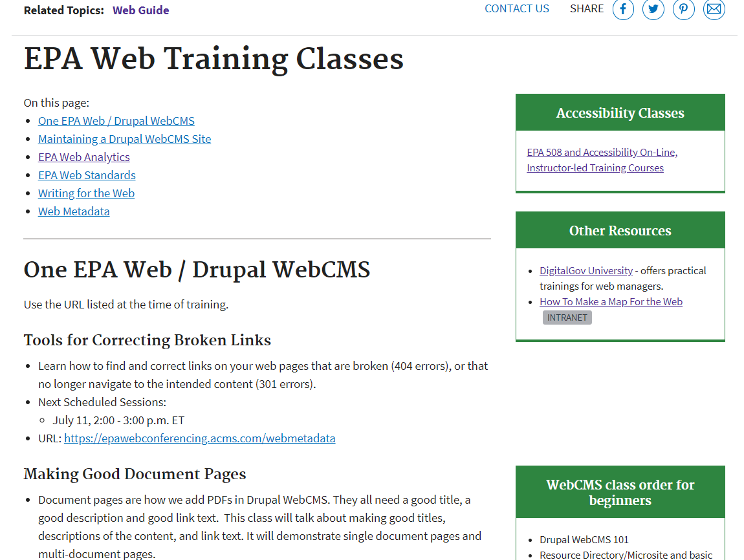
Our Web Training Page

Slide 13
EPA’s WebCMS Training Site Demo
We have a standard WebGuide site that’s everything related to web
It links to our WebCMS Training Site
71 published pages in Drupal WebCMS training
14 how do you do this in the WebCMS videos

Slide 14
Contact: Judy Dew
Information Manager
Dew.judy@epa.gov
919-541-2987
Program Analyst
Fagan.susan@epa.gov
202-566-2021
Contact: Susan Fagan
5/19/2011
14

