Slide 1
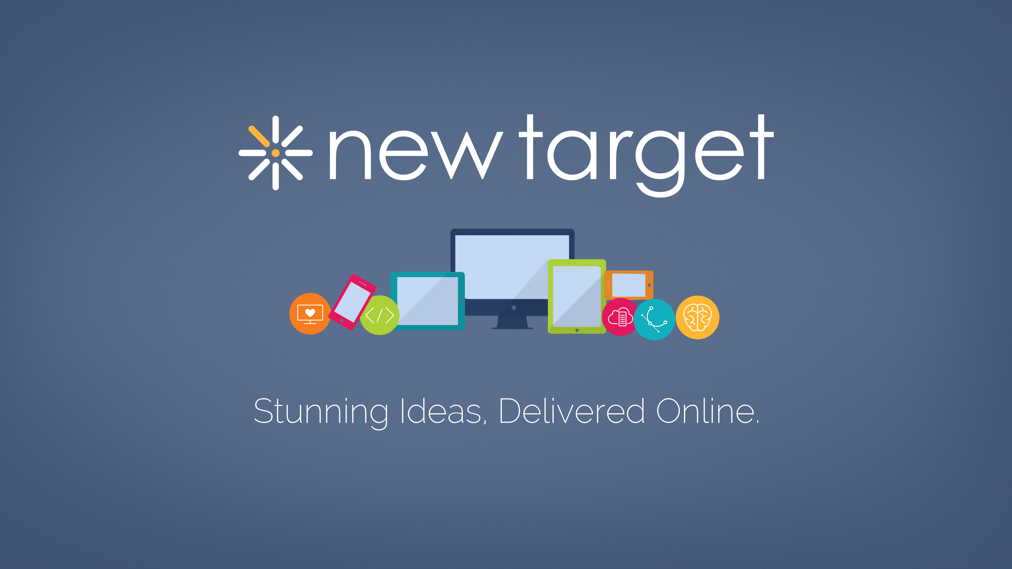

Slide 2

Finding Your
✨ Perfect ✨
Vendor Match

Slide 3
The Matchmaker

Slide 4




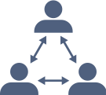
The Matchmaker
10+
years in Project and
Program Management
Worked on RFPs and vendor submissions and contracts
Experience at government agencies, non-profits, and vendor organizations
Participated in “rescue missions” when relationships go bad as well as witnessed poor request development processes
Elana Schaffer
PMP, CSM, FAC/COR-I
Senior Project Manager

Slide 5
The Bad “Dates”

Slide 6

The Bad “Dates”
Responses don’t meet your needs
Responses seem to meet your needs, but don’t match the RFP format/criteria so get disqualified
One or some response(s) appears to meet your needs and then vendor can’t deliver
One response appears to meet your needs and then vendor says “scope creep”
Other “bad dates/relationships”?

Slide 7
Who’s Writing Your Profile?

Slide 8
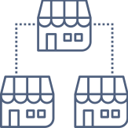
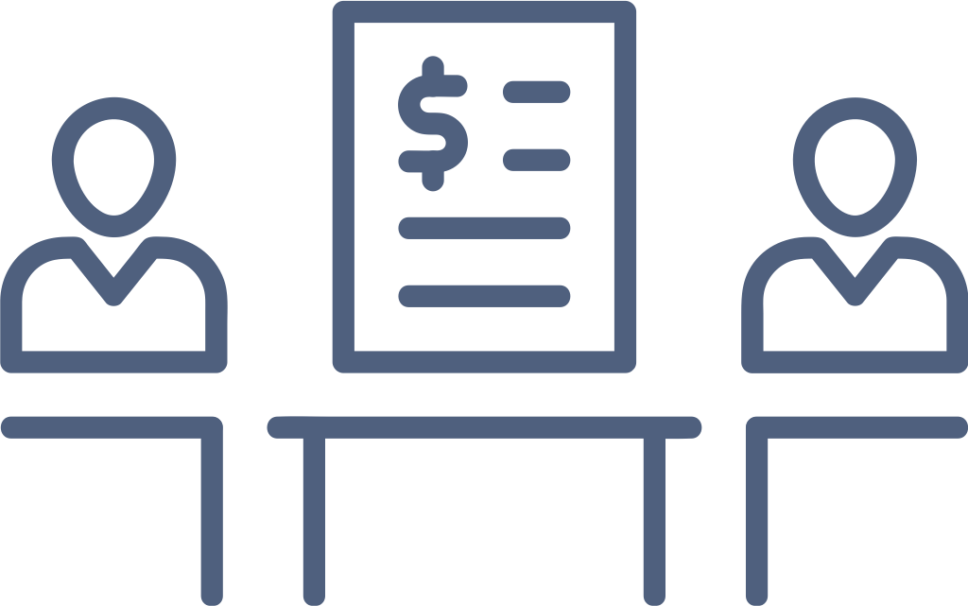
Who’s Writing Your Profile?
Vendor
Contract Officer/
Other Non-SME
RFP dictates a solution that meets the vendor’s business and not your needs
RFP doesn’t include enough information to allow a vendor to truly understand the needs

Slide 9


Who’s Writing Your Profile?
Non-Technical Team Needing the Work
Technical Team Needing the Work
Doesn’t include much of the technical “must-haves” (hosting environment, etc.); get responses from firms that don’t meet the technical need
Often includes too much technical detail and dictates the “how” to build vs. the “what”
May forget to include enough context because they are too close to it

Slide 10
Enhancing Your Profile

Slide 11



Enhancing Your Profile
Don’t let a vendor
lead the effort,
use them for support
if you have to
Involve all
stakeholders up front
in drafting and reviewing RFP
Focus on “what” you need:
how the end system should function for users (functional requirements) not how to build it

Slide 12
Enhancing Your Profile
Include only absolutely critical technical requirements - hosting environment details if being hosted outside of vendor, etc.
If SMEs are involved, provide suggested technical build ideas, not required ones - recommend to use Drupal, eAuth standard integration, etc. but be willing to consider other ideas

Slide 13

Enhancing Your Profile
Draft requirements from the user perspective
Example:
User logs in once and can access their Salesforce profile information and edit through Drupal
Vs.
Workflow diagram with authentication methods and specific workflows outlined as required

Slide 14


Enhancing Your Profile
When including technical requirements,
make sure they are required, not just desired
Vs.
East/West region
hosting with 2 load
balancers, etc.
99% uptime,
LAMP stack, etc.

Slide 15
Seeing Everyone’s True Colors

Slide 16



Seeing Everyone’s True Colors
Background, history, budget, and need lets vendors see the real “you” and decide whether they are a good match up front
Functional, not technical, needs allow vendors to demonstrate their ability to understand your needs and architect a solution
Not dictating the “how” shows vendors’ expertise, strategy, and creativity in meeting needs, scope, and budget
Being flexible in the technical architecture allows for proper and true scoping, budgeting to meet your end goals

Slide 17
Choosing Your Date

Slide 18






Choosing Your Date
Keep in mind that cost isn’t everything –you pay a premium for quality, customer service, strategy, and expertise
Remember that an organization that is asking well-thought out questions cares about trying to understand your needs and is probably thinking strategically
Meet the team in person, if possible, to see if you ”click”/have chemistry
Understand that organizations that say they are technology agnostic or can use whatever tools you want are often contracting out at least some of the work
If it seems too good to be true all around, it likely is – ask deeper questions

Slide 19
✨ A Perfect Match ✨

Slide 20
A Perfect Match
Communication and transparency vs. dictation and misunderstandings helps build a better long-term relationship
The vendor-client relationship can be a beautiful, long-term one if everyone goes in remembering it truly is just like any other relationship
Considering the vendor as a trusted partner helps build a mutually beneficial relationship vs. a one-sided relationship that often goes bad
Having everyone on the same page from the start about what they need in the relationship and what they expect to be included prevents future issues and non-completed projects

Slide 21
Questions?
Thanks!

