Slide 1

Taxonomy Terms
as
Organic Groups

Slide 2
Legal stuff
"The following content was developed by Mobomo as a subcontractor under contract number G15PD00018 between A&T Systems, Inc. and the U.S. Geological Survey. Use of this content herein as an example of Mobomo's performance in that capacity does not constitute endorsement of either Mobomo or A&T Systems, Inc. by the U.S. Geological Survey and is intended for illustrative purposes only."

Slide 3
The requirements leading to Organic Groups

Slide 4


Once upon a time...
608 (public) sub-domains
327 candidates for first round
Over 3.1 million individual pages
At least 300 (known) web developers
Search was a disaster
Confusing navigation between sites
Inconsistent, poorly designed, labeling inconsistent, etc.
High turnover in developers
Many technologies
Notes:
We initially identified 608 public facing sub-domains across the country
Of that, 327 were identified as candidates for our first heavy-lift into Drupal
We identified over 3.1 million individual pages
300+ (known) web developers...likely more we didn't know of
Search was a disaster (limited metadata, poor HTML coding practices, etc)
Navigating in sites and between sites was confusing, inconsistent, poorly designed, labeling inconsistent, etc.
High turnover in developers (students, contractors, etc)
Many technologies (JSP, ASP, PHP, .Net, Java, Flash, you name it we did it)

Slide 5
Organizational structure (Micro-Sites? Groups?)
Cost Centers
(science centers, laboratories, observatories, etc.)
Mission Areas & Programs
(Climate & Land Use Change, Ecosystems, etc., programs fall underneath a Mission Area, but each program still has its own staff)
Regions & States
(offices covering a geographic footprint and the overall efforts in that area)
Science Support
(Administration, Budget, etc. - administrative offices)

Slide 6
Primary client needs
Microsite / sub-pages “owned” by the group’s members
BUT
Non-members still able to add content to groups’ pages
Option to create group-specific taxonomy vocabularies
Consistent mobile-first look and feel agency-wide
Convert sites as needed (repeatable)
Sounds like a job for Organic Groups instead of separate Drupal installs or crazy complicated permissions!
Notes:
Some specific things we knew we needed to have to make a conversion possible:
Allow a limited sub-set of users to edit content "owned" by a particular group (science center, mission area, program, etc
Allow all logged in content creators to be able to add content to that group's pages, even though they may not be a member of that group
Provide group-specific taxonomy vocabularies that allow every group to have the option of their own taxonomies to tag their content. There’s a module for that! We’ll get to that in a moment…
Be able to convert sites as needed
Don’t have a set schedule
No one standard “from” platform
Automatically pick up on existing content tagged with the taxonomy term set up ahead of time
Content which is tagged with a center (Attribution section) should link off to current site until they do convert (include something about how)
BONUS: All conversion of content is manual and is the problem of the individual centers. One-time chance to cut away out the junk and cruft and fluff

Slide 7
OG “Microsites”
Organic Groups is a contrib module which provides the following features:
Any entity can be a “group”
Any content type can be “group content”, allowing it to be “owned” by a group and be governed by OG roles/permissions access.
Users can “belong” to a group (join/leave, membership)
Sensible default views pages and blocks
Roles and permissions for the group (default settings per group type, can be overridden)
  Node types which are available as “group content” have a full sub-set of permissions (view/update/edit/delete their own/any node of type)
  Group management permissions

Slide 8
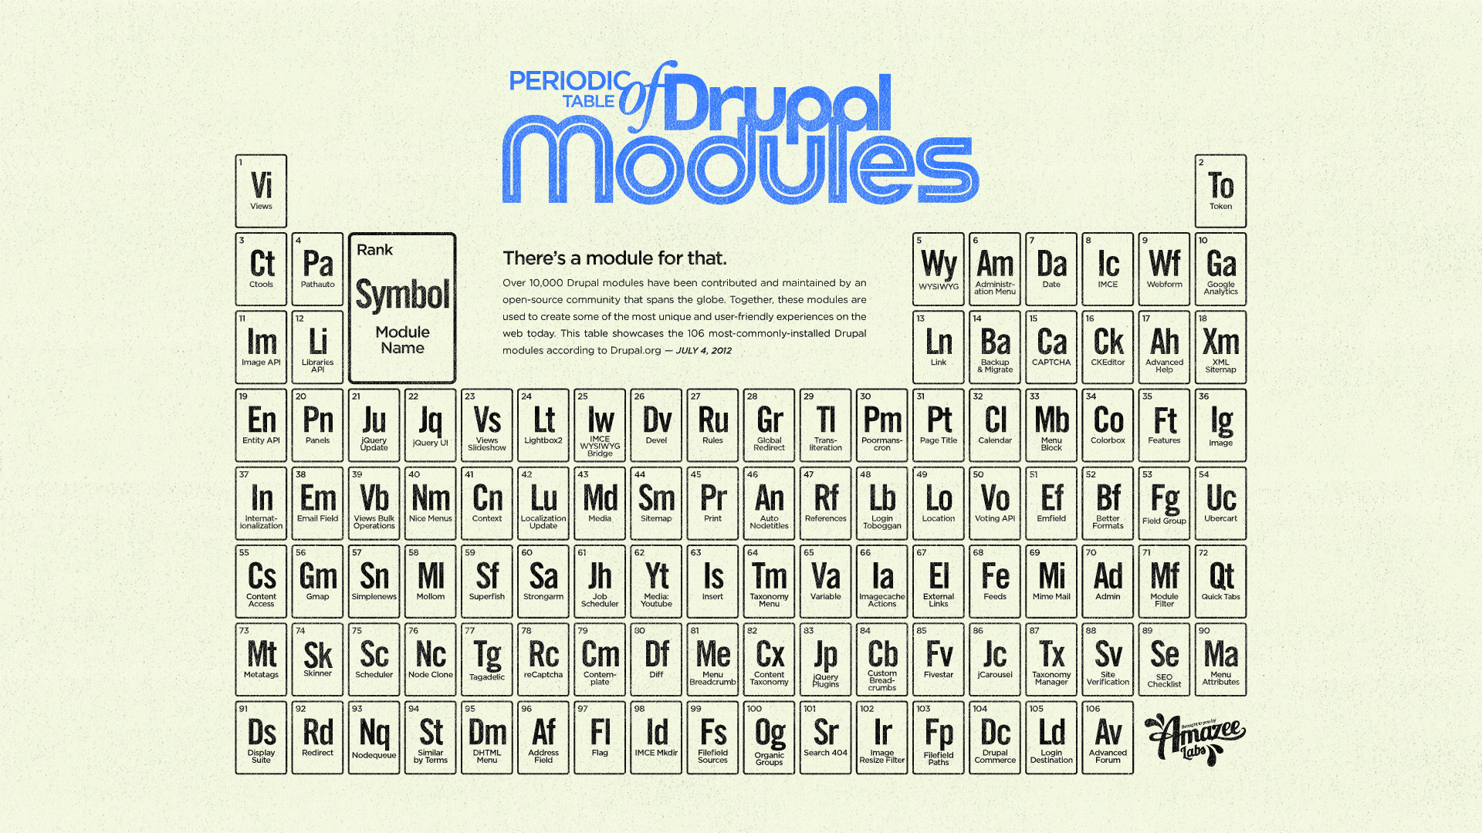
OG “Microsites” (cont.)
TONS of additional modules extending common other contrib functionality to OG world
  Workbench OG - Workbench module, transitions to/from various publishing states within the group context
  Scald OG - media handling
  OG Menu - context-aware
  OG Vocab
  Views/panels integration

Slide 9
Initial setup concept
For each group type, create an OG-enabled vocabulary
Each term represents a site
  Initial creation of vocabularies and terms via Feeds
Content tagged by other users show up automatically
Site may or may not be converted or ready to convert
  Hook_url_outbound_alter on these terms’ rendered taxonomy terms
  Field on each term (field_landing_page_type)
    If converted, link to term landing page within Drupal
    If not, link off to external site

Slide 10
Initial setup concept (cont.)
Each vocabulary must have a taxonomy_term ref field on all relevant content types in order to tag and include on the term’s page.
Content must be able to be tagged with center-specific terms (science topic landing page type).
Panelizer to customize layout components on the term landing page.

Slide 11
The Deal-breaker
Group-specific taxonomies...
Contrib to the rescue with OG Vocab!
Create group-specific taxonomy vocabularies
OG permissions for who can manage terms
Complex widget which can determine group membership for user and provide all vocabularies the user has access to in one field (og_vocab)
Yay!?
  Doesn’t actually work on Taxonomy Terms, only nodes as host entity.

Slide 12
Time to regroup… (pun intended)
OG-enabled content/node type for each group type
Matching vocabulary with terms for each unit of that type
Modify Feeds approach to also create nodes and the relationship to a term (create terms, export, create nodes with ref to term)
Each node is simple:
  Title, Intro text
  Custom blocks
  Carousel
  Primary taxonomy term (type = same as node type) - the node is now related to a single term, nothing else, so views can leverage “Has Taxonomy Term” filter
OG Menu is auto-created on group node create (default links sub-module)

Slide 13
Time to regroup… (cont.)
Each group node = “microsite home page”
Create all landing pages needed for the group - 11 types (Science, News, Publications, Maps, Software, etc.)
  Content on a landing page shares 2 characteristics:
    Same Primary Term as the cost center’s home page
    Filtered by content type (“Maps” landing page, “Software” landing page, etc.)
  Created “Build” tab to automate this a little bit
Default Panelizer content
Create OG Vocabularies with fields
Import terms from spreadsheet using Feeds

Slide 14
Help! So much work per micro-site!
Improving the group creation process
Imported initial data
Each new center required manual process
  Create menu links, associate group nodes with taxonomy, customize panels and views (20 page document of step-by-step approach).
  Took an hour or more of developer time per microsite.

Slide 15
The automated solution (custom module) for microsites
Automated tool - simple form with confirmation
  Fewer than 10 elements
  5 minute content manager task instead of developer time
  Node, Menu, Panelizer, Taxonomy, APIs
Cost centers only for now
Consistency of platform and “branding”
DEMO
Notes:
New Solution: Automated tool
Uses a simple form (and confirmation form) with fewer than 10 elements.
Now takes only 5 minutes of content manager’s time instead of developer time.
How it works
Uses the node API to create the group node if it currently doesn’t exist.
Uses the menu and OG API for creating and arranging menu links
Uses the panelizer API to set panel pages with correct vocabularies.
Uses Drupal form submit to create Theme and Topic Vocabularies
Uses field API to configure Theme and Topic Vocabularies
Uses taxonomy API to convert csv data into taxonomy terms.
Limited to cost centers at first, expanding to other group types later
Agency-wide consistency of platform and “branding” (yes, this is a thing for a federal agency. A sexy website matters!)

Slide 16
Thank you

Slide 17


