Slide 1
Government Issues:
Leveraging Accessibility with Usability to Serve *Really* Diverse Audiences

Slide 2
... Or, “breaking through the buzzwords and creating a foundation that will benefit everyone”
Notes:
So in this talk, I will be

Slide 3
sharing ways that we’ve succeeded,

Slide 4
sharing the ways that we borked up in achieving that goal,
Notes:
Because I feel everyone has something to learn from mistakes they’ve made and sharing them with others

Slide 5
things that we’re changing,
Notes:
To achieve both compliance and a greater experience for our users

Slide 6
and tools you can use to achieve similar results in your projects.

Slide 7
Quick Notes About Me
Tearyne Glover
(pronounced like Karen, but with a T)
Front End/UX Developer
Employees’ Retirement Fund of the City of Dallas, Texas

Slide 8
Quick Notes About Me
I am also
a communications specialist
head of the myERF helpdesk
digital communications strategist (email, social, etc.)

Slide 9
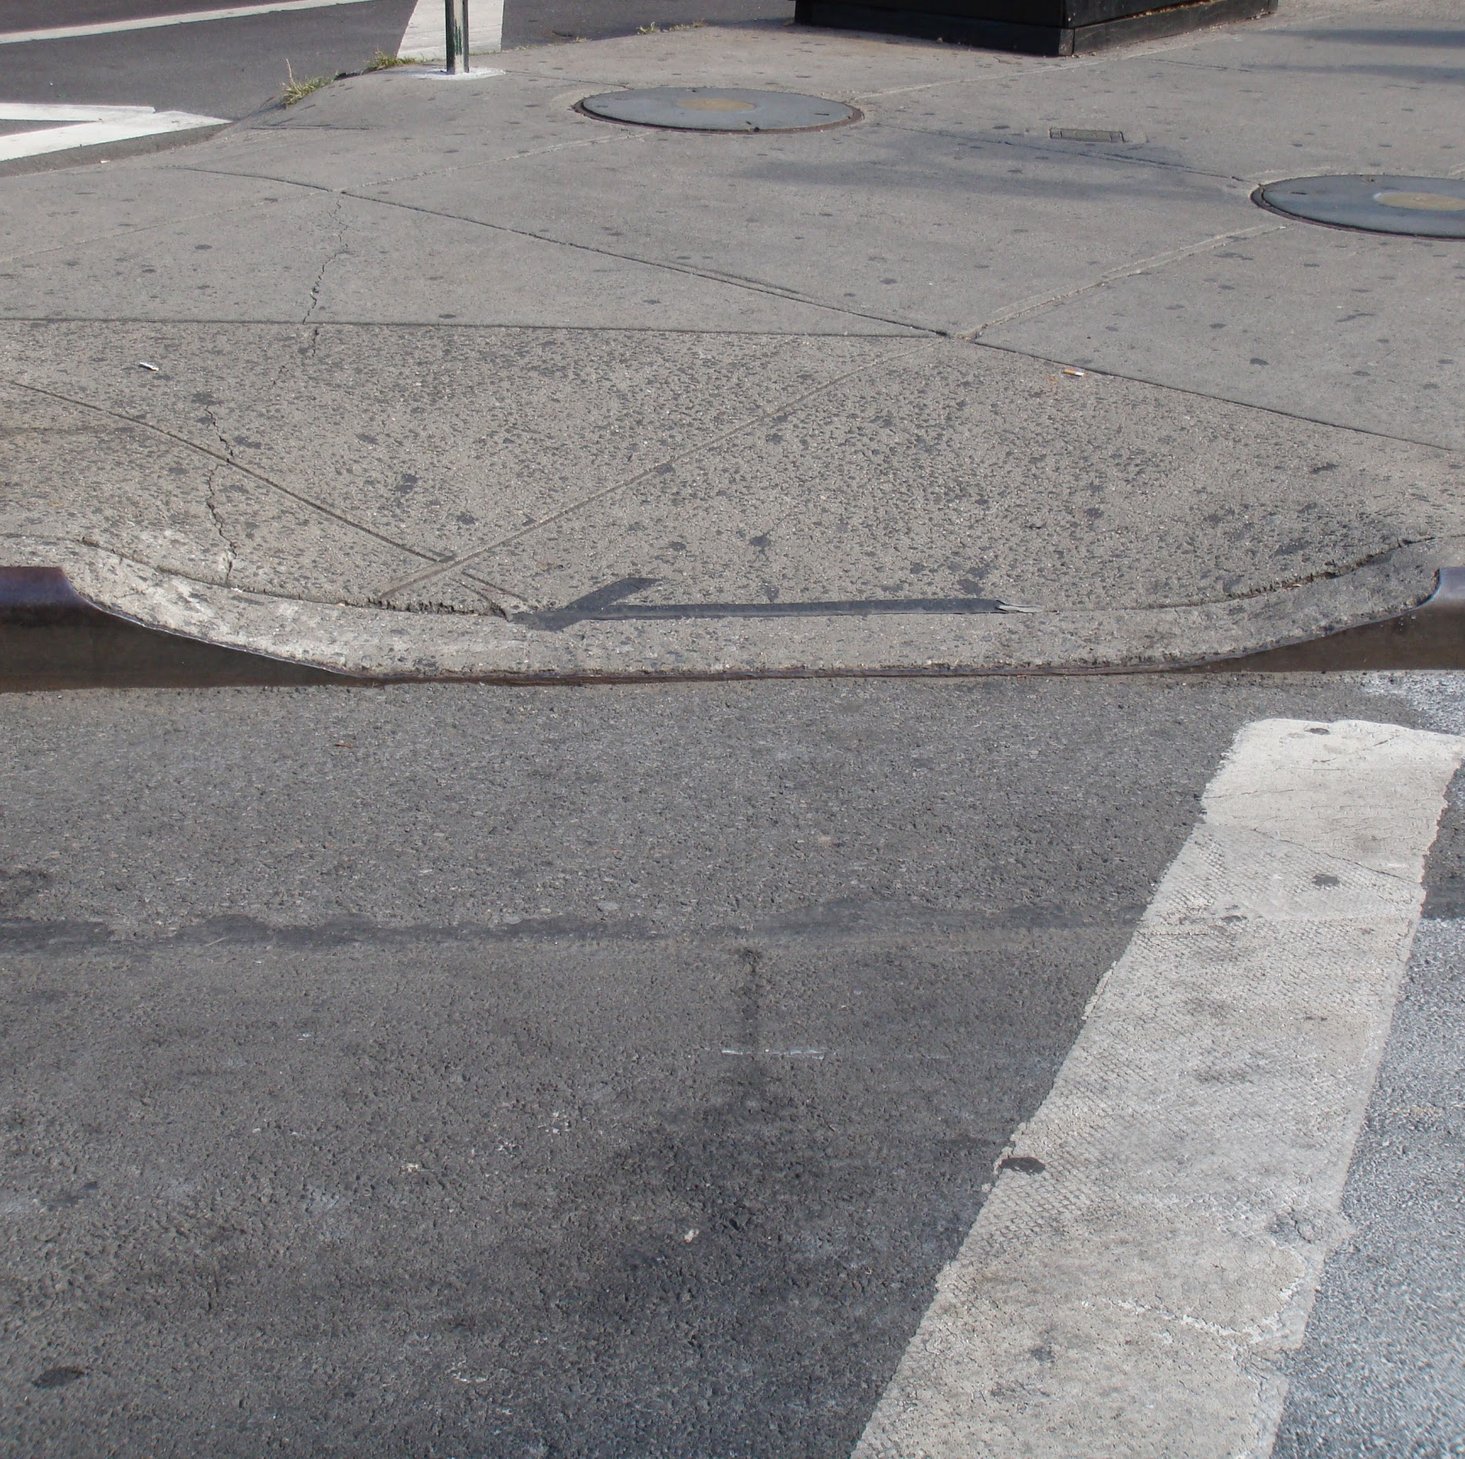
Who benefits from curb cuts?
People in wheelchairs
The visually impaired
People who find themselves temporarily disabled in some way, with mobility issues that fall under one of the previous situations
People pushing baby buggies/strollers/prams
People transporting wheeled rolling carts
Bicyclists, rollerbladers
Notes:
Fun fact: when I googled curb cuts this picture came up as a “pram ramp”

Slide 10
When I saw this image for the first time, something just clicked for me

Slide 11
Accessibility:
ensuring direct and indirect access through accommodations to people with disabilities

Slide 12
Accessibility:
ensuring direct and indirect access through accommodations to people with disabilities

Slide 13
accessibility is heavily related to
universal design,
which aspires to create environments that are designed to be accessible to older people, people with disabilities, and without disabilities
Notes:
Curb cuts are a great example of this philosophy, because while their use is initially recognized and intended as being for people who use wheelchairs, they are useful for a wide variety of people and situations. The tech equivalent of this is known as [[click over]]

Slide 14
Design for All
“a design philosophy targeting the use of products, services and systems by as many people as possible without the need for adaptation”
(https://ec.europa.eu/digital-single-market/en/policies/creating-digital-society)
Notes:
Talk about Design For All, Europe etc.

Slide 15

About ERF
Employees’ Retirement Fund is a department part of the City of Dallas
Established in 1944
Dallas has 12,911 employees, 9,690 of whom are unsworn (~7k in our fund)
Pension contributions are 13.32% of employee pay

Slide 16
Evolution of the Dallas ERF Website
2002: ERF Launches its first (static) website
2015: Launched active employees’ portal
2017: Launched retiree portal, giving them access to their 1099-R forms online
2018: Paystubs launched in retiree portal, giving them access to paystubs online (and stopped mailing physical stubs unless people opted in to receiving them)

Slide 17
Knowing Your Audience

Slide 18
Diversity in Theory
Versus
Diversity in Practice

Slide 19
Diversity and inclusion in tech is often presented as building products that include marginalized people based on their group membership

Slide 20

Notes:
https://www.flickr.com/photos/wildrose115/27623264486

Slide 21

Notes:
https://www.flickr.com/photos/93963757@N05/8551937456

Slide 22
Let’s get beyond surface fluff.

Slide 23
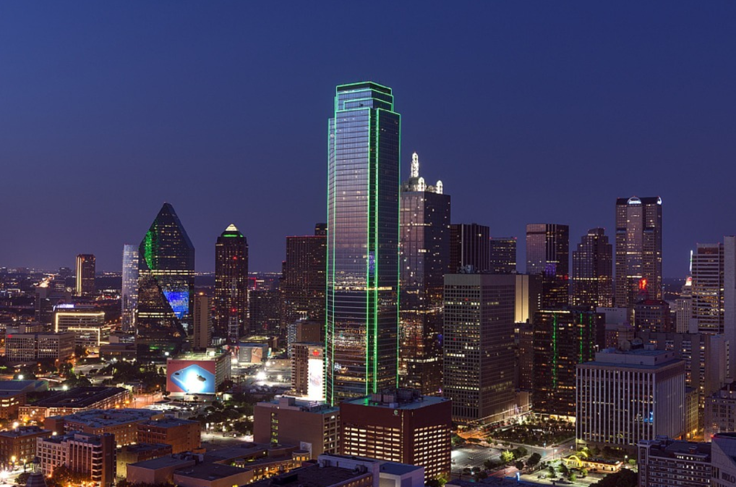
The City of Dallas:
Stats
1.3 million people live in the City of Dallas
33.4% of the overall population of Dallas, TX are native Spanish speakers.
Most of the employees (62.9%) for the City of Dallas do not live in city limits (NBC DFW, New Figures Verify Most Dallas City Employees Live Elsewhere, Apr 17, 2018)
Notes:
Note: people not living in the city means that you have people that are commuting in a variety of ways.
https://datausa.io/profile/geo/dallas-tx/
https://www.texastribune.org/2015/11/26/languages-spoken-texas-homes/
https://www.nbcdfw.com/news/local/New-Figures-Verify-Most-Dallas-City-Employees-Live-Elsewhere-480056253.html

Slide 24
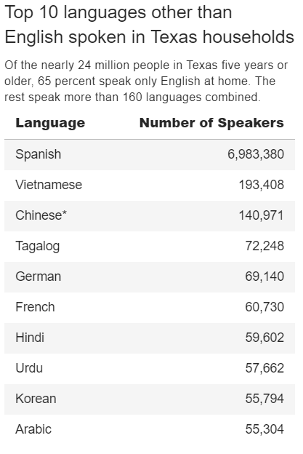
Languages Spoken at Home in Texas
Texas Tribune, As Texas Population Grows, More Languages are Spoken at Home, November. 26, 2015

Slide 25
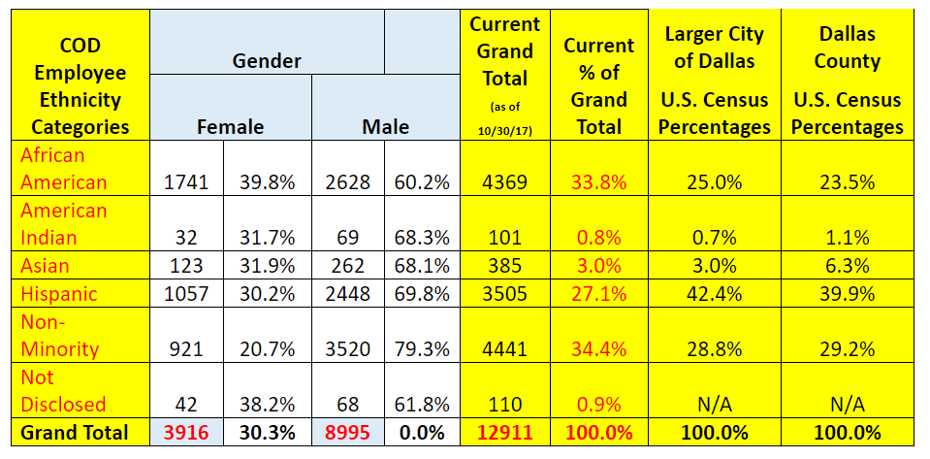
City of Dallas Employee Stats: Gender
Notes:
Note that this chart does have a possibility of some people not being counted because it is binary focused in gender identification.

Slide 26
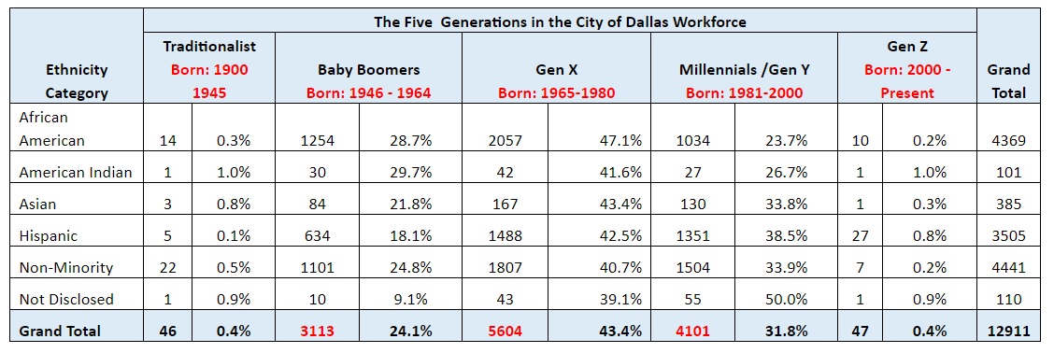
City of Dallas Employee Stats: Ages

Slide 27
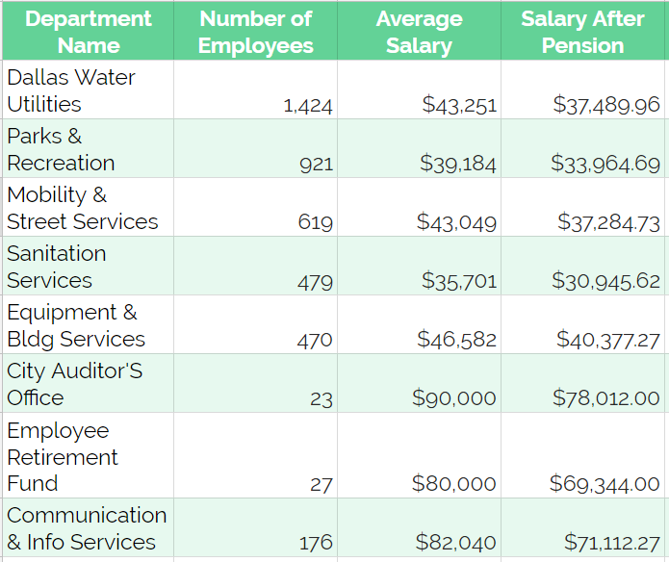
City of Dallas Employee Stats: Incomes
3,913 employees make up our top five departments ( approximately 55.9% of employees in the fund) (assuming that all enumerated employees are permanent employees who contribute to the fund)
The departments with the top average pay compose only 3% of our total workforce
Salary information courtesy of The Texas Tribune Website
Notes:
https://salaries.texastribune.org/dallas/departments/

Slide 28
So instead of giving lip service to diversity,

Slide 29
What are actionable steps we can take to build products that foster inclusion?

Slide 30
1. Build room for margins in your product from the beginning
Notes:
This means taking barriers into account
How to resolve the situations that you have identified or been informed disproportionately affect the audiences you are trying to serve

Slide 31
This means taking into account the various barriers that exist for users in the margins
Economic
Educational
Language
Technological
Access

Slide 32
The great thing about this?
These are intersectional issues that benefit everyone while simultaneously alleviating the disproportionate impact they have on the marginalized

Slide 33
Building products with accessibility standards at their core makes this infinitely easier.

Slide 34
Example: Front Page Slider

Slide 35


Slide 36
Image in Text Sliders
What other issues does it cause?
Whenever we update this slider, we have to create two versions of it: one for the English homepage, and one for the Spanish Homepage.
Might seem like an effective solution, but that still means we leave out other parts our audience:
  Arlington, TX has a strong community of Vietnamese native-speakers
  With the Toyota plant, we have an increase in the number of Japanese speakers who come in
People on low bandwidth connections might not get to see this information due to load times.
Obviously an accessibility no-no. Text inside images can’t be read by screen readers, and this particular slider we’re using can’t take alt text.

Slide 37
Solution: Front Page Panels

Slide 38
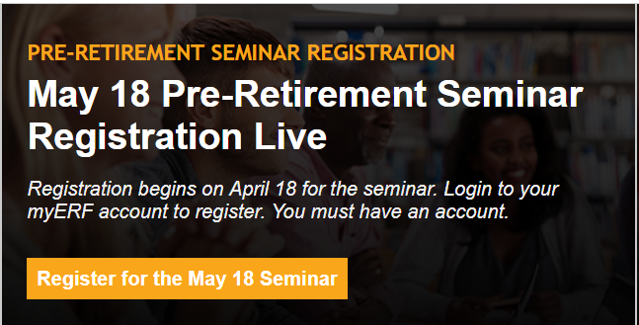

Slide 39
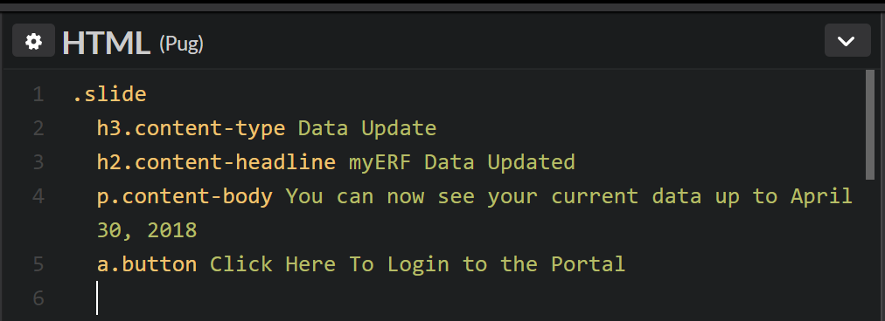
Taxonomy
Node Title

Slide 40
Case Study: New Login Procedures

Slide 41
Please Login
username
password
Login
*not the actual interface
Notes:
This an example of our older login form when we first came out with myERF. It actually extended beyond the fold on some screens due to other elements on the page.

Slide 42
Nefarious folks kept trying to brute force in usernames and passwords
Changed the process to three steps on separate pages
Required users to come up with three security questions

Slide 43
We explained this new process to returning users in a modal. :D
(Please don’t use modals unless absolutely necessary)
(I hate them so, so much)

Slide 44
On checking our Drupal analytics, the Forgot Password link showed up as the top hit, but in Spanish.

Slide 45
What gives?

Slide 46
The modal was only in English.

Slide 47
The City of Dallas:
Stats
1.3 million people live in the City of Dallas
33.4% of the overall population of Dallas, TX are native Spanish speakers.
Most of the employees (62.9%) for the City of Dallas do not live in city limits (NBC DFW, New Figures Verify Most Dallas City Employees Live Elsewhere, Apr 17, 2018)
Notes:
Make a note that people not living in the city means that you have people that are commuting in a variety of ways
https://datausa.io/profile/geo/dallas-tx/
https://www.texastribune.org/2015/11/26/languages-spoken-texas-homes/
https://www.nbcdfw.com/news/local/New-Figures-Verify-Most-Dallas-City-Employees-Live-Elsewhere-480056253.html

Slide 48
Unfortunately, the security questions were also only in English.

Slide 49
The forgot password link gave users a workaround, in that it let them login without having to deal with the hassle of the unexplained new process.

Slide 50
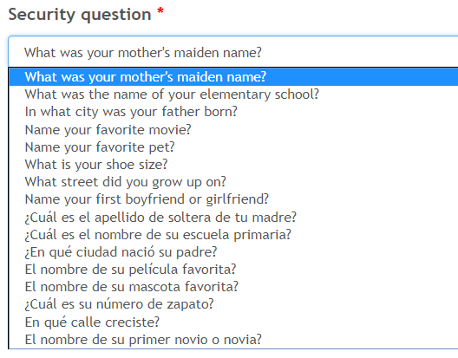
Solution:
We translated the modal to Spanish, and we also added Spanish translations of the security question.

Slide 51
2. Identify the pain points that create challenges for your audience (which are often intersectional in nature)

Slide 52
3. Design your products to offset the situations that result from the marginalization
Notes:
How to resolve the situations that you have identified or been informed disproportionately affect the audiences you are trying to serve.
So in this case, we know that for many of our users, they might not have a computer at home, and their phone is their only means of accessing the internet. Increasingly, more and more people are not using desktops at home, either. That means we need to make sure that we’re testing our new features for mobile readiness.

Slide 53
Because employees in
City Hall, the Streets Department, the
Parks Department, and the
City Attorney’s Office
can have very different experiences and challenges
Notes:
In these different departments, different skills are required, and a natural disparity in life experiences crop up.
I work at ERF and have a college education, college educated parents, and work in tech, so my experiences as a black user are different from other people’s due to intersectional factors.

Slide 54
And retirees have different needs and requirements all their own

Slide 55
...resulting in very different user experiences that need to be accounted for in your site’s architecture and content

Slide 56
Due to my hybrid role, I’m able to learn this data from one-on-one experiences with members (help desk, at member meetings),

Slide 57
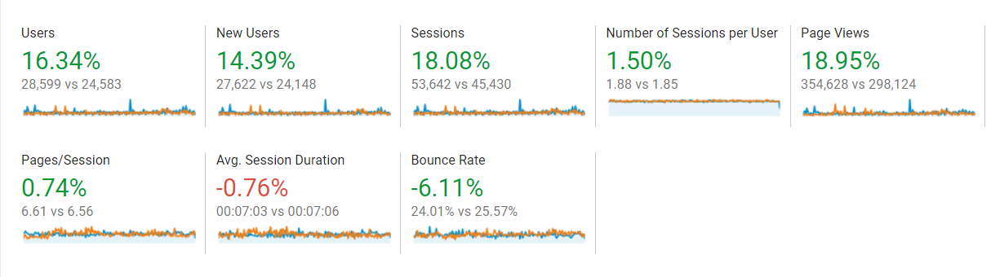
From analytics data (Drupal, Google, Facebook, Mailchimp)
Notes:
This helped me to advocate for the users, knowing which users were accessing the site from what networks, at what resolutions, and from what kinds of devices. It also tells us what resources people are really using and what programs we should develop on the communications team

Slide 58
And from member feedback surveys
Notes:
From these surveys, we were able to spend time improving products that people wanted and needed and stopped building products just to prove that we could.
We also learn about recurring bugs that might come up, like shorter EIDs locking users out.

Slide 59
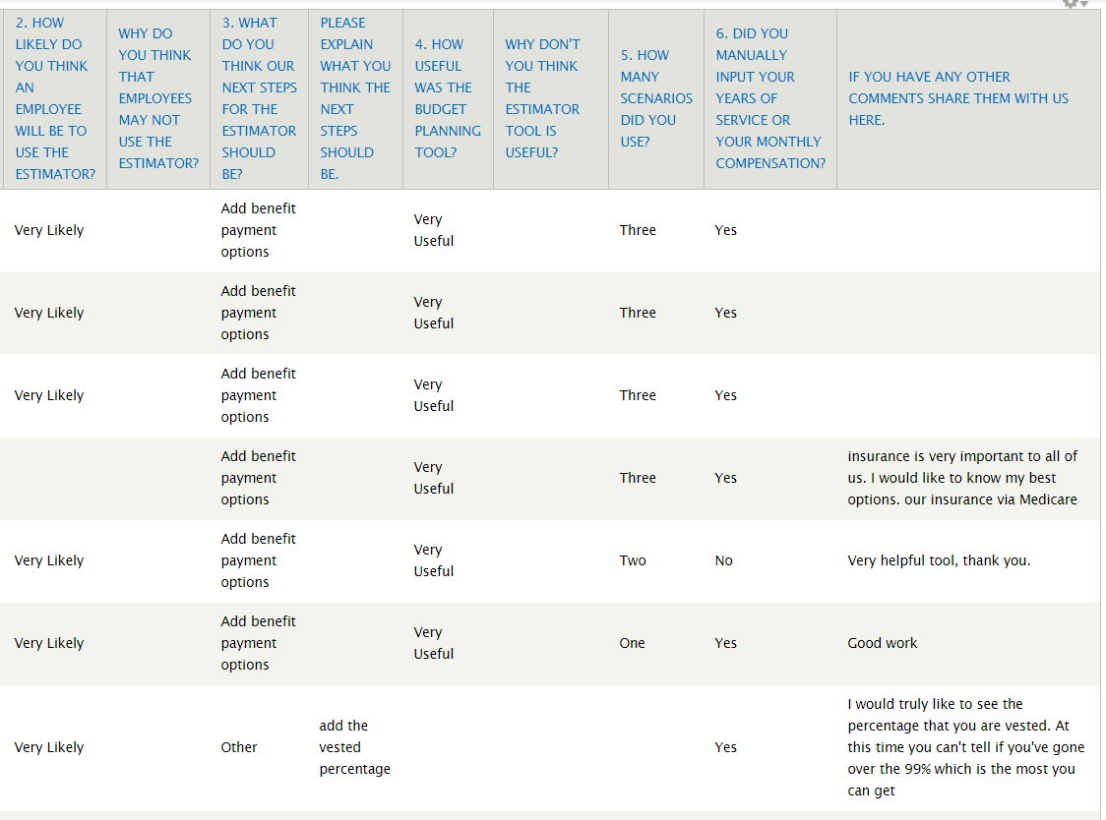

Slide 60
What Have We Learned?

Slide 61
We have to hold ourselves accountable

Slide 62
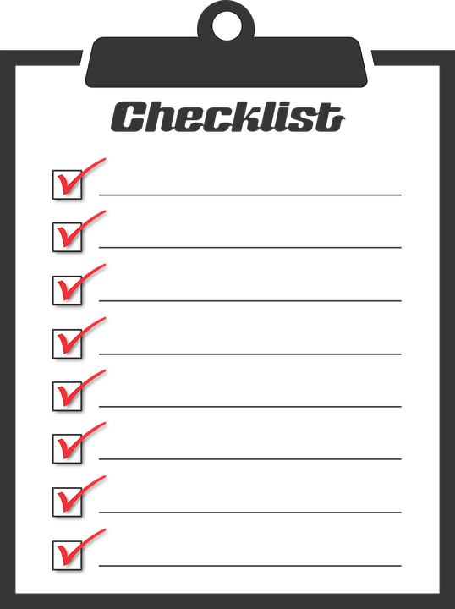
New Standards for Development
Once we had a portal, we had customers (our members) who needed service
My role transitioned from being just a Frontend Developer to being the UX Developer
Web portal team adopted a ticketing system
Adopted a project management system
A standards list for all new custom products/modules
  Built so that availability in Spanish was easy
  Mobile testing is required
  Now ensuring the builds are accessible

Slide 63
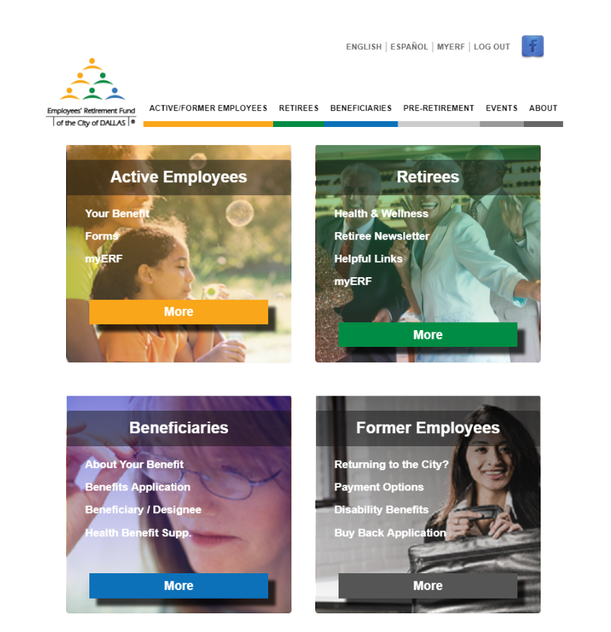
Screens and Devices
This is one of the most important screens we have.
From our analytics data, we know that most users accessing our site from a CoD computer see this resolution. This is because they tend to have standard issue monitors and workstations
We’ve also discovered that retirees often use this resolution, as it’s easier for them to read the information at this scale.
The also have a higher use of tablets.
We use this data to improve our internal help desk processes and our layouts

Slide 64
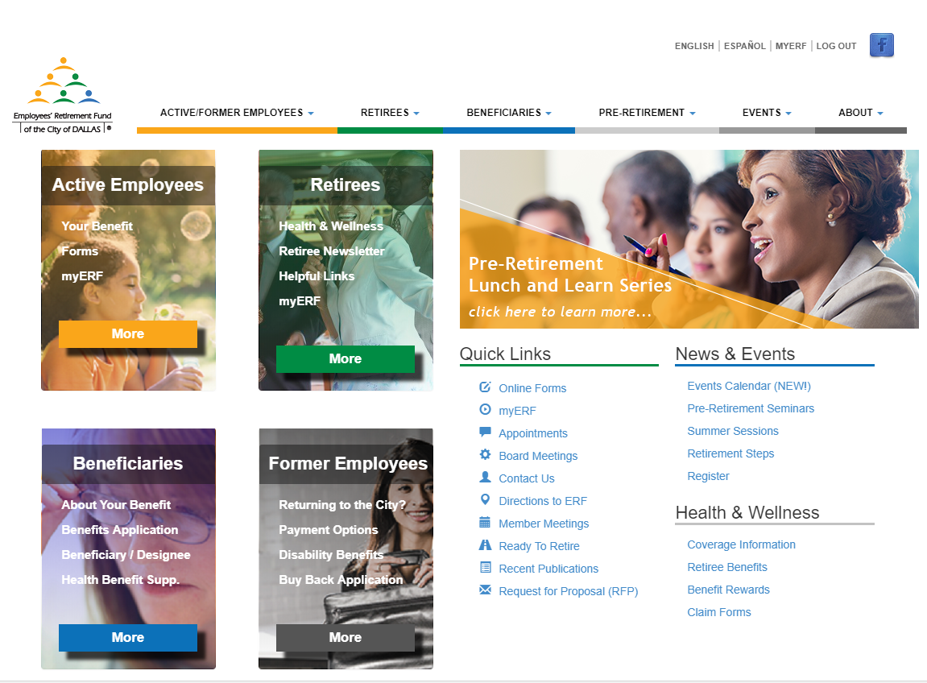

Slide 65
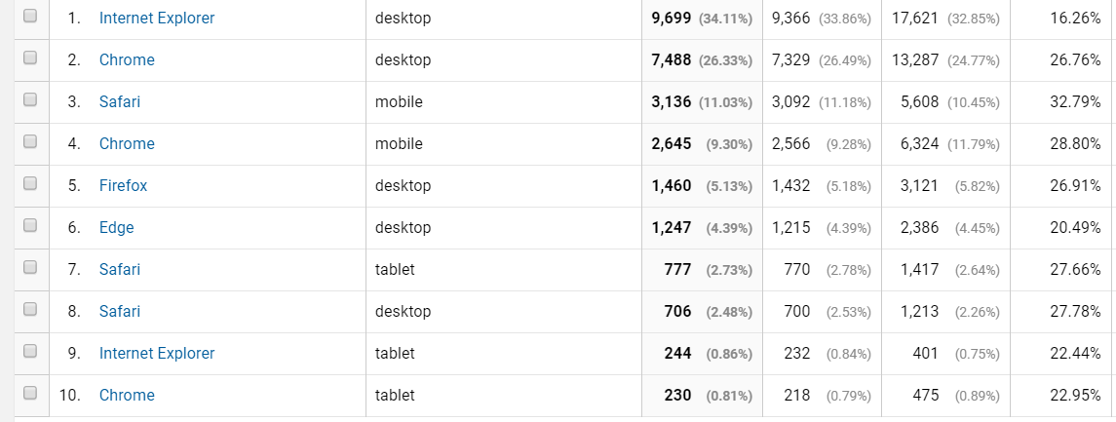
Browsers x Device Type

Slide 66
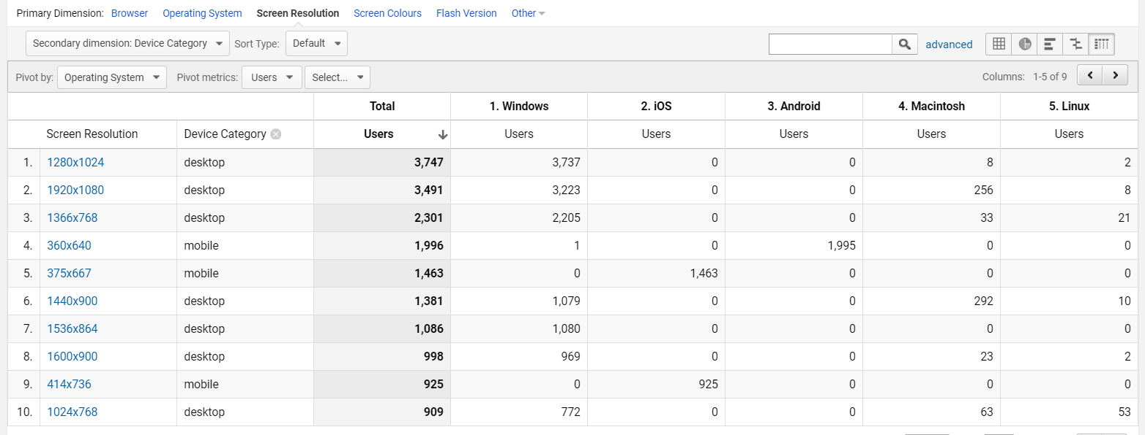
Screen Resolutions x Device x OS

Slide 67
Costs of Exclusion
Counselors end up on calls with members about base knowledge questions that could be answered by online resources.
Members end up frustrated and call the helpdesk when registration and login questions are unclear
Instead of resorting to the source of truth (our website), members sometimes disseminate incorrect information among each other
Members make decisions that can harm them financially in the long term

Slide 68
Benefits of Inclusive UX @ ERF
Members know that they have a resource they can go to if they have questions, 24 hours a day, 7 days a week, that is device agnostic
The self-service nature of the portal leaves them feeling empowered
Members generally make much better decisions for their futures
The portal frees counselors up to service issues of higher complexities and higher sensitivities (i.e. pensions in a divorce, helping beneficiaries when their loved ones pass away)
We are able to focus our energies on creating new products to solve more complex issues (pension calculator, pension budget planning, etc.)

Slide 69
As a local government agency, we’re required to do accessibility work by law,

Slide 70
but we technologists should be holding ourselves and our dev communities accountable for performing acts of inclusion, too

Slide 71
This is achievable. Likely not all at once, or even when you’re first starting out. But a good base allows room for expansion.

Slide 72
Resources!
My Google Analytics Template (was monthly, switching to quarterly)
CodePen.io, which is a great tool for rapidly prototyping user interfaces and testing them with less technical internal teammates
Responsive Web Design Toolkit: Hammering Websites Into Shape by Ken Tabor (book)
Seniors and UX Designing for Baby Boomers and Beyond by Mike Hill (video)

Slide 73
Keep in Touch
Twitter: @TearyneG
Email: Tearyne.Glover@gmail.com
Web: www.karenwithat.com (warning: the cobbler’s children have no shoes)
Drupal: NineLivesBlackCat (also on Steam)
Thanks!

