Slide 1


Drupal 8 Migration Strategy
August 2018
Notes:
Welcome to Drupal 8 Migration Strategy - How to be a resource for your team during a website migration.

Slide 2

Lynne Walsh
Senior Technical Content Strategist, CHIEF
lynne.walsh@agencychief.com
Notes:
But first, a little about myself. My name is Lynne Walsh, I am a Senior Technical Content Strategist at CHIEF. My specialty there is to help facilitate website migrations for Drupal 7, Drupal 8, and Wordpress sites. What that really means is that I do database analysis, and using those findings, make sure that the information structure that we build can handle the data that needs to live there. I work with clients to understand their needs, I work with strategists make sure their messaging recommendations align with the structure, and I work with developers to map and then QA content.
Before we get in the weeds of the presentation, I’d like to get an idea of who’s in the audience today. How many of you have successfully migrated a website in the past? How many of you are actively planning a website migration at the moment? When you first thought about your migration, how did you feel?

Slide 3

Notes:
Overwhelmed? Stressed? Confused? Me too!
I like to think of website migration as a sort of inexact science but some things are fundamental.
In this presentation, I want to break down my approach to website migration so you can walk away feeling like you have the perspective you need to get your arms around your migration.
We will talk through the types of website migration out there and how to approach mapping your migration piece by piece. We’ll go through the different methods of migration, and how to decide the best one so that you can team up with your developer and be confident in the data you’re discussing.
So take a breath, feel the feels, and let it go because….

Slide 4

Notes:
Because you got this.

Slide 5

Notes:
Migrating a website is like upgrading a piece of furniture…
Say you buy a new bookshelf from West Elm for your favorite books. Your current bookshelf, is made of that plywood stuff that bends over time, and has started to crack with all it’s sagging. You’re so excited for your new bookshelf and it’s time to move your beloved Harry Potter series to their new, sturdy, mahogany-scented home. But you realize some unexpected things. Your new bookshelf is 4 inches longer than your old shelf, and has some different sections to it - your books aren’t going to fit the same way they did before.
You realize you don’t need to keep your books in the same order as you used to! You used to keep your Harry Potter series on the lower shelf, out of view, in case the bending shelf broke, but now you can have them front and center with these super cute quidditch-themed bookends from etsy! Your old bookshelf certainly didn’t have room for those! Just in time for your quidditch team housewarming party with your friends.
Website migrations are a great way to refresh your content and get the right stuff in front of the right people, but it takes a bit of planning to get it right. So where do we start?

Slide 6
Where to Start
Inventory
Notes:
Where to Start
Looking at a migration as a whole can be overwhelming, so I like to take it one piece at a time starting with the inventory. I’m sure many of you are well aware of what an inventory is. But for those of you who don’t or who want a refresher, I’m going to run through the basics at a high level.

Slide 7
What is an inventory?
Number of:
urls (how many pages)
taxonomy terms (how they are organized)
site directories (how many site sections there are)
user accounts (who’s updating the site)
files and assets (pdfs, images, video etc.)
Like an inventory of a library, an inventory of a website includes:
Notes:
An inventory in a library is a full list of all the books, including the authors, the genres they fit in, and perhaps the reading level for each. Like an inventory of a library, an inventory of a website includes the count of urls included, taxonomy terms - or how they are organized, the directories - how many site sections are there, how many user accounts exist, how many files are present, etc.
As you think about your inventory, make sure to keep in mind anything the developer needs to move from one place to another. It’s this information that you and your developer will need to know so that you can create a mapping plan. But you can’t map to something without knowing where it’s coming from.
So let’s talk about how to compile your inventory.

Slide 8
Compiling Your Inventory
Database
Get a copy of your database and pull counts for:
Content Types
Nodes
Taxonomy
Images
Users
Site Crawl
Run a site crawl using automated site crawler to count:
Directories
File links
*Don’t forget to compare your results to look for Orphan Pages
Notes:
To compile an inventory, I like to focus on two things: the site database and a site crawl.
Looking at the Database, you can run queries to get counts of nodes, content types, taxonomy terms, images, user data, etc.
To run a site crawl, there are lots of different site crawlers you can use, my personal favorite is ScreamingFrog. Once you run a site crawl you can compile a list of all directories used, as well as all files being linked to.
Don’t forget to compare your database data to your crawl data too - this will uncover any orphan pages. These are pages that exist within your database but are not linked from the site and can be detrimental. Flag these to your team as well as your stakeholders to determine next steps.
Compiling this information and sharing it with your team, as well as with the stakeholders, will help you understand what you’re dealing with. Talking about these results will give you an idea of what’s a priority for the client, so you can focus your efforts on the most important parts first.
Once you know what you’re working with, you’re ready to compile your Migration Mapping Spreadsheet!

Slide 9

Map It
Notes:
Mapping It…
Anything your developer will need to move, should be clearly communicated to ensure that it has a clearly defined place in the new database. For our team, we have found spreadsheets to help a lot in this area.
An effective mapping document should easily display the source fields from the source database (or CSV, or Feed) and then also what it needs to become in the new database. The more detail that is included in this document, the easier it will be for the developer to script it.
So let’s discuss putting a mapping spreadsheet together.

Slide 10
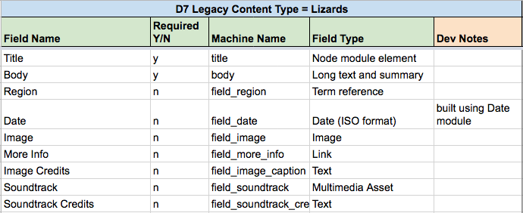
Take it By Type
Notes:
Using the data you gathered from your inventory, start with the content types one at a time. In this example, I’m pulling the fields for a content type called Lizards. As you can see, I’ve pulled the field names associated to my Lizards content type into a spreadsheet. Each field should include as many details as possible including the field label, the machine name, and the type of field it is - specifically, the type of field it is. Is it a text field, is it a wysiwig, is it an image field, location field.
The type of field is especially important for the developer to know about since certain fields in Drupal 7 are treated differently in Drupal 8. Images, for example may need to be stored using Media which is now part of Drupal 8 CORE. Pointing these fields out can potentially mean your developer will need to spend some extra time mapping that data. By pulling this information out into a easily readable spreadsheet, you are flagging these items early for your dev - something they will appreciate.
Now let’s take a look at a sample mapping spreadsheet filled out.

Slide 11
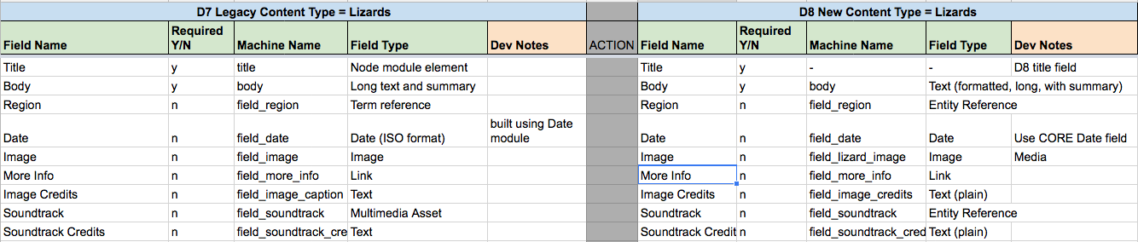
Mapping Spreadsheets
Notes:
In this example mapping document, I pulled the fields for our Lizards content type in a legacy database on the left side. Also included is a column for notes, where i can flag certain fields that may need extra care out to my developer, like File Attachments, and Date. On the right side, I’ve written in the fields in the NEW database that I want the legacy data to map into.
Using this spreadsheet, my developer can now see clearly the “from” and “to” aspects of the migration and can get started scripting without having to spend much time in the database themselves.
Similar spreadsheets can be used for mapping fields associated with Taxonomy terms, User data, etc.

Slide 12

You don’t need to be a developer to put this spreadsheet together.
You just need to know where to look.
Notes:
The point here is that you don’t need to be a developer to put this spreadsheet together. You just need to know where to look.

Slide 13
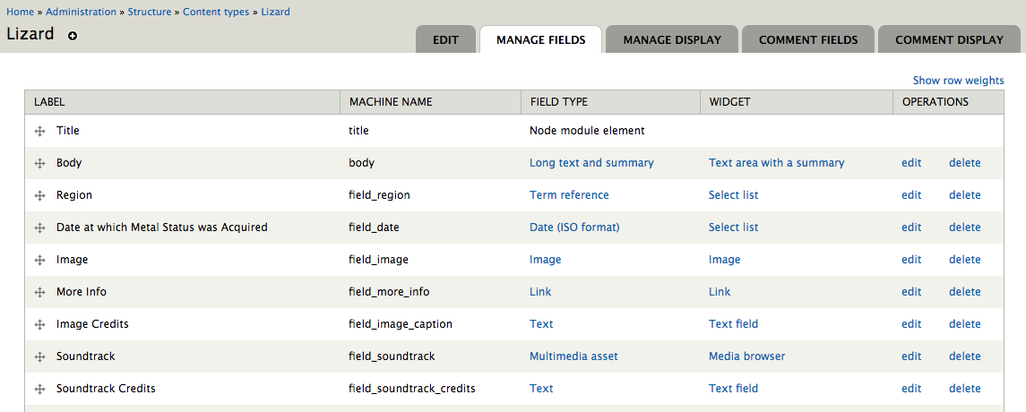
Where to Look
Notes:
Here is an example of a fields list associated to a content type called “Lizards” in a drupal 7 site.
After logging in, navigate to the Manage Fields page for your content type and here, youll see, your spreadsheet is pretty much laid out for you.

Slide 14

Migration Types
Notes:
Now we’ve discussed Inventories and Mapping, but let’s talk a bit about deciding How to migrate your data.
There are a number of different types of migration options. Many times the option will depend on the resourcing available on the team, other times, it will depend on the content type you’re working with and the frequency at which it’s updated.
So let’s dig into these...

Slide 15
4 Types of Migration Sources
Scripted Migration
Manual Migration
1
Database to Database
3
CSV to Database
4
Good ol’
Copy & Paste
2
API to Database
Notes:
While migration by definition is moving data from source to another, different sources can can mean different ways to migrate.
You can move data from a database to another database, you can move data into a database via API, you can move data stored within a csv into a database. These are all different forms of scripted migration.
And then there’s always manual migration, good ol’ copy and paste - possibly the most time consuming, but if strategically planned, can actually save time in the long run.

Slide 16
Scripted Migration
1
Database to Database
Move data from
one database into another,
using coded files that direct where the data should go and how.
2
*API to Database
*can also be applied
to API migrations
Notes:
The database to database scripted migration method, is generally the most obvious first choice when planning a migration. Your developer will write a script, generally a YAML file, which maps data from a legacy database into new fields in a new database. These scripts can be rolled forwards and backwards to update content consistently several times over the course of a project.
You can migrate from any type of database - Drupal 6, Drupal 7, even other types of databases outside of Drupal like Wordpress and home-made databases. The complexity of the script that the developer will need to write does increase as the database is less and less similar to Drupal, but as long as the “Source” and “To” fields are properly mapped, anything can be migrated this way.
An API migration is mapped similarly, except using a different source, like a JSON or XML, but the same concepts apply.
This method is great when you have a migration that needs to run multiple times. I worked on a project for a client who needed to constantly update their site as we were developing their new one. So as we were redesigning their site on our side, every other week, they’d send us the new database from their legacy site which we would run the migration script on, and assuming the fields hadn’t changed, our dev site would update accordingly. This allowed us to have a short content freeze when it came time to go live.
Now, a drawback to this method, is that any time a field on the legacy database or in the new database is changed, the migration script needs to be updated as well.
Also, if any content is being edited or added in the dev site and the migration script is run again, it will overwrite any content updates that have been made.

Slide 17
Scripted Migration
Move data from
a CSV into a database,
using coded files that direct where the data should go and how.
3
CSV to Database
Notes:
Another way to script a migration is by CSV. In this method, data is stored within a CSV file which acts as your ‘source’. Similar to a database migration, the data is still scripted via YAML file, however instead of mapping fields to fields, you map columns within the CSV to fields in the new database.
The nice thing about CSV migrations is that you can curate your content within the csv before migrating it into the new database. This is helpful when you have a set number of pages that are not updated frequently, and you want to edit them all in one place before migrating them. Take leadership bios for example. You have a website with 10 bios for the leadership board, and they all want to edit their bios before you migrate them. Instead of relying on them to update their content in the database you can pull all body content out of the database, export it as a csv, and send that to them. They can make their changes in a spreadsheet, sometimes a little easier to work with, and send it back to you. You can then migrate data from that csv into the database.
Before you decide to migrate this way though, be sure to look at how often the content on the legacy site is updated. This method is better when you have content that is not updated frequently - because you are not really able to roll csv migrations back and forth, unless you want the added step of editing the csv source file every time.
This method is also a good idea when you have a developer with limited bandwidth. The script for a csv migration is generally shorter, and simpler, and therefore faster to put together and run.

Slide 18
Manual Migration
Move data by hand.
Copy and Paste,
directly into the wysiwyg in the new site.
4
Good ol’ Copy & Paste
Notes:
Finally, the method which requires the least amount of developer support is manual migration. In my experience, manual migration is a part of every possible migration - be it a large, complex site, or a small, simple site- which is why it’s included in this presentation. This method comes with lots of pros and cons but at the end of the day, no amount of automation comes close to the human touch.
My personal, general rule of thumb is if the number of pages is less than 100, manually migrate.
Manual migration is often a better option for building landing pages and custom one-off pages that have unique layouts, formats, and functionality.
When your developer has a lot on their plate - consider helping them out and migrate the data by hand.
If you find yourself with more strategists than devs, you can divide and conquer.

Slide 19
How to Choose?
Database to Database (scripted)
Manual
(good ol’ copy and paste)
CSV to Database (scripted)
Notes:
So how do you choose? There are pros and cons to each individual migration method, but ultimately, the best decision will involve a bit of each.
How much of each?

Slide 20
One Section at a Time
To determine how to approach a migration, take it content type by content type.
Notes:
Take it one section at a time.
Organizing your migration plan by content type allows you to make decisions step by step, and check off each type of content one by one.

Slide 21
Examples
Blog content types typically have:
Consistent fields;
Consistent functionality;
High number of nodes.
Therefore, the fastest option is
scripting the blog content type.
Page content types typically have:
Small amount of content;
Varying layout;
Varying functionality.
Therefore, the best option is to migrate page content by hand.
Notes:
Say we start with a blog content type and we see that the fields are consistent and there’s a high number of them. Scripting will probably be your best bet here. On the other hand a Page content type, generally used as landing pages, generally low in number, and varying with functionality. Maybe assign this part to the content strategists to migrate manually.
In some cases, you may even see places where you can start as other site decisions are still being made. In one of my previous projects, we spent a lot of time going back and forth with the client to get a specific section of their site approved. But we knew off the bat that they wanted to keep their blogs. So while the content strategists were working to get the site section in question approved, we moved forward with migrating the blogs and were able to get ahead of our timeline for a bit.
The takeaway here it to look back at your inventory, consider each content type, and make decisions from there.

Slide 22

Resourcing
Think about your team.
Notes:
Our last section is on Resourcing.
When you’re planning your migration, a lot of different factors need to be considered. We’ve talked about looking at the content in your inventory and thinking about what specifically you need to migrate, then you’re thinking about how you’re going to migrate. Are you going to script it? Are you going to migrate it manually by hand?
Understanding your team can help you determine the best migration method.

Slide 23

Consider The Players
Developer Heavy and limited strategist support. Consider scripting.
Developer support is present but limited. Rely on your strategists to manually migrate so your dev can spend their time where they are needed most.
Diverse Team. Lots of strategists, copy editors, UX, and developers. Consider splitting work up between people to divide and conquer.
Who is on your Team?
Notes:
One way to think about choosing a migration method is based on the people on your team.
Do you have a fully fledged team of backend developers with previous experience in migration? Do you have a team of devs who’s bandwidth is split between several projects? Do you have one developer and a large team of content strategists with bandwidth to spare?
Resourcing can have a large effect on the type of migration for each content type. Look at each person on your team and think about migrating from there.
If your team is Developer Heavy with limited strategist support, consider scripting.
If Developer support is present but limited. Rely on your strategists to handle some manual migration so your dev can spend their time where they are needed most.
If you have Diverse Team with lot’s of strategists, copy editors, UX, and developers. Consider splitting work up between people to divide and conquer.
But if you do decide to migrate content manually, be sure to...

Slide 24

Consider the Rate
How fast can your team manually migrate.
Notes:
Consider the rate at which your team can manually migrate.
If your team is considering a good amount of manual migration. Consider the rate at which they can work and do the math.
If you have 5 strategists, and one developer, divide and conquer. Have your strategists manually migrate the 100 bios. Maybe you have them work on that while your dev works on scripting the 500 blogs, and factor it all in to your timeline.
If you have a team of fully fledged devs, be sure to talk to them about whether they can...

Slide 25
Recycle Your Code
Scripts are written field by field and this code can be reused.
Talk to your developers about the code they’ve used before and avoid having to start from scratch.
Notes:
Recycle their code. A developer’s history with migration can save the team time.
Has your team scripted a migration before? That’s great!
Scripts are written field by field, so if you have a dev who has written a script for that type of field before, chances are they won’t need to start from scratch. Talk to your developers about the migration scripts they have run in the past, it may save time if field-specific scripts can be reused.

Slide 26
Talk to Your Developer
Types of fields in each content type. Plain text vs. formatted text (like a WYSIWYG).
Make sure there is a migration plan for any unique functionality (calendars, video, php code, things brought in via iframe).
How taxonomy used on the site.
Run through the results of the inventory & make note of the following:
Notes:
And finally, talk to your developer - and run through the inventory with them.
Note the types of fields in each content type. Scripting a plain text field is different than scripting a formatted text field (or a WYSIWYG) - so call that out to your dev.
Note the unique functionality. As a technical content strategist, it is my job to find this stuff and put it together. Since I’m the one in the weeds, I’m the one who finds the funky functional elements like calendars, video, and php code, that can challenge a migration…. and it is my job to flag it.
Note how the content is organized with taxonomy. Taxonomy can use to organize, as well as structure content, so make sure there’s a plan to either pull that functionality over to the new site, or not.
Discussing these elements as a team will ensure that everyone is on the same page, and that you are choosing the best migration method for your project.

Slide 27

Questions?

Slide 28
Helpful Resources
Migration Mapping Spreadsheet
Screaming Frog site crawler
CHIEF Blog:
Migration Strategy: Using Your Inventory
*ongoing blog series on migration

