Slide 1
✔
✋
Voters
Pledge
[click to begin]

Slide 2
Goals
Manage D8 sites with Composer.
Select production-ready modules.
Explore H5P interactive content.
Learn the basics of non-expert theming.
“What does a Do-It-Yourself Site Builder need to know to work with Drupal 8?”

Slide 3
Outline for DIY Drupal 8
Know Your Requirements
Find the Modules You Need
Prototyping, Media, Views, Theming
D8 Considerations
Slack, Meetups, Issue Queues
Install with Composer
Introduction to H5P Interactive Content
Voters Pledge is presented as a case study.

Slide 4
Initial Requirements & First Draft

Slide 5
Initial Requirements
Content
Static Content
Articles
Interactive content
Difficulty levels
Users
Groups
Quiz Events
Lectures & Classes
Individuals
Topical browsing
Level-up challenges
Pledged community
Smartphone
Presentation
Videos
Cards
Desktop
Remote Users
Quizzes
Know your Content and User needs first! Presentation comes last.

Slide 6
Development Stages
Need Now
Data Model
About, Purpose
Demo Interactive Content
Logo, Theme simple & smart
Guest Access
SSL, Privacy, CloudFlare
Need Soon
Lessons, Events
Donate
User Logins, Student Scoring
Social Media Interaction
As Business Requires
Content Moderation
Import/Export
Expand Content Scope
Articles
Static content
Improve Theming
Data Analytics, Research
Gaming, Apps
Wiki
Upgrade Hosting as Needed
Stay Simple. Quick Launch to test business model, then deliver first program.

Slide 7
Data Model Vision
Interactive Content (Quizzes)
Crowd Sourced Content
Wiki
Articles
Media links
Content Moderation
Challenge Questions
Tag by topic, level, region
Content Moderation
Static Content
Users & Groups
Reference Material
Participants
Organizations
Export Content
School Curricula
Voters Challenge Events
Monthly Meetups
Daily Quiz

Slide 8
Users & Groups
Groups
Users
Hierarchy
Colleges/Universities
Type of Institutions
College / University
K-12 School
Retirement Home
Attributes
Address
Political Affiliation (if any)
Organizers
Host Teams, Coordinators
Content Moderators
Review for Accuracy
Review for Bias
Event Participants
Belong to Institutions?
Registered to Vote?
Party affiliation?
Student Organizations, Departments

Slide 9
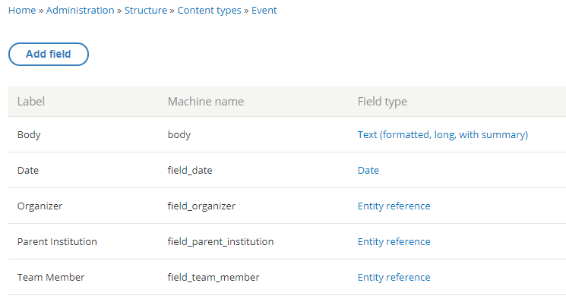
Events
Host (Parent Institution)
Date/Time
Team Members
Participating Groups (Institutions)

Slide 10
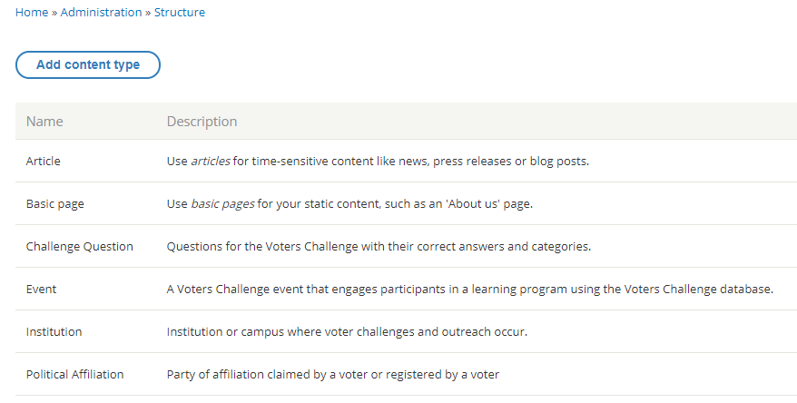
Editorial Content Types
Article
  Posts, announcements
Challenge Question
  Question
  Correct, Incorrect Answers
  Tags: Difficulty, Topic
Event
  Calendar
  Participants (Groups, Individuals)

Slide 11
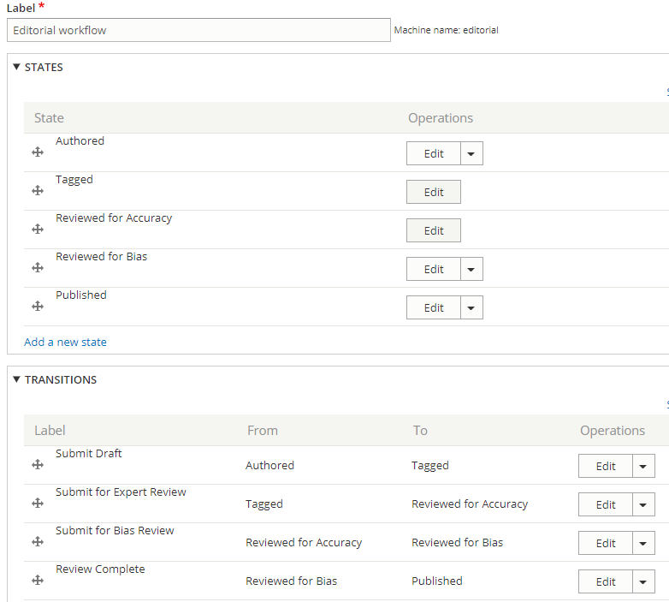
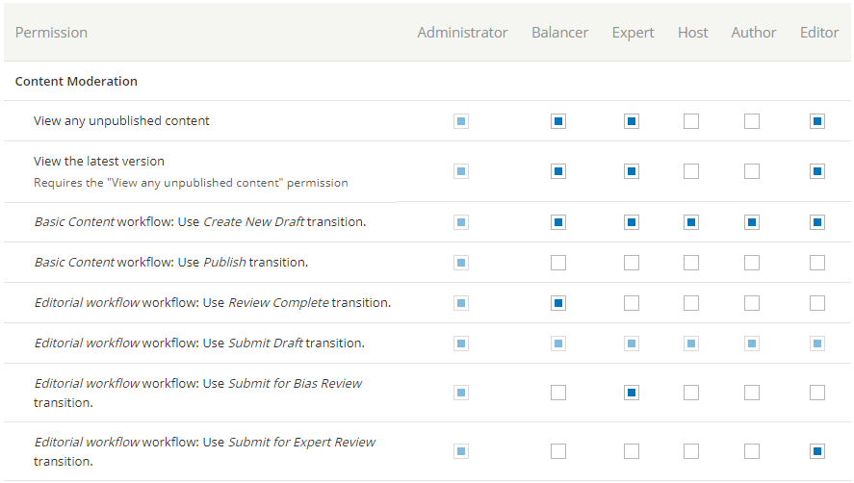
Content Moderation/Workflow

Slide 12
Install with Composer

Slide 13
Drupal 7 Installation
Install Options
  One-click install (Softaculous)
  Drush
  Distributions
Extend
  Modules
    UI or Drush
  Libraries
    Drush or manually
Upgrades
  Core
    Drush
    Softaculous (when it’s ready)
    Manual
  Modules
    Recommended releases in UI
    Dev releases by Drush or manual

Slide 14
D8 with Composer
Why Composer?
  Core, modules declare dependencies in .json file
  Composer calculates compatible versions
Example
  Require HOTDOG BEER
    Get HOTDOG, BUN, BEER, GLASS
  Require BEER:12oz
    GLASS cannot be less than 12oz
    GLASS can upgrade to higher
Using Composer
  composer.json defines paths
  Modules, themes use different path than UI-installed
    [d8]/modules/contrib/…
    [d8]/themes/contrib/…
  Libraries cannot install from UI
  Learn commands
    why/why-not
    require/remove
    outdated

Slide 15
Find the Modules You Need (Demo H5P)

Slide 16
Challenge Question (Quiz) Type
Not ready for D8
  Quiz Module (D7)
Opigno LMS
  Can manage full curricula
    But comes with bloat
    Some old modules still in alpha
  D8 version still in alpha
    Will use new H5P libraries instead of porting D7 modules
H5P Interactive Content
  39 libraries of content type
    Multiple choice, fill-in-the-blank, etc.
  Delivered in iFrame
  Attractively themed, modern feel
  Responsive

Slide 17
Is it Drupal 8 Ready?
Drupal 7 Ready
Quiz, Other Modules
Opigno LMS
Drupal 8 Ready
Huge Footprint
H5P
39 Libraries
Styled
Import / Export
Simple DIY
Opigno (alpha)
Rebuilding with H5P

Slide 18
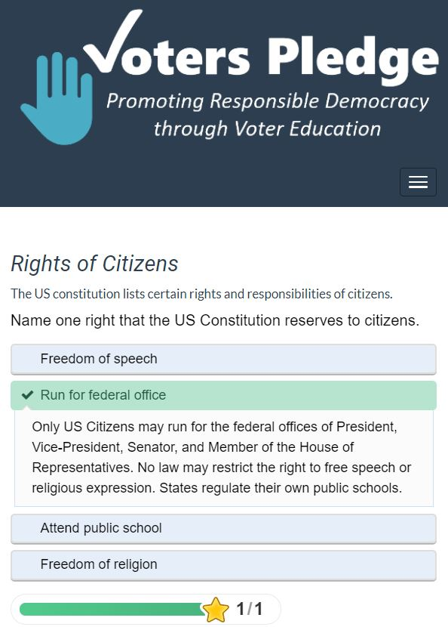
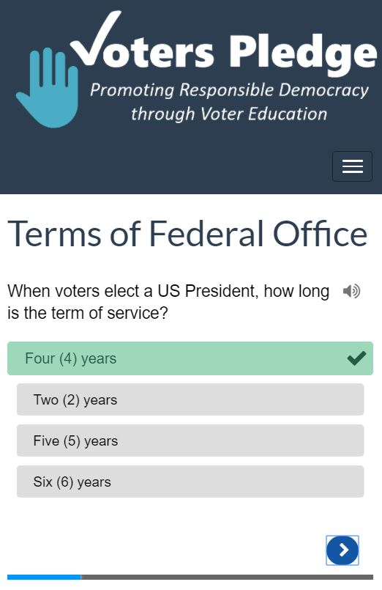
H5P Interactive Content
H5P.org
  Open source
  39+ Library Types
  Regularly updated
  Displays in iFrame
  Attractively styled, no theming required

Slide 19
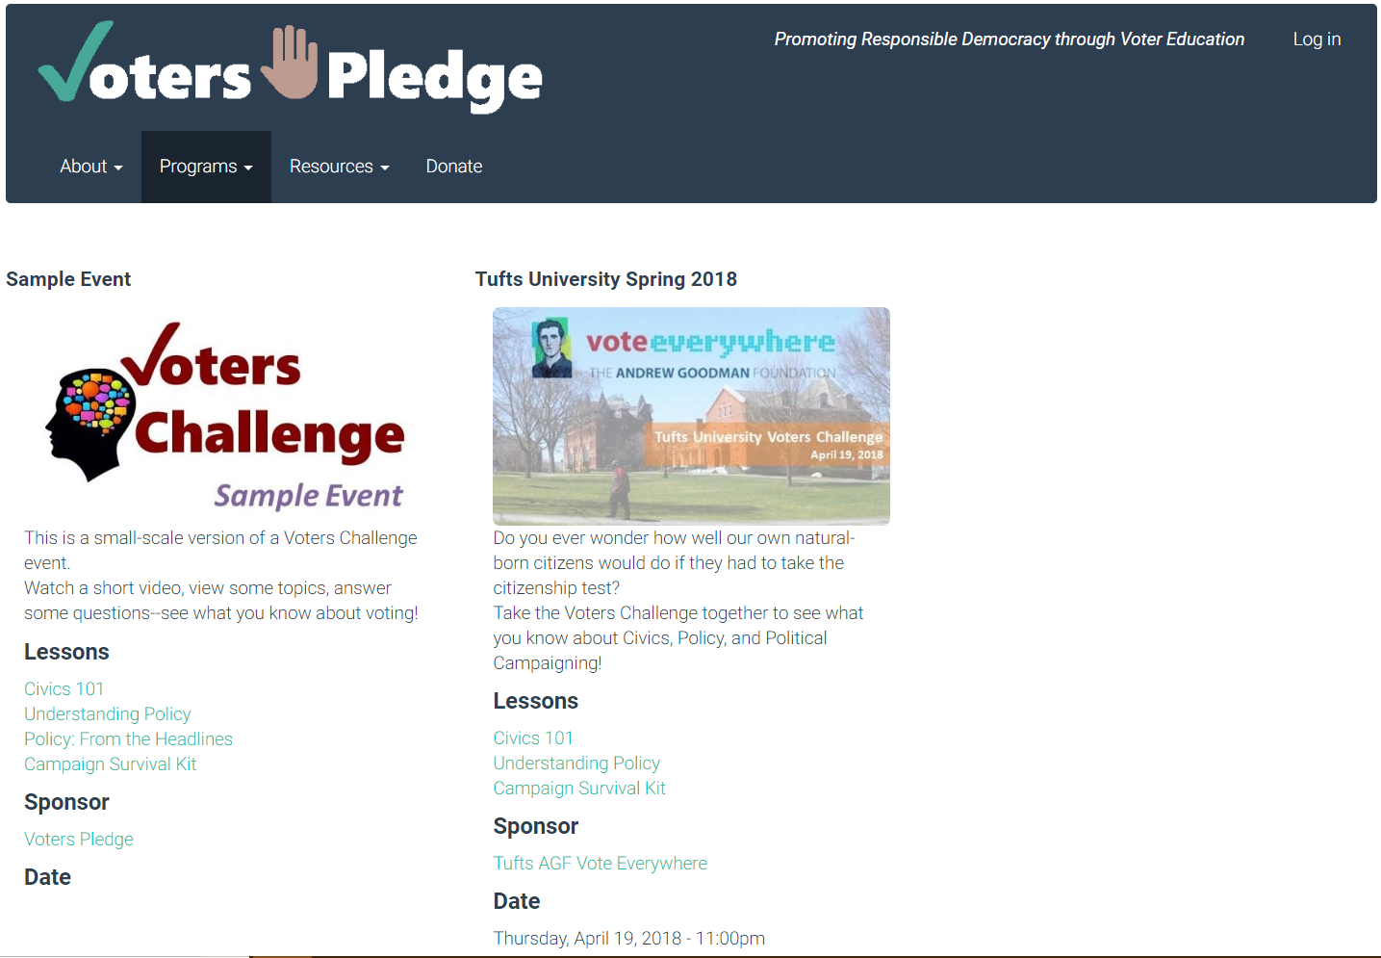
Content Features
H5P Interactive Content
  Open source libraries
  Replaces Quiz modules
Taxonomies
  Useful for weight sorting
  Challenging for parent terms
Views
  Become expert in Views!!!!!

Slide 20
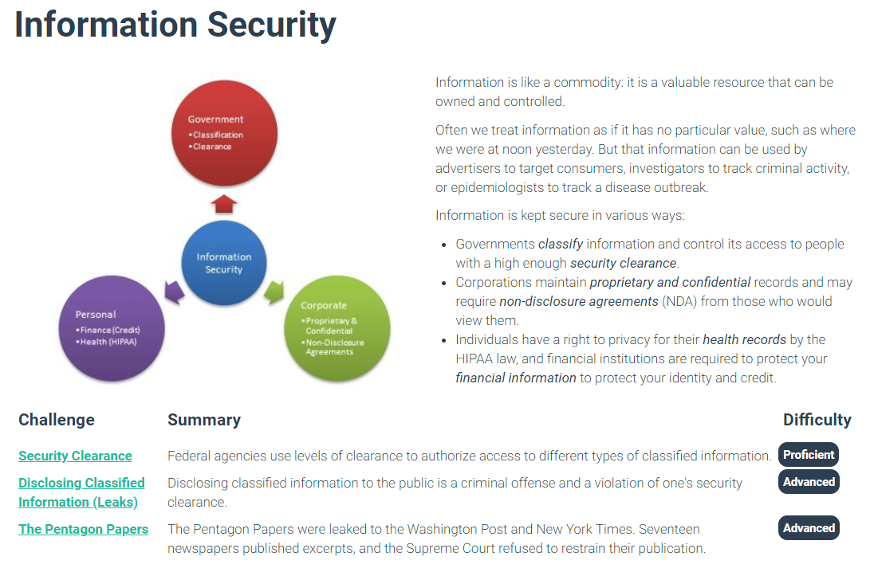
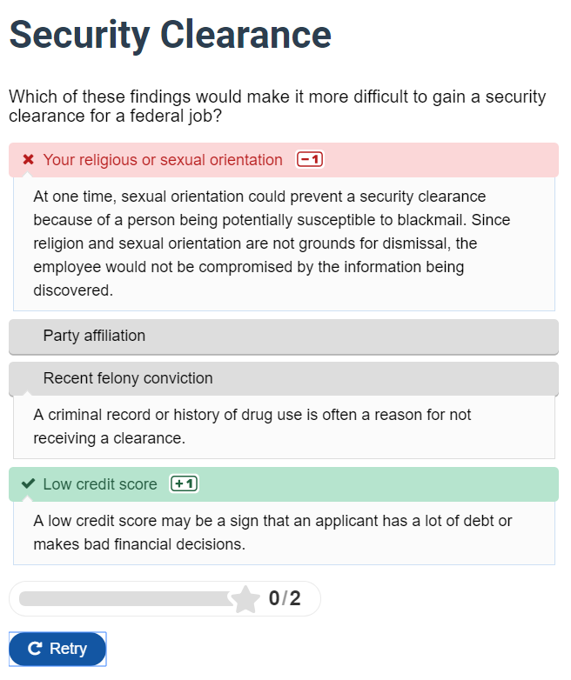
Sample Challenge Content

Slide 21
Build, Theme, Go Live, Repeat

Slide 22
Configuration: Production & Test
Use 2 Environments
  Production environment (PROD) for your last “safe” build
  Staging environment (TEST) for development, tweaks
  Periodically commit changes to Production
Use Configuration Management
  Both sites share a Site ID (hash)
  UI includes Configuration Sync to import/export configuration
  Config Split allows configuration differences between PROD & TEST

Slide 23
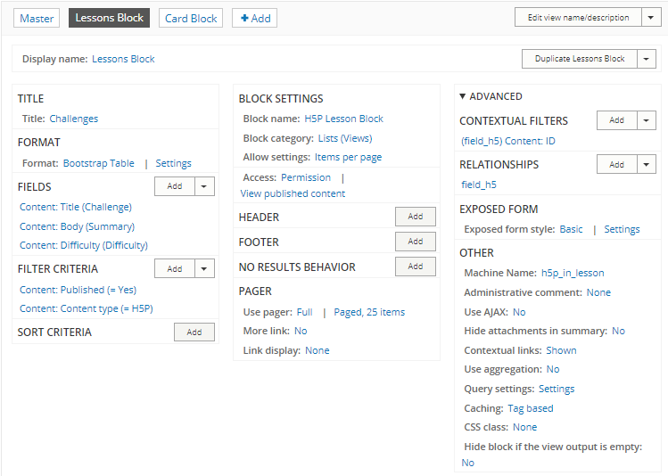
Views
Logical arrangement of Content
  Select by Type, Taxonomy, etc.
  Entity References link other items
  Link fields to other content
  Filters
    Exposed to User
    Contextual based on the page ID, User ID, etc.
  Group, Sort, Page
Static content (About, Privacy, Contact, etc.) may not need Views

Slide 24
Development Cycles
DIY is so agile…
  Remember your requirements
  Prioritize your needs
    Security, SSL,
    Static content first
    Simple theme
  Future-proof your own work
    Avoid optional modules with multiple dependencies
    Be able to backtrack
    Stay inside the box

Slide 25
Theming
Bootstrap out of the box
  Simple start on 3.3
    CDN
    Flatly skin
  Views Bootstrap
    Layouts with Bootstrap selectors
    Panels only from other modules
      Deprecated in 4.0 anyway
Advanced Bootstrap
  Add CSS Classes in Views
    list-unstyled, panel-heading, etc.
    Find where classes go in Views
  Subtheme
    Learn regions, classes
    Begin to customize
    Bootstrap tool to pick LESS variables
      Brand color as primary; padding
    Bootswatch skin
      Read overrides.css.min with pretty-print

Slide 26
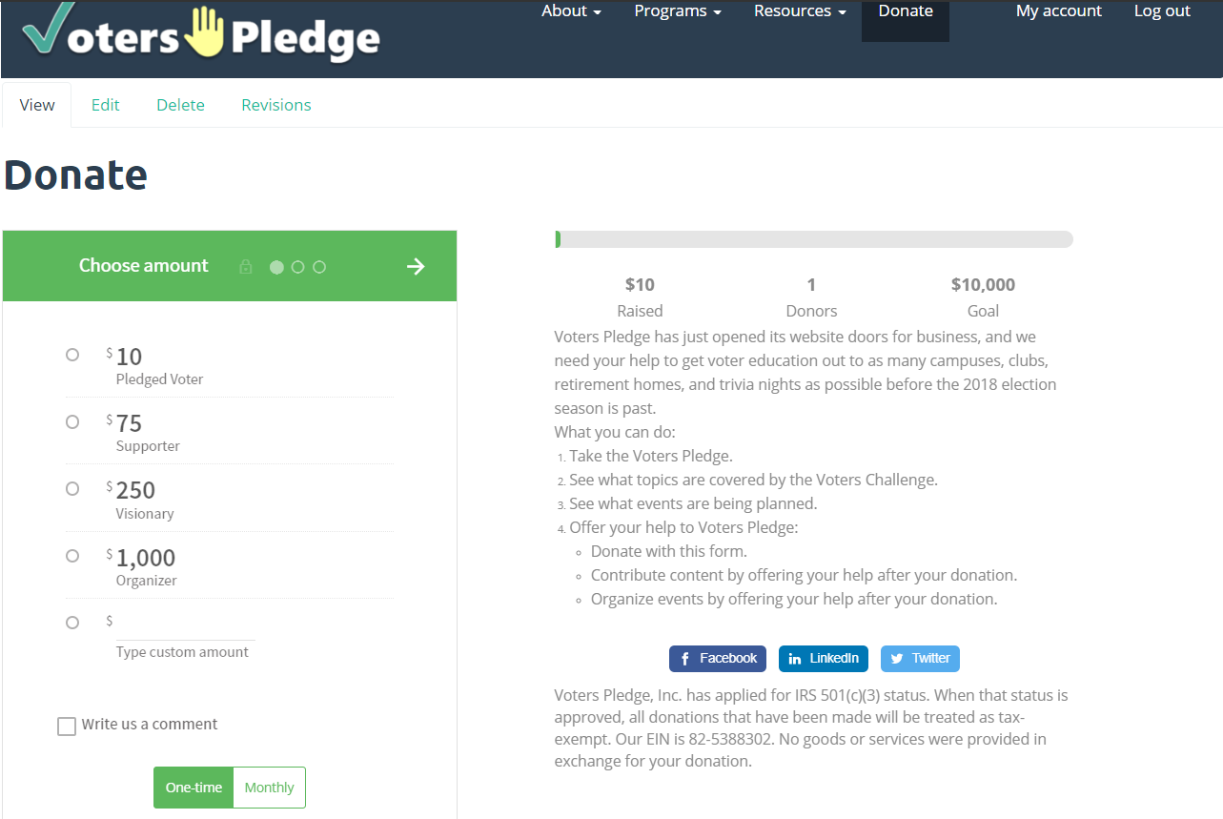
Other Enhancements
Donate
  Donorbox integration
    Add campaign at Donorbox
    Paste script as Basic Page
  Stripe for payment
Privacy Policy
Trademarks, Copyright

Slide 27
Lessons Learned
Start with Composer
  You’ll need it for something
Media in Core
  Transitioning;
  Entity browsing in development
  KISS until 8.6 (simple…)
Theming
  Learn modern design language
  Bootstrap, Material Design
Beware Dependency Pits
  Paragraphs needs ER Revisions
  Entity Browsers for Media
Staging environment
  Synched with Production
  Don’t want whole developer platform, package, etc.
Theme customizations
  Waiting for Bootstrap 4
    Especially for Cards
  Colors to replace Bootswatch Skin

Slide 28
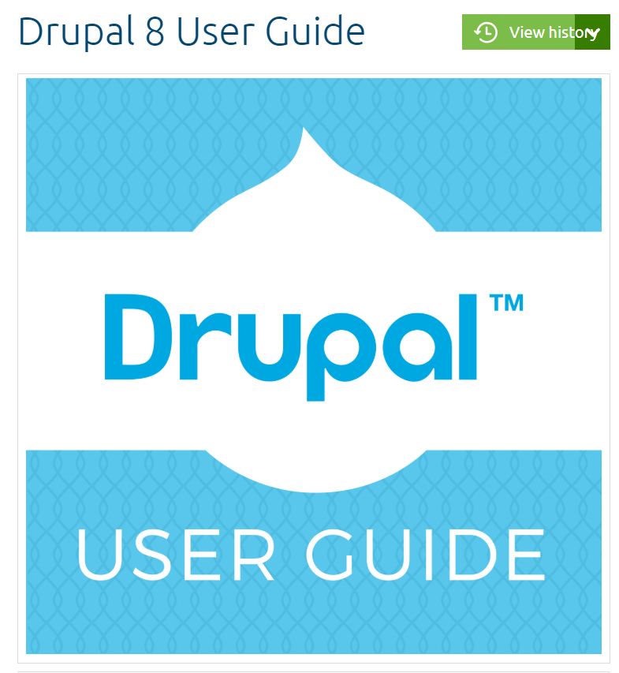
This is What a Site Builder Can Do with Drupal 8.

