Slide 1


(In)organic Groups
Washington, DC - August, 2018
The D8 Group module
Drupal GovCon 2018

Slide 2


Scot Self
Senior Development Engineer
Live and work remotely from Birmingham, AL
Married ~19 yr to Daphne, 2 kids (Juniper - 10, Tristan - 8, homeschooled)
BA from Alabama, MA from NYU (in French!)
Amateur musician, huge fan of Phish and bluegrass
@scotself on Twitter, IRC and drupal.org
~10 yrs with Drupal, front-end, site-building
Semi-frequent module contributor
Notes:
In addition to USGS, NASA is one of our highest profile federal clients. One of our more exciting recent successes with NASA was providing a live Drupal-based experience for watching the solar eclipse which turned out to be the largest online event in internet history! Our NASA team provided a cloud infrastructure for the Drupal platform that supported over 1.19 billion requests over 5 hours.

Slide 3

Notes:
In addition to USGS, NASA is one of our highest profile federal clients. One of our more exciting recent successes with NASA was providing a live Drupal-based experience for watching the solar eclipse which turned out to be the largest online event in internet history! Our NASA team provided a cloud infrastructure for the Drupal platform that supported over 1.19 billion requests over 5 hours.

Slide 4

Full disclosure
Or why I chose this topic
Work extensively with OG on USGS.gov for 2+ yr
Explore ideas for possible D8 migration on the horizon
Not an expert on either module
Will not have all the answers, but I’ll try or get back to you!
Not an
OG v. Group deathmatch
Notes:
Not because I am an expert with this module, but more as an excuse to start actually trying to build with Group

Slide 5
Q:
Why (or Why not) Organic Groups (OG)?
Notes:
OG doesn’t have a viable D8 release. It may never have one.
Group has a D7 release but the real work has been done in D8.

Slide 6
What do both OG and Group do well?
Concept of a group and somehow relate content types to them
Grant membership to a group
Provide custom roles and permissions per group type, separate from Drupal permissions
Make few assumptions about your use case
https://www.drupalcampatlanta.com/2017/sessions/taxonomy-organic-groups

Slide 7
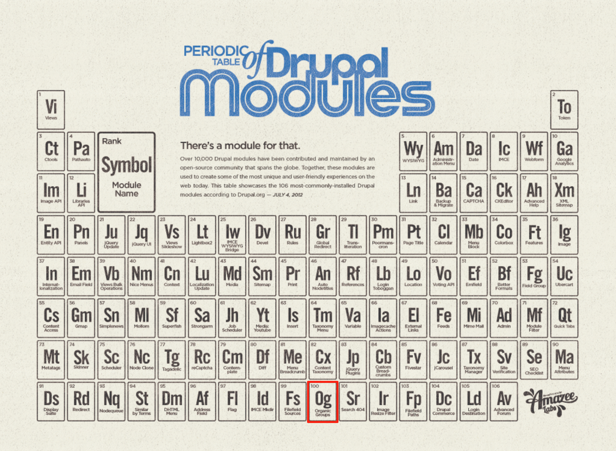
Organic Groups (D7) - Pro
Widely-adopted (~26k+ sites on d.o)
Decent DX/API, few assumptions, lots of easy functions to call (e.g., og_group, og_ungroup)
Full-featured
- Roles/permissions
(w/overrides) per group
- Views integration (default blocks)
- Field access
- Group registration
LOTS of additional contrib modules (OG taxonomy, OG menu, OG workbench moderation, OG scald, etc)
106 Most downloaded modules for D7 Credit: Amazee Labs

Slide 8
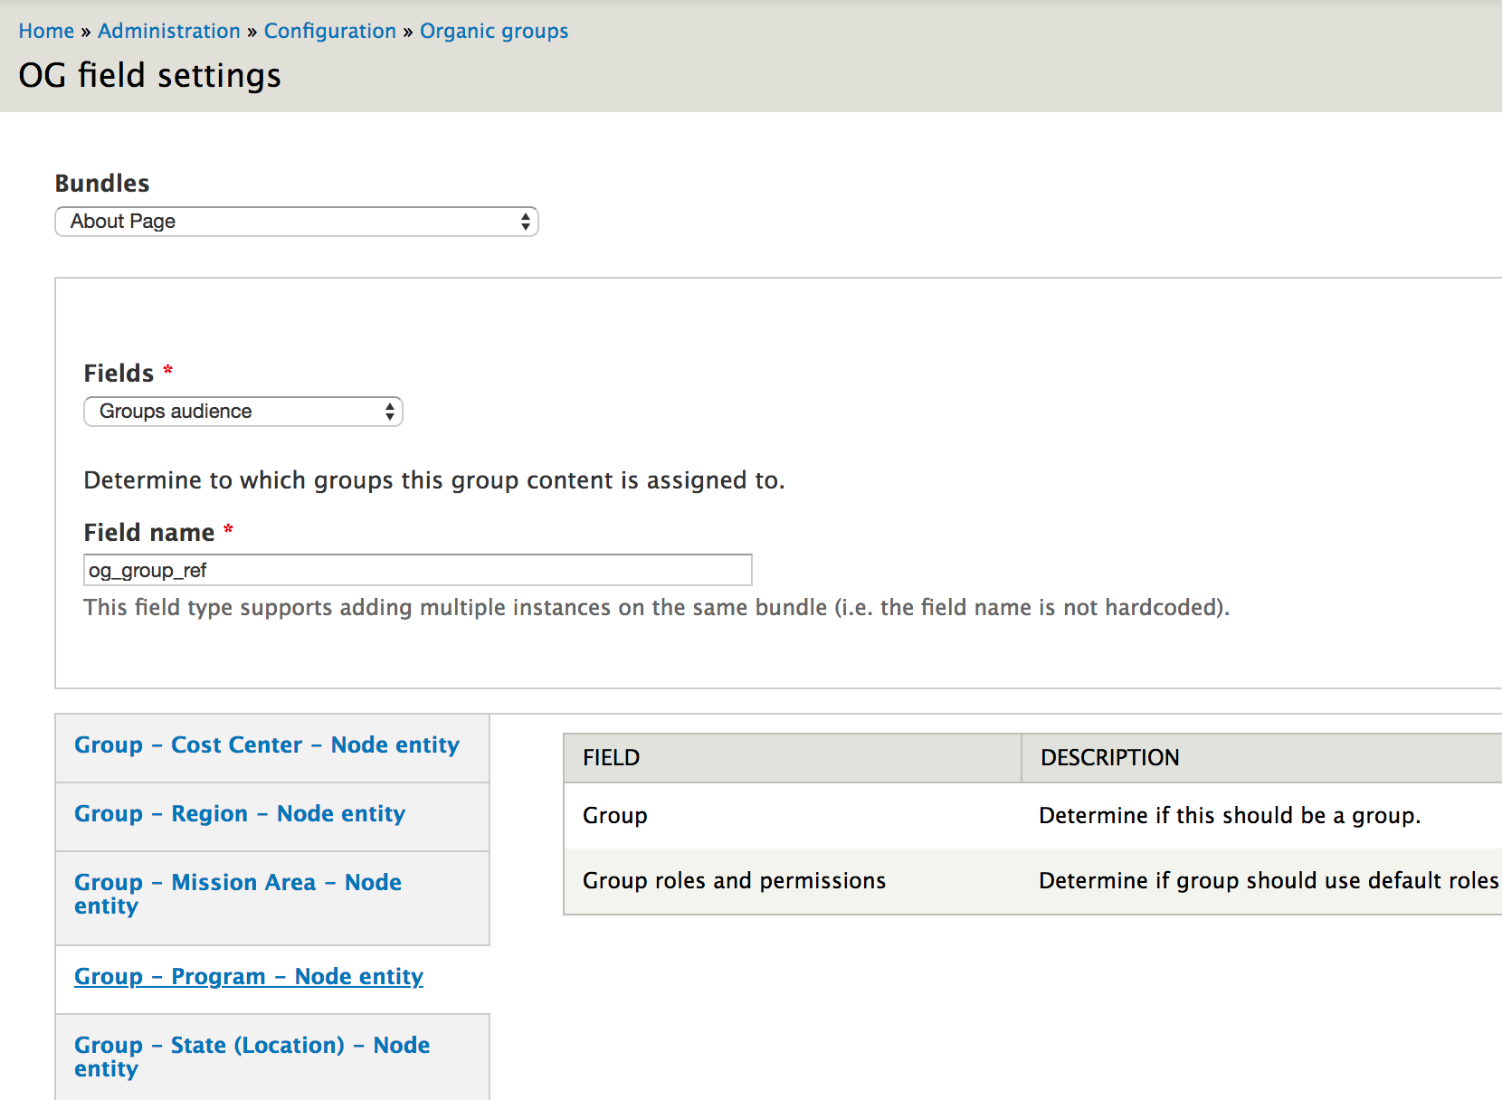
Organic Groups (D7) - Con
Relies on an entity reference field to keep track of the ties between a group (node, term, ...) and its content (node, term, user, ...) - @amitaibu himself, “abusing the Field API” *
Confusing UI/UX for site-builders, reusing existing entities
- Fields on entities for all aspects
- Config per “group type” (re-used entity) separate from group entity’s config
D8 - recently picked up momentum again
* DrupalCon Baltimore 2017

Slide 9
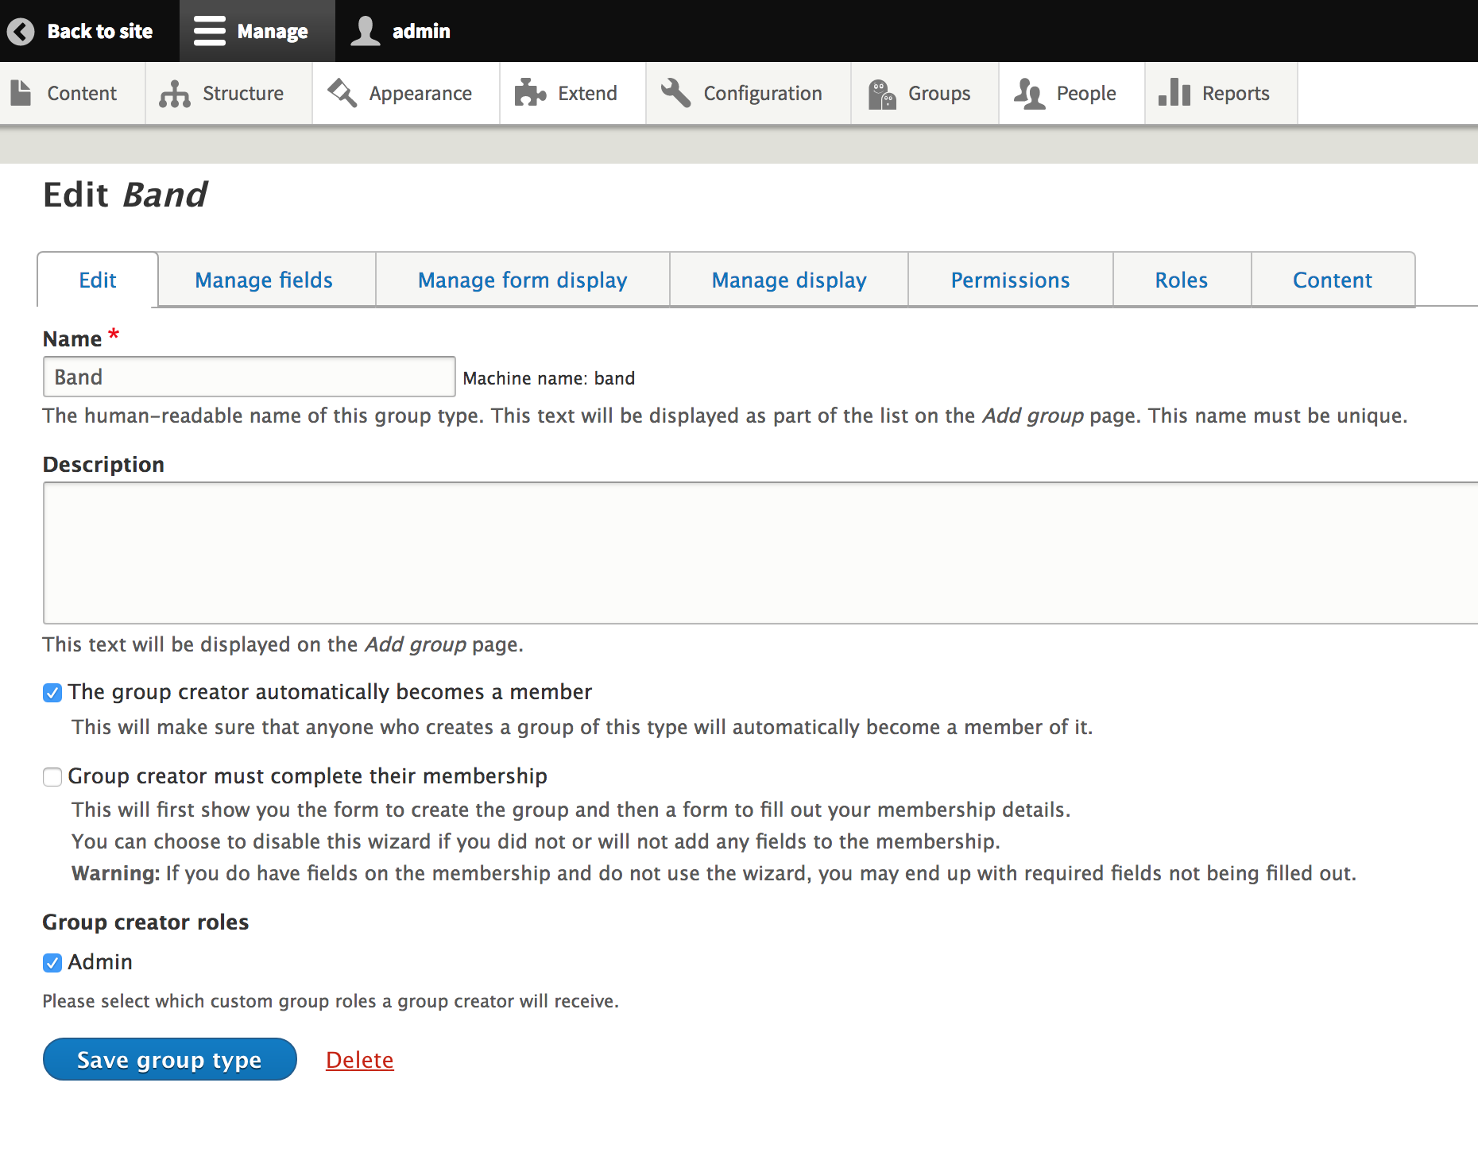
Group (D8) - Pro
Group = fieldable entity; 1st-class object
Awesome DX/API - OO, class-based everywhere it can be, easy to extend and integrate other entity types
Separate membership/relationship entities
A single Group can’t override Group type-level settings - a Group type will always function how you set them up

Slide 10
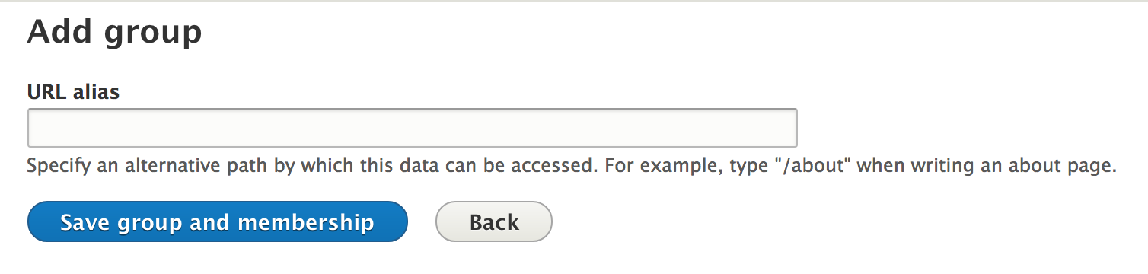
Group (D8) - Con
UX still needs some love; some config leads to unexpected/confusing results
Nomenclature, wording needs improvement
Missing integration with config entities (menus, taxonomy, webforms)
https://www.drupal.org/project/group/issues/2797793
A single Group can’t override group type settings - your Groups can only function how you set them up
Example:
Group type requires creator to also complete membership in that Group (can be turned off).
No fields on the membership entity by default, so this makes no sense.
Page title still says “Add group” when in reality what you’re doing is filling out the “Group membership” entity form, which links the User entity to the Group.

Slide 11

Nodes (article)
Nodes (basic page)
Nodes (any CT)
“Group node (article)”
(relationship entity)
“Group node (basic page)”
(relationship entity)
“Group node (any CT)”
(relationship entity)
Group
Group membership
Credit: Mike Anello (@ultimike)
Users

Slide 12
Q: Why (or Why not) Organic Groups (OG)?
A:
D7 - Organic Groups (OG)
D8 - Group
Notes:
OG doesn’t have a viable D8 release. It may never have one.
Group has a D7 release but the real work has been done in D8.

Slide 13
DEMO TIME!

Slide 14
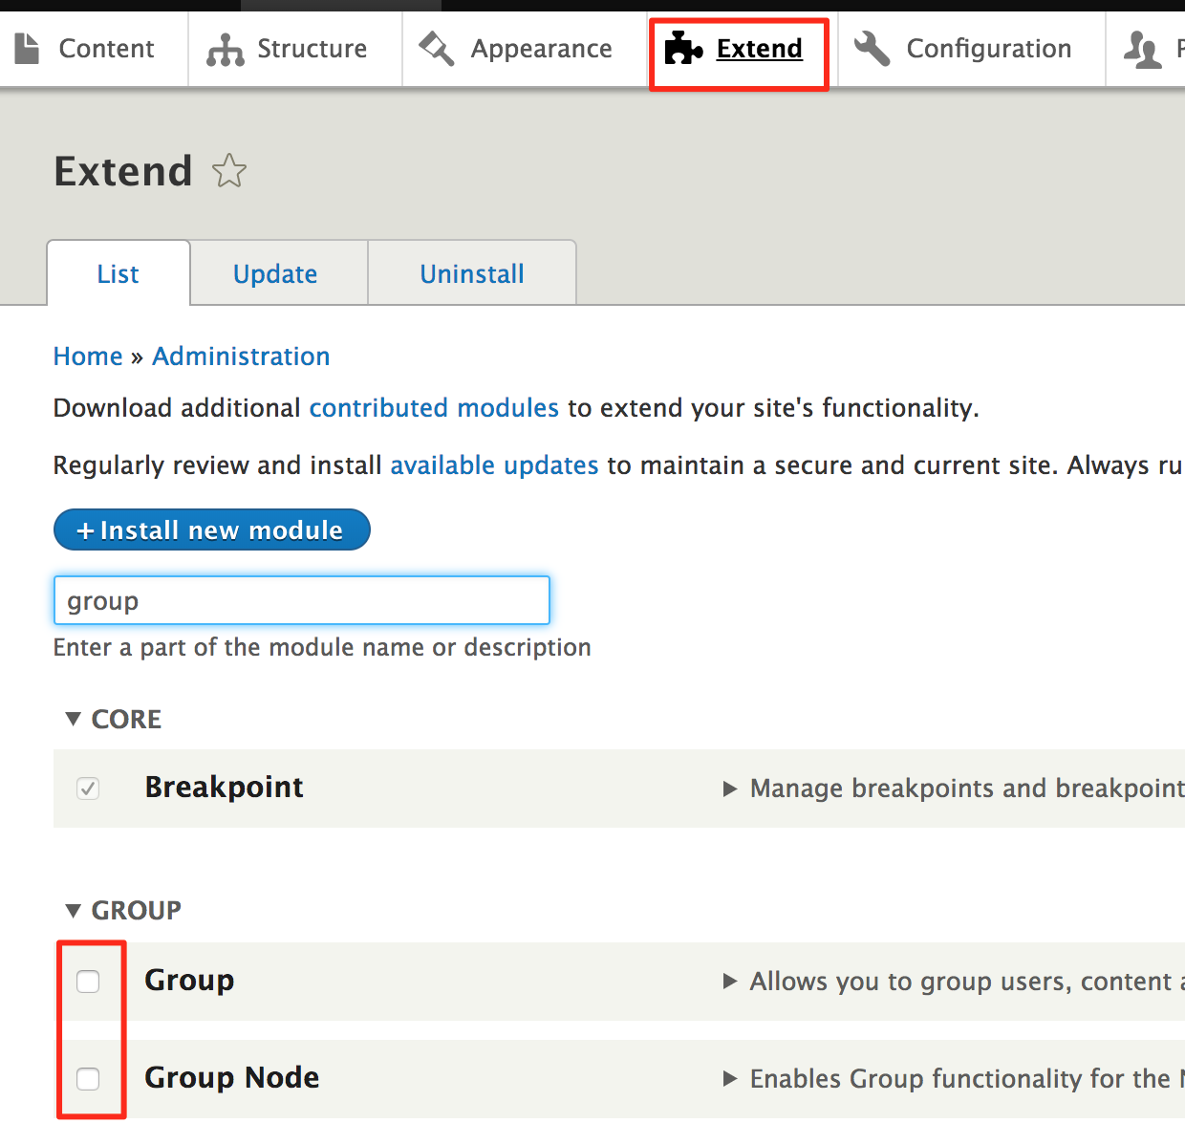
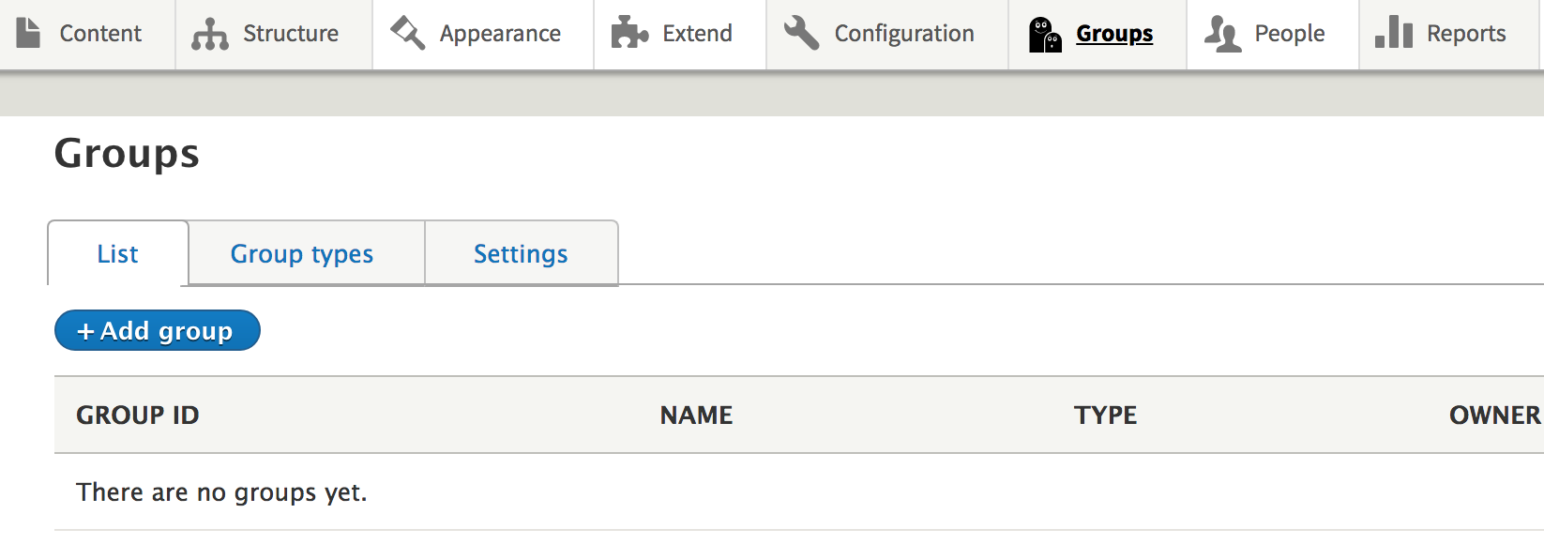
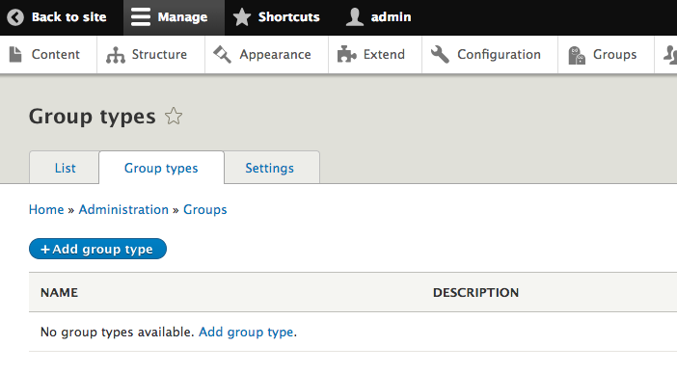
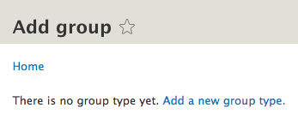

Slide 15
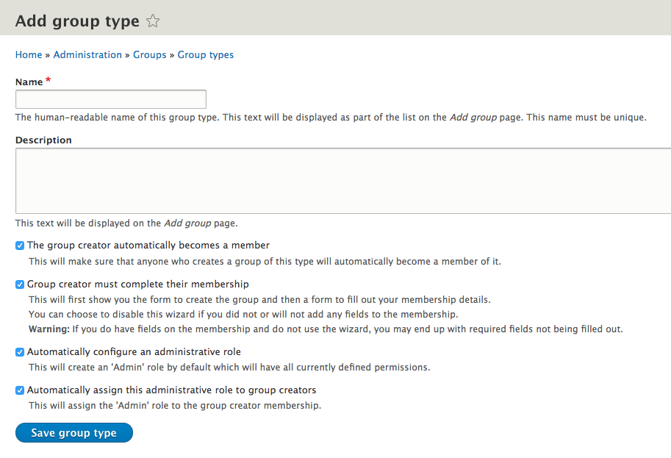



Group creator automatically member
Group creator must complete membership
Automatically configure admin role
Automatically assign admin role to creator
Submit button text on new group form affected by combination of the above
Uncheck if membership has no fields

Slide 16
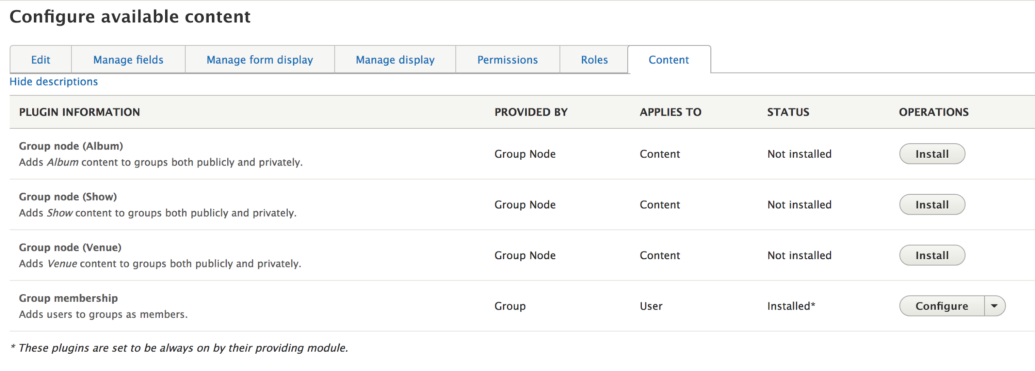
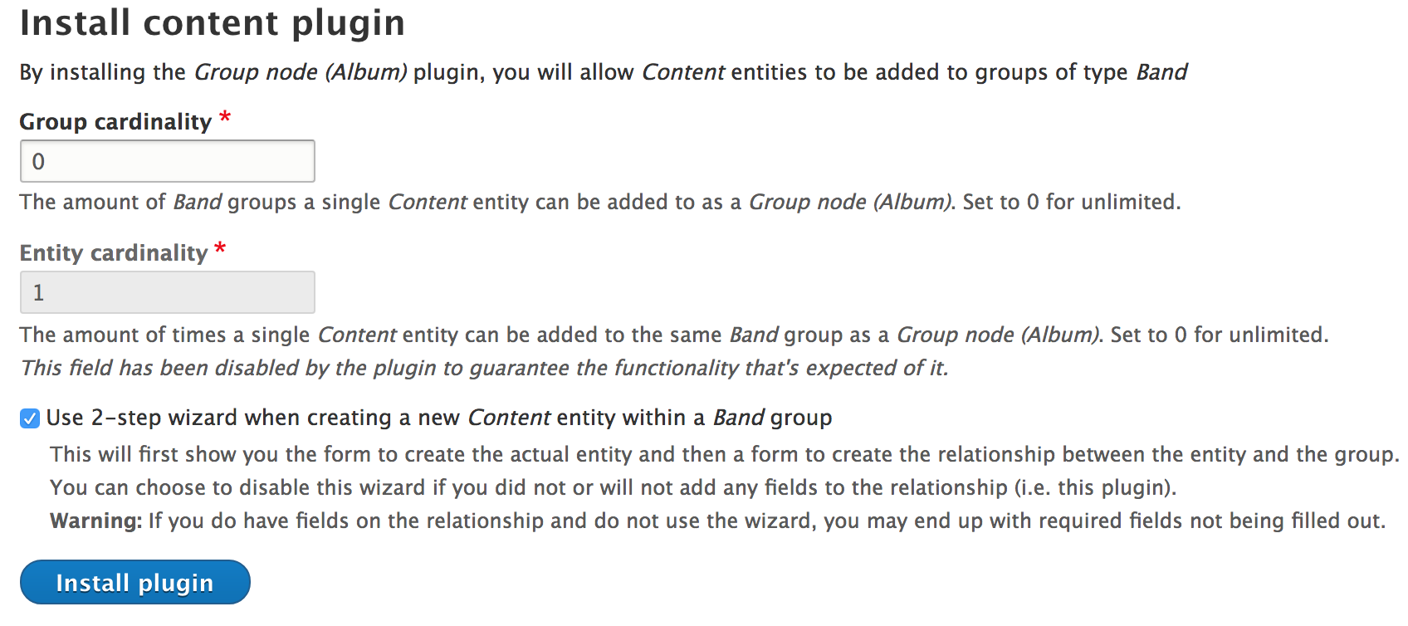
Must “install” the plugin for each entity type which you want to be available as “Group content” for this Group type.
“Install” the plugin
=
Create a relationship entity type (“Group Content” entity)
2-step wizard = extra step after creating content to edit the relationship entity between them. If no fields are needed on the relationship entity, uncheck 2-step wizard (s/b default?).
Group membership plugin cannot be removed but is fully fieldable for adding additional info to users’ membership.

Slide 17
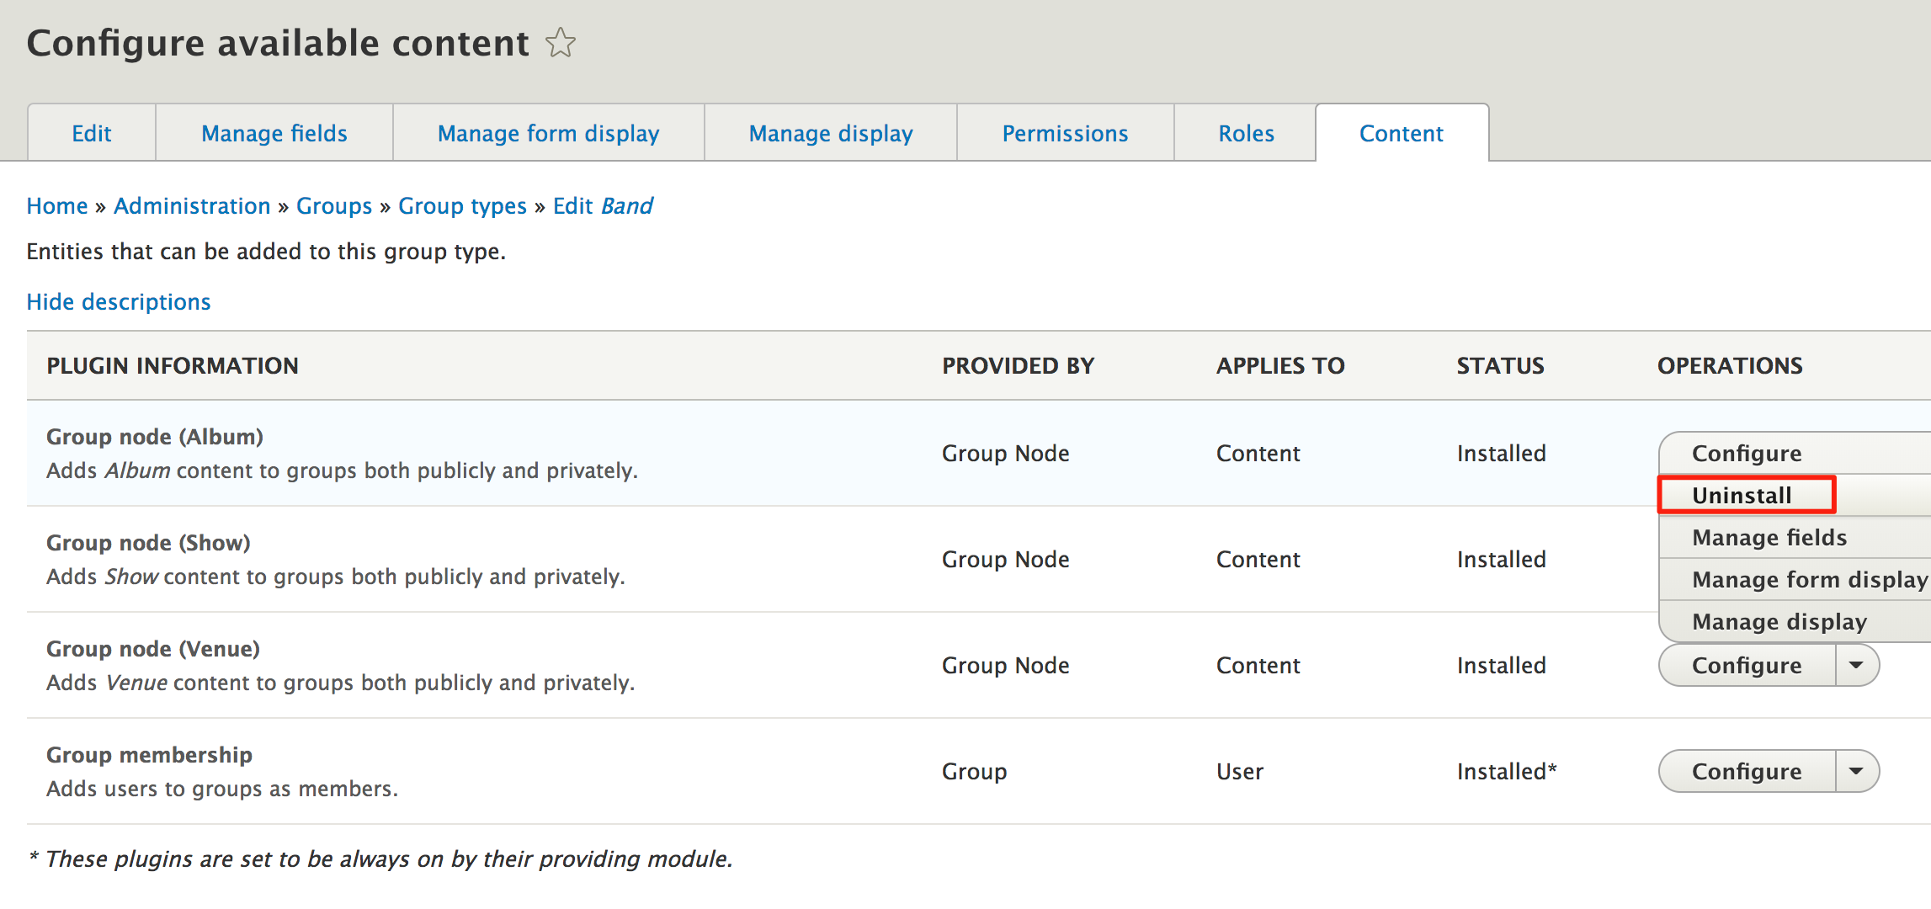
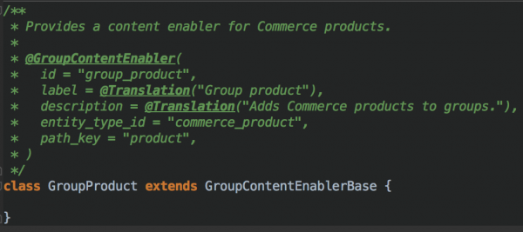
Each relationship entity type is fieldable, describing the entity’s relationship to the Group.
Content which is related to a Group is subject to its rules
BUT
not all entities of a particular type are necessarily related to a Group.
Uninstalling a plugin
=
Delete relationship entity
Related entities remain intact if relationship entity is removed.
Example of extending the GroupContentEnablerBase class to allow Commerce Product types to be Group Content

Slide 18
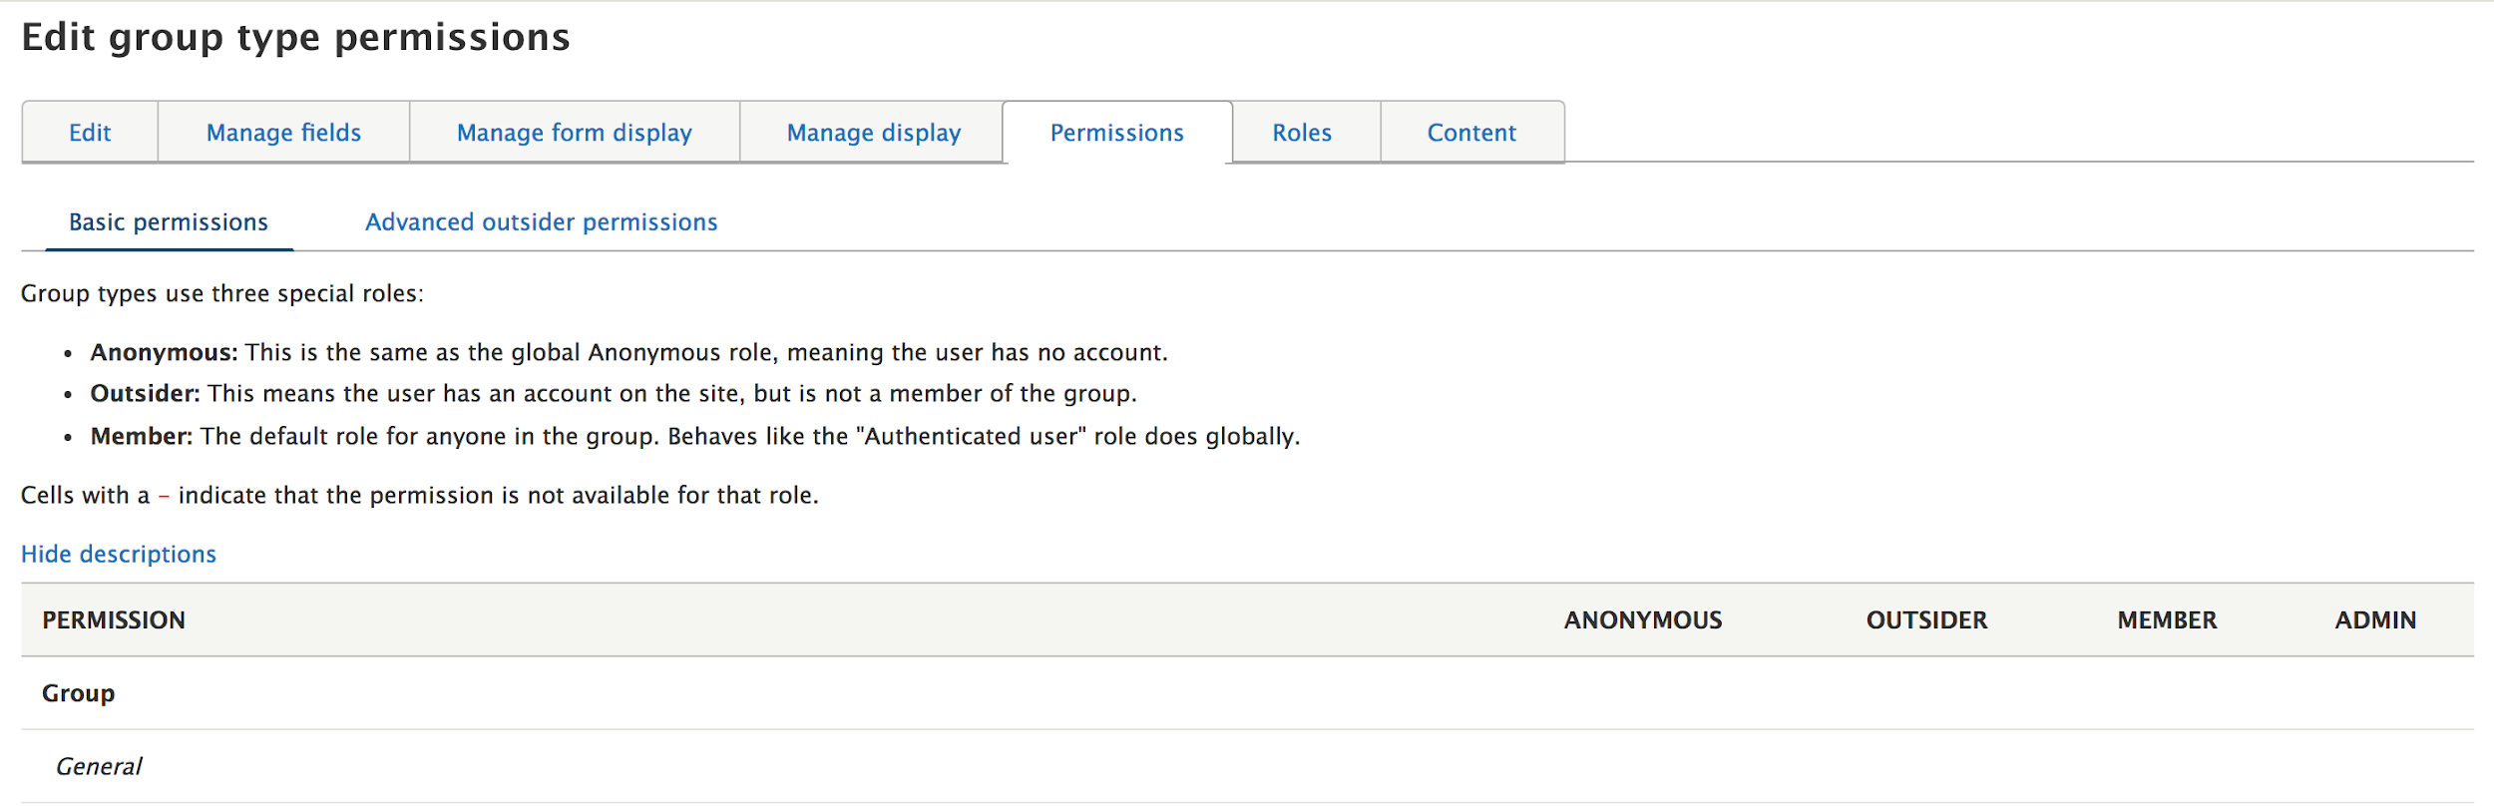
Create additional (Group type-specific) roles as needed, tweak permissions:
Allow all to view group - how else can they find/join the Group?
Don’t allow admin to leave Group?
Add, Delete any/own, Edit any/own, View and View unpublished for each CT enabled as “Group content” as well as the intermediary relationship entity

Slide 19
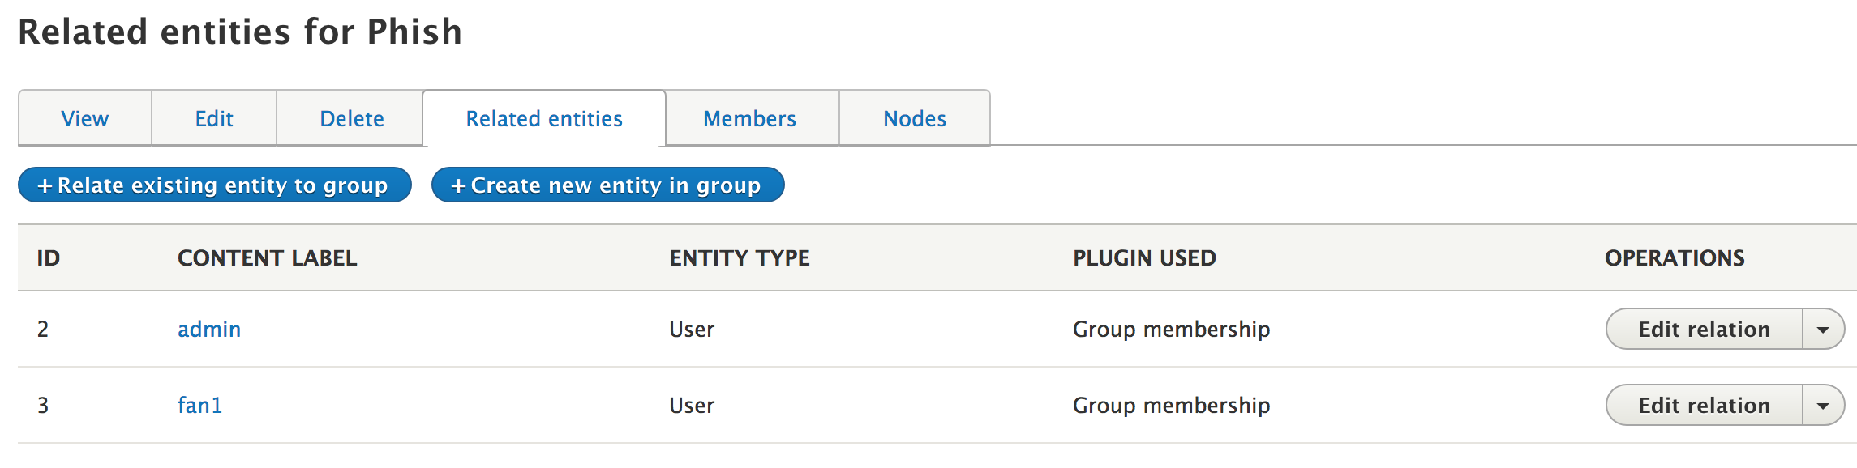
Related entities tab = ALL entities related to the Group, including users
Relate existing entity
  Link existing users or content if plugin for that content type has been installed (i.e. there is a relationship entity defined between the Group type and the CT)
  If no CTs have been installed as Group content, takes directly to the “Add member” form
Create new entity
  Add a new node and its relationship entity in 1 (or 2) steps for CTs which have a relationship entity defined
  Cannot add members from here

Slide 20
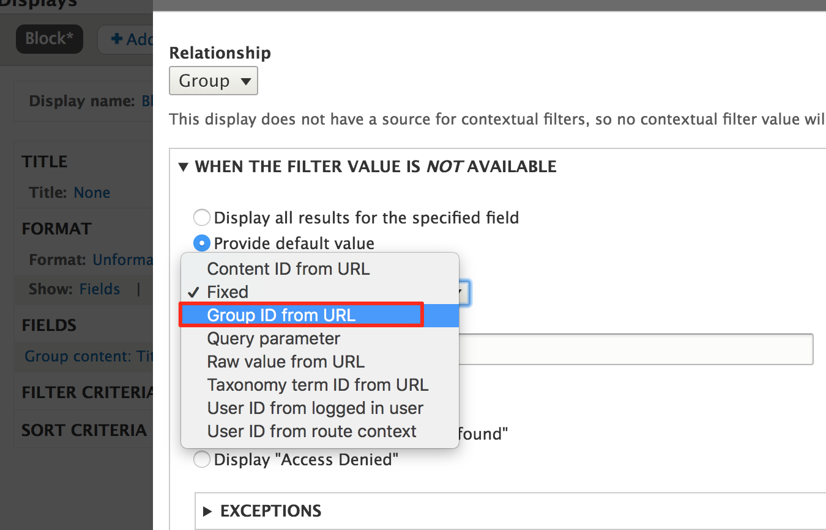
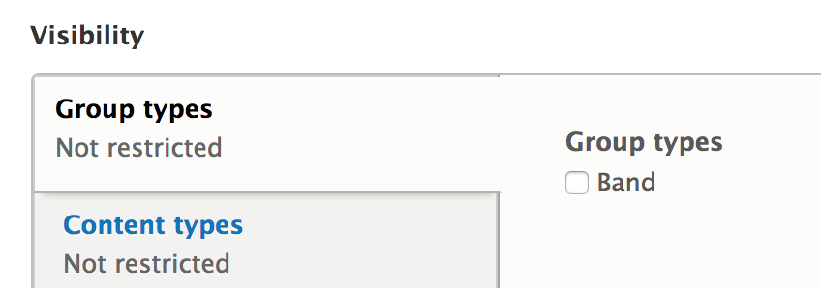
Start from “Group Content”
Contextual filter - default value option
  Not working for blocks?
Raw Value from URL
  group/[group_id]/content/[entity_id]
Blocks - visibility restriction by Group type

Slide 21
Brainstorm
What else could we do/add?
Flag - favorite albums, bands, venues, shows
Comments - notifications when favorites are commented on
Voting/rating - sorting/filtering by most popular
All the Views - most popular bands, venues, albums (using flag/voting/rating), recent shows, etc.
Moderation/workflows
  Group owner must approve submitted content
  Editor role for members who can update but not delete

Slide 22
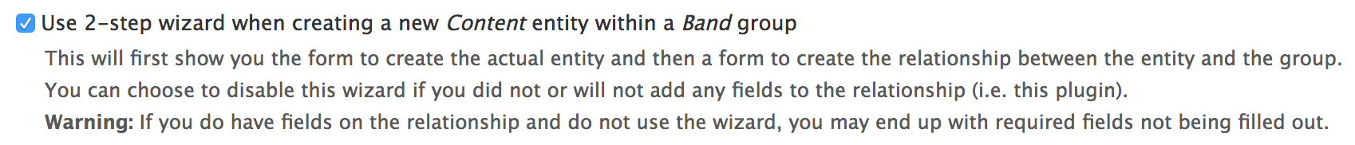
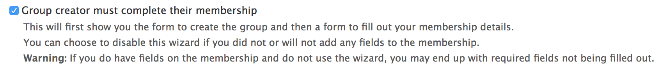
// @TODO
Odd defaults for new group types, new group content types (2-step wizard checked)
Wording/nomenclature can be confusing
  “Group content”? S/B something like “relationship entity”? Esp. since anything can be “Group content”
Views contextual filter issues? (use Raw Value from URL for now)
Bug: Group add form caching - previous (completed) submission form data showing when I go back to group/add/[type]?
Bonus: Groups > add link (s, by type) in menu (to be fair, Core doesn’t do this for nodes either)

Slide 23
Links
Group - an alternative to Organic Groups
Drupalcamp London 2016 - Group for D8 managing groups has never been more awesome (video)
OS Training, Organizing users using Group
Phase2, Building community sites with Drupal 8
Acquia “module of the week” series - 1/31/17
DrupalEasy StreamCast - D8 Group module (video)
DrupalCon Vienna 2017 - DrupalCon Vienna 2017: Building social websites with Group and Open Social (video)
DrupalCamp St. Louis - Group: an alternative to Organic Groups (video)
Modules unraveled podcast # 158 (audio)
Setting Up User Groups Is Now Easier Than Ever
DrupalCon Baltimore: How we develop Organic Groups 8 after 2 years with Elm (@video)
Taxonomy as Organic Groups (video)

Slide 24


